Slide 1
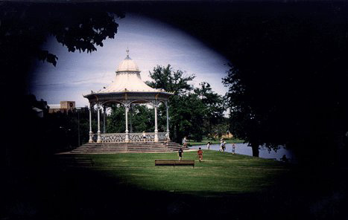
GLAUCOMA
Thief of the Sight

Slide 2
Glaucoma is the second leading cause of blindness in the world, according to the World Health Organization¹
8.4 million people will be blind from primary glaucoma by 2010, rising to 11.1 million by 2020²
1.http://www.glaucoma.org/learn/glaucoma_facts.php
2. Br J Ophthalmol. 2006 March; 90(3): 253–254

Slide 3

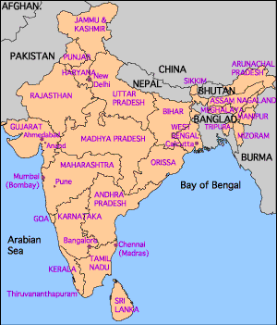
GLAUCOMA : INDIAN PREVALENCE
Approximately 11.2 million persons aged 40 years and older have glaucoma
Primary open angle glaucoma is estimated to affect 6.48 million Indians
Primary angle-closure glaucoma is affecting 2.54 million Indians
Those with any form of primary angle-closure disease comprise 27.6 million Indians
Adapted from:
Journal of Glaucoma: August 2010 - Volume 19 - Issue 6 - pp 391-397

Slide 4

GLAUCOMA: HOW THE DEFINITON IS EVOLVED OVER THE YEARS
Glaucoma was widely known as the disease related to the rise in intraocular pressure (IOP) > 21 mm Hg
And now what is the current definition of Glaucoma
An optic neuropathy characterized by a specific pattern of optic nerve head and visual field damage characterized by acquired loss of RGC cells and optic nerve atrophy
Ref: AAO preferred Practice Patterns

Slide 5
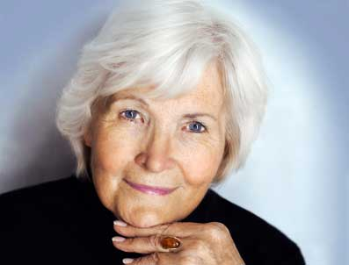
GENDER & GLAUCOMA
Women are at higher risks for angle closure glaucoma, but there is no clear gender predilection for open angle glaucoma
Decreased estrogen exposure is associated with increased risk for open angle glaucoma in women
Older women are at risk for glaucoma and glaucoma blindness
Adapted from:
Current Opinion in Ophthalmology: March 2010 - Volume 21 - Issue 2 - p 91–99

Slide 6
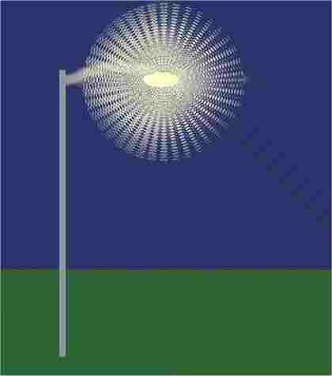
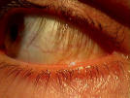


Halo around lights
SYMPTOMS
Red eye, pain in the eye,
Blurred vision
Vision loss
Tunnel vision
http://www.nei.nih.gov/health/glaucoma/glaucoma_facts.asp

Slide 7
GLAUCOMA SYMPTOMS

Slide 8
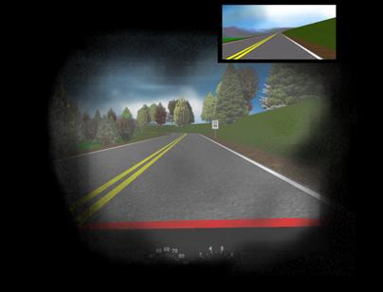

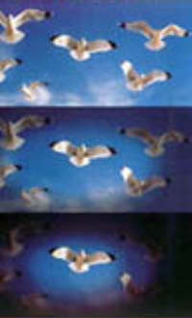
TUNNEL VISION IN GLAUCOMA

Slide 9
GLAUCOMA : AQUEOUS HUMOR

Slide 10
GLAUCOMA : RISK FACTORS
Risk Factors
Perfusion Pressure
Age
Race
Family History
Myopia
Genetics
Diabetes
Hyper- tension
IOP Fluctuation in IOP
Disc haemo- rrhage
Ref: Euro Times May 2004

Slide 11
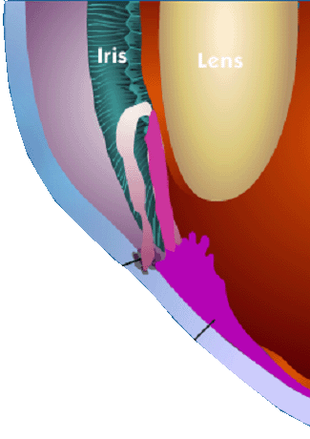
Glaucoma: The Disease
Lens
Normal Drainage Picture
The Trabecular meshwork – is the eye’s drain
The Ciliary Body – is the eye’s “faucet” or “tap” where fluid is made
When this drainage of the fluid gets blocked, excess pressure is formed leading to Glaucoma
http://www.nei.nih.gov/health/glaucoma/glaucoma_facts.asp

Slide 12
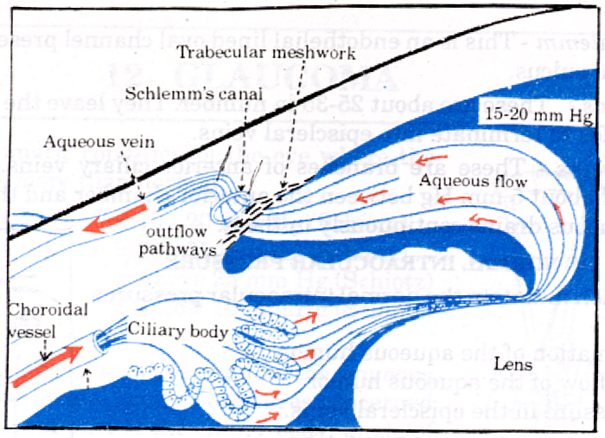
AQUEOUS HUMOR: TRABECULAR MESHWORK FLOW
50% trabecular meshwork
50% Uveoscleral outflow
Basic Ophthalmology, 2nd Ed., 180

Slide 13
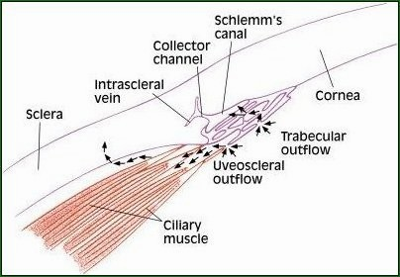
AQUEOUS HUMOR: UVEOSCLERAL OUTFLOW

Slide 14
INTRAOCULAR PRESSURE
Definition
Intraocular pressure (IOP) is the pressure maintained inside the eyeball under normal conditions, created by the volume of its liquid and solid contents (i.e. the aqueous humor and vitreous humor)
Normal intraocular pressure = 10 –21 mm Hg

Slide 15
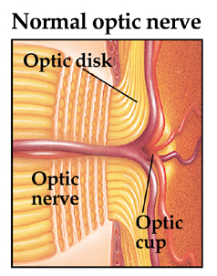
OPTIC DISC/OPTIC CUP/OPTIC NERVE

Slide 16
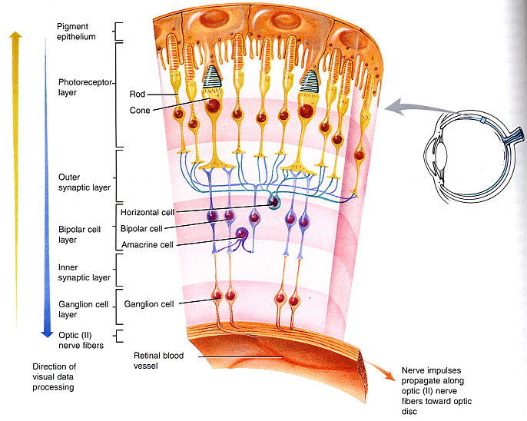
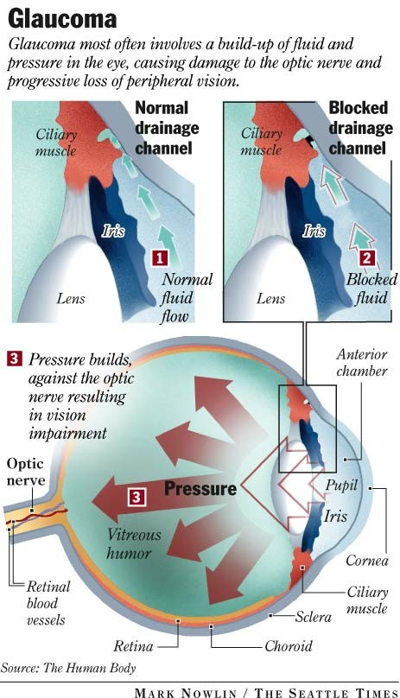
GLAUCOMA: PATHOPHYSIOLOGY
So, what is Glaucoma according to the new theories?
Definition
Progressive optic neuropathy characterized by specific morphological changes (optic disc cupping) resulting in acquired loss of retinal ganglion cells (RGCs) and RGC axons.
The RGCs die by apoptosis (programmed cell death)
RGC death leads to peripheral visual field loss
Glaucoma

Slide 17
GLAUCOMA: OPTIC NERVE DAMAGE
Elevated IOP
Mechanical back pressure
On the junction of optic nerve/retina
Reduce the blood supply to the optic nerve
Loss of blood supply (< in pOBF)
Ischaemia
RGC cell loss
Ref. Neuroprotection in Glaucoma Ophthalmology Times. May 2007 Suppl

Slide 18
How Glaucoma leads to RGC death
Pressure Lowering
IOP
Neuro-protection
Ischemia
Optic Nerve Injury
Irreversible Death of Retinal Ganglion Cells
Genetics
Others
RISK FACTORS
OPTIC NEUROPATHY
NEURONAL DEATH
Ref. Neuroprotection in Glaucoma Ophthalmology Times. May 2007 Suppl

Slide 19
GLAUCOMA : CLASSIFICATION
Glaucoma
Congenital Acquired
(Buphthalmos)
Primary Secondary
Open angle Primary angle closure glaucoma
Primary open angle Normal Tension glaucoma (POAG) glaucoma/Normal
Pressure glaucoma (NTG/NPG)
http://www.nei.nih.gov/health/glaucoma/glaucoma_facts.asp

Slide 20
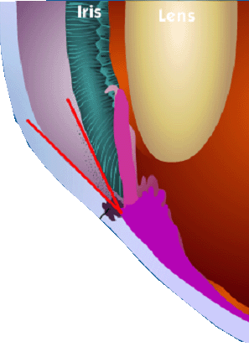
Glaucoma: Types of Glaucoma
Lens
Chronic or Primary Open Angle Glaucoma
Clogged Drainage holes
The angle between the iris and the cornea is normal, but the drainage holes get clogged from the inside.
http://www.nei.nih.gov/health/glaucoma/glaucoma_facts.asp

Slide 21
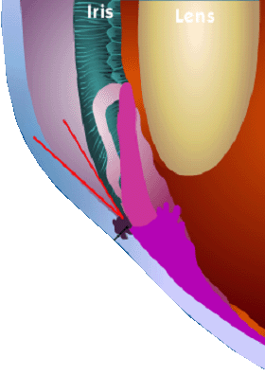
Glaucoma: Types of Glaucoma
Lens
Acute Angle Closure Glaucoma
Blocked Drainage holes
The angle is narrower than normal. If fluid can’t flow easily through the opening in the pupil, the iris pushes forward and blocks the drainage holes.
http://www.nei.nih.gov/health/glaucoma/glaucoma_facts.asp

Slide 22
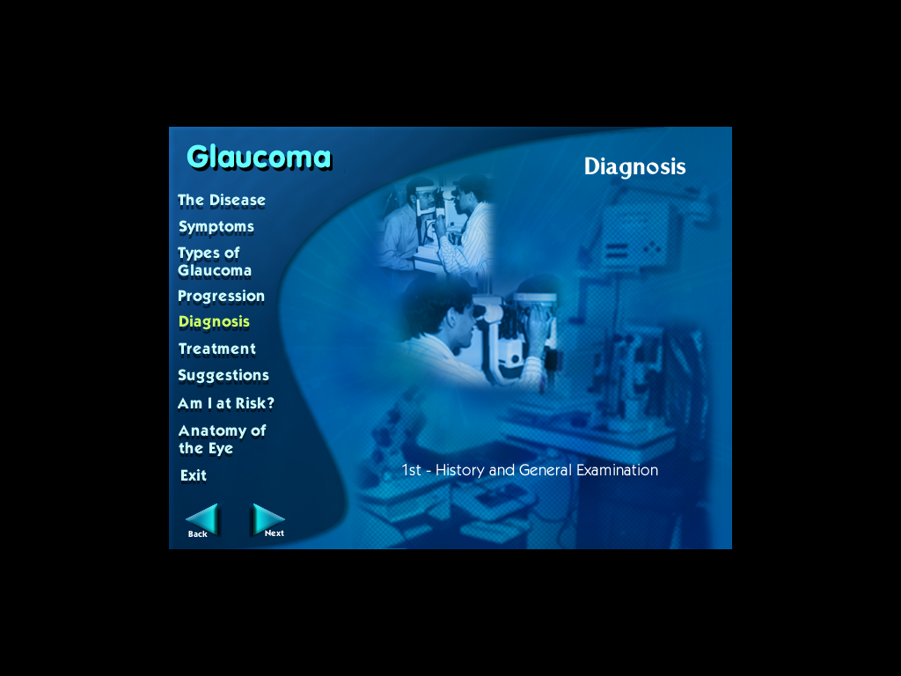
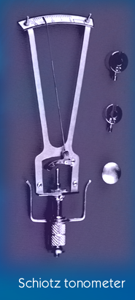
Glaucoma : Diagnosis
Tonometry
Measurement of I.O.P.
Schiotz tonometry
Applanation tonometry
Non contact tonometry
Ref: Asian J. of Ophthalmology vol.3. No.3. 4, 2001 suppl.

Slide 23
TONOMETRY
Tonometry measures IOP by recording the resistance of your cornea to pressure (indentation)
Eyedrops to numb the surface of your eye are used with most of the methods
http://www.webmd.com/eye-health/tonometry

Slide 24
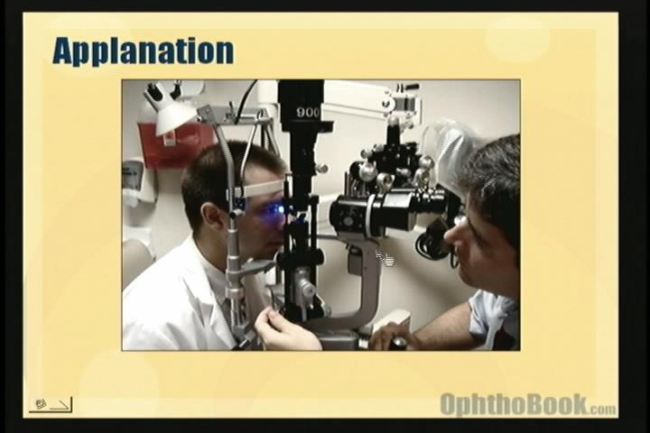
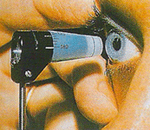
Applanation (Goldmann) tonometry
Uses a small probe to gently flatten part of the cornea to measure eye pressure and a microscope called a slit lamp to look at eye
The pressure in eye is measured by how much force is needed to flatten the cornea
This type of tonometry is very accurate and is often used to measure IOP after a simple screening test (such as air-puff tonometry) finds an increased IOP
http://www.webmd.com/eye-health/tonometry

Slide 25
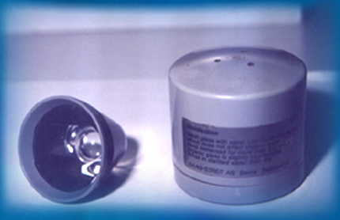
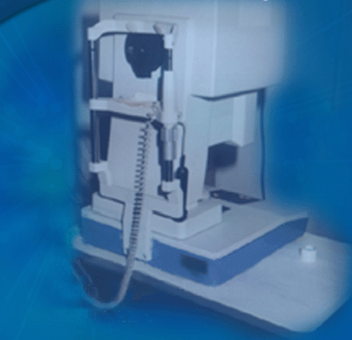
Glaucoma : Diagnosis
Gonioscopy Measurement of anterior chamber angle
Perimetry Actual measurement of visual field looking for any dark areas in field of vision
Ref: Asian J. of Ophthalmology vol.3. No.3. 4, 2001 suppl.

Slide 26
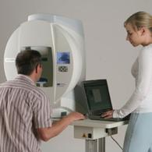
PERIMETRY
To do the test, you sit and look inside a bowl-shaped instrument called a perimeter
While you stare at the center of the bowl, lights flash
You press a button each time you see a flash
A computer records the spot of each flash and if you pressed the button when the light flashed in that spot
At the end of the test, a printout shows if there are areas of your vision where you did not see the flashes of light
These are areas of vision loss
Loss of peripheral vision is often an early sign of glaucoma.
http://www.webmd.com/eye-health/perimetry-test-visual-field-testing-for-glaucoma

Slide 27
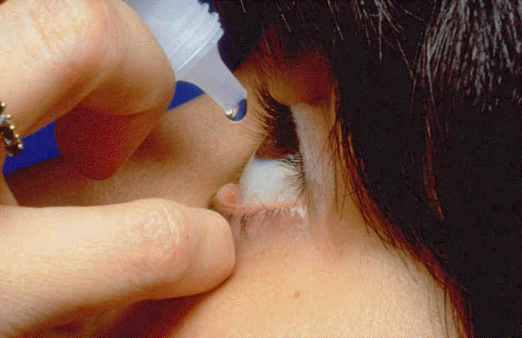
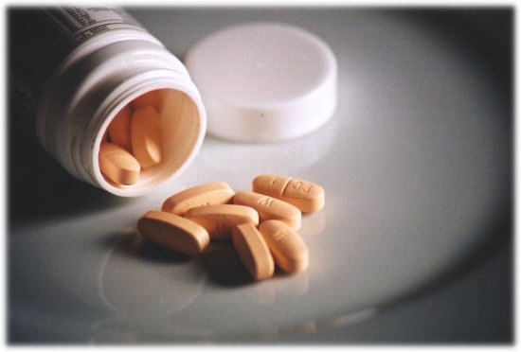
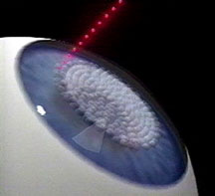
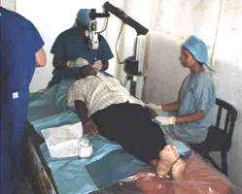
TREATMENT
Pills
Eye drops
Combination method
Laser surgery
Eye operations
http://www.nei.nih.gov/health/glaucoma/glaucoma_facts.asp

Slide 28
GLAUCOMA: MEDICAL MANAGEMENT
Today the glaucoma treatment is targeted at lowering the intraocular pressure, which is the most common risk factor for the progression of the symptom
There is a lot of research work going on in Neuroprotection and neuroregeneration
Adapted from:
Ophthalmology Practice 2008, Vol 56; Issue 3; pgs: 223-230

Slide 29
BROAD CLASSIFICATION OF MEDICINES AVAILABLE (ANTI GLAUCOMA DRUGS)
1. Beta blockers (timolol, betaxolol and
levobunolol)
2. Alpha agonists (brimonidine)
3. Prostaglandins and prostanoids
(latanoprost, bimatoprost)
4. Topical CAI (dorzolamide)
5. Combinations of drugs
Adapted from:
BMJ 2001;323:1401–2

Slide 30
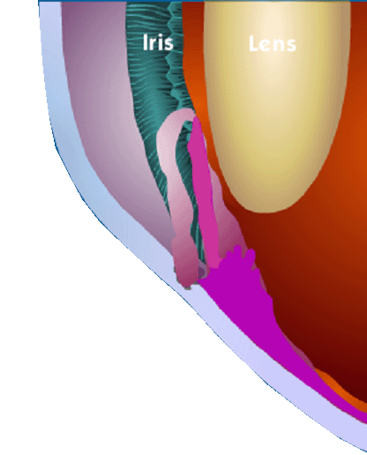
Glaucoma: Treatment
MEDICAL
Lens
Drugs increase conventional outflow.
http://www.nei.nih.gov/health/glaucoma/glaucoma_facts.asp

Slide 31
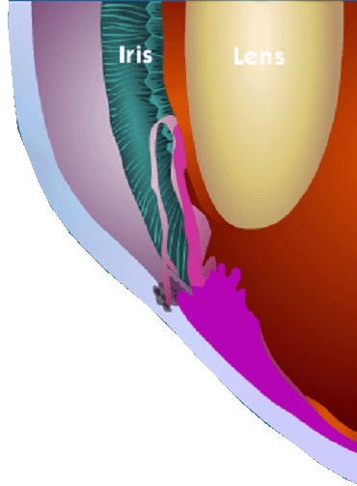
Glaucoma: Treatment
MEDICAL
Lens
Drugs reduce production of fluid in the eye.
http://www.nei.nih.gov/health/glaucoma/glaucoma_facts.asp

Slide 32
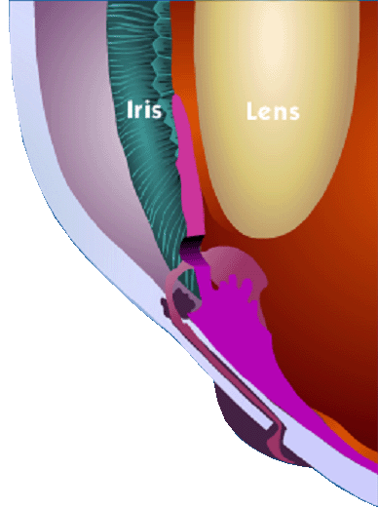
Glaucoma: Treatment
SURGERY
Trabeculectomy
Lens
Sclera
New Drain
http://www.nei.nih.gov/health/glaucoma/glaucoma_facts.asp

Slide 33
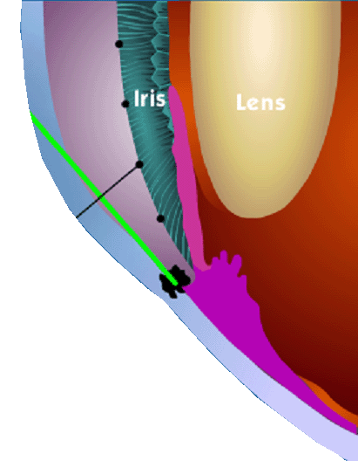
Glaucoma: Treatment
SURGERY
Trabeculoplasty
Lens
Open Drainage hole
Laser
http://www.nei.nih.gov/health/glaucoma/glaucoma_facts.asp

Slide 34
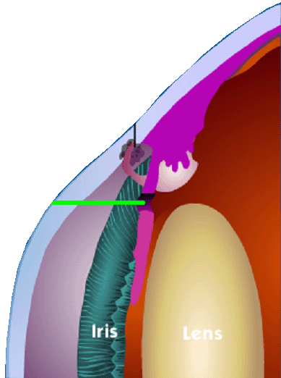
Glaucoma: Treatment
SURGERY
Iridotomy
Making a tiny opening in the iris with a laser allows fluid to drain freely
Laser
Lens
http://www.nei.nih.gov/health/glaucoma/glaucoma_facts.asp

Slide 35
SURGICAL TREATMENT
The role of laser trabeculoplasty and glaucoma surgery as a primary option has declined by 50-60%, since the glaucoma drugs, particularly prostaglandins analogues came into the market
Yet, trabeculectomy or other glaucoma filtration surgeries hold an edge over the medical options in lowering the intraocular pressure more effectively and consistently
Adapted from:
AIOS, CME Series (No.14)

Slide 36
DORZOX IN GLAUCOMA

Slide 37
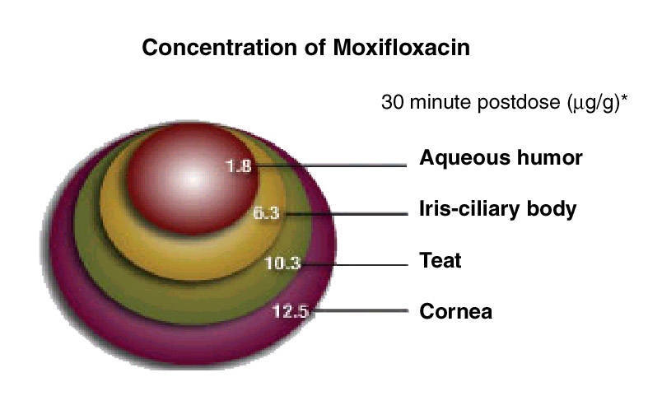
Dorzolomide ophthalmic solution has Ampholytic Character – due to which it penetrates
Cornea
24 μg/g
28 μg/g
7.8 μg/g
Aqueous humor
4.26 μg/g
Retina
Ref: J of Glaucoma 1995; 4:49-62 * IOP: Intra Ocular Pressure
Ref: Surv. Ophthalmol 54: 33-46, 2009

Slide 38
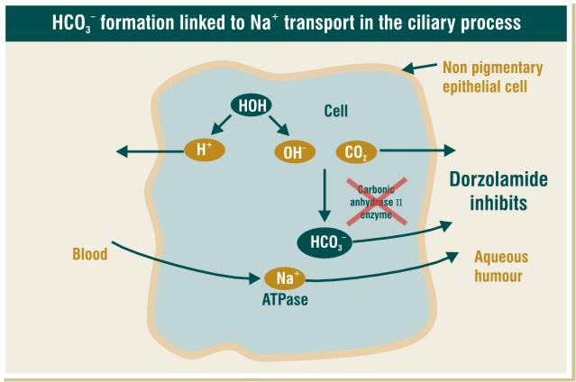
(illustration of cell needs to be designed from artist end)
Artist Note: Inside the cell below mentioned chemical reaction to be shown

Slide 39
Inhibits Carbonic Anhydrase
Slows down HCO₃* production
Aqueous humor secretion
Effective IOP* reduction
Ref: Drugs and Aging 1997; 10(5),384-403 * IOP: Intra Ocular Pressure & important component of Aqueous Humor

Slide 40
Effectively reduces IOP by inhibiting CA & enhances the ocular blood flow
Dorzolamide
CA*
HCO₃
CO₂
More
carbon dioxide vasodilation
Less
bicarbonate
Artist Note: CO2 concentration increases in the cellular level – it attracts oxygen from the adjacent blood vessels.

Slide 41

9 PM IN GLAUCOMA

Slide 42
Prostaglandins
A group of organic compounds derived from essential fatty acids and causing a range of physiological effects in animals.
They act at very low concentrations to cause the contraction of smooth muscle
Inflammation in allergic reactions and other diseases is also thought to involve prostaglandins.

Slide 43
Analog
A chemical compound that has a similar structure and similar chemical properties to those of another compound(Naturally occurring prostaglandins), but differs from it by a single element or group.

Slide 44
Types of prostaglandin and their receptor
Prostaglandin
PGD2
PGE2
PGF2α
TXA2
PGI2
DP
EP
FP
TP
IP
Note: The FP receptor has a widespread distribution within the tissues of the eye
including the ciliary muscle and the ciliary processes.
Bimatoprost and travoprost have higher affinity for the EP receptor which is responsible for the higher side effects like hyperemia with the other PG analogs in comparison with Latanoprost

Slide 45
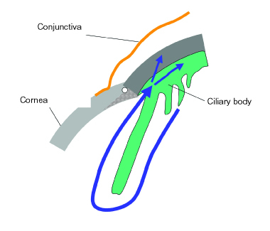
Latanoprost: Mechanism of Action
Latanoprost reduces IOP by increasing uveoscleral outflow by 50%

Slide 46
How do Prostaglandin Analogs Decrease the IOP
Latanoprost Latanoprost Acid
Caused relaxation of FP Receptor on
the ciliary Muscle ciliary Muscle
Enhanced Uveosceleral Decrease the
Outflow resistance in Uveosceleral outflow
(Prodrug)
(Active Form)

Slide 47
THANK - YOU

