Slide 1

Glaucoma Evaluation “Glaucoma Suspect”
Puzzling Through Diagnosis & Management

Slide 2
Who is a glaucoma suspect?
Elevated IOP (OHT)
Myopia, vascular disease, migrane or peripheral vasospasm
Any individual with
Suspicious but not diagnostic disc appearance
Old age, ethnicity, thin central corneas
Suspicious but not diagnostic visual field changes
Family history of glaucoma
http://one.aao.org/CE/PracticeGuidelines/PPP.aspx Last accessed 15th May 2012

Slide 3
Glaucoma Suspect Definition -As per Preferred Practice Pattern by AAO

Slide 4
An individual with clinical findings and/or a constellation of risk factors that indicate an increased likelihood of developing POAG.
The clinical findings that define a glaucoma suspect patient are characterized by one of the following in at least one eye in an individual with open anterior chamber angles by gonioscopy :
Appeareance of optic disc/retinal nerve fiber layer suspicious for glaucomatous damage
Enlarged cup-disc ratio
Asymmetric cup-disc ratio
Notching /narrowing of neuroretinal rim
Disc haemorrhage
Nerve fibre layer defect
Visual field suspicious for glaucomatous damage in absence of clinical signs of other optic neuropathies
Arcuate bundle defect
Nasal step
Paracentral scotoma
Altitudinal defect
Larger mean pattern standard deviation (PSD)
Consistently elevated IOP associated with normal appearance of optic disc & retinal nerve fibre layer & with normal visual field test results
This definition excludes known secondary causes for OAG, such as pseudoexfoliation (exfoliation syndrome), pigment dispersion and traumatic angle recession
Preferred practice pattern-AAO.2010

Slide 5
Likelihood of developing glaucoma increases with number & relative strength of risk factors which include-
Higher IOP
Older age
Family history of glaucoma
Lower ocular perfusion pressure
Lower systolic & diastolic blood pressure
Thinner central corneas
Disc haemorrhage
Larger cup to disc ratio
Larger mean pattern standard deviation on threshold visual field testing.
Preferred practice pattern-AAO.2010

Slide 6
Prevalence
There are no estimates on glaucoma suspects based on the appearance of their optic nerve or visual field¹.
The number far exceeds the number of people with glaucoma¹.
Wide variations exists in reported rates of OHT ²-
Andhra Pradesh Eye Disease Study (APEDS)-0.42%
Aravind Comprehensive Eye Survey (ACES)-1.1%
Vellore Eye Study-3.08%
Thus an estimated 4.7 million people could be ocular hypertensive in India².
Preferred practice pattern-AAO.2010
J Glaucoma.2010;19(6):391-397.

Slide 7
Glaucoma suspect symptoms
Usually don’t experience any symptoms.
By the time glaucoma patients notice vision loss, significant amounts of optic nerve damage & vision loss have already occurred.
This damage is permanent.
Owing to asymptomatic nature of glaucoma, regular eye examinations with an ophthalmologist are extremely important for glaucoma suspect & those at high risk.
http://www.emedicinehealth.com/adult_glaucoma_suspect/page4_em.htm last accessed on 15th May 2012

Slide 8
Glaucoma Suspect Detection
IOP is an important risk factor for developing glaucomatous damage, but, alone, it is insufficient for glaucoma diagnosis
http://www.emedicinehealth.com/adult_glaucoma_suspect/page6_em.htm Last accessed 15th May 2012

Slide 9
History
Anterior segment examination
Intra-ocular pressure management
Gonioscopy
Fundus examination
Visual acuity measurement
Pupil examination
Optic nerve head & retinal nerve fibre layer examination
Comprehensive adult medical eye evalaution
IT MAY REQUIRE MORE THAN ONE VISIT TO CONFIRM DIAGNOSIS

Slide 10

History
Ocular, family & systemic history (e.g., asthma, migraine headache, vasospasm). Severity & outcome of glaucoma in family members, should be obtained during initial evaluation.
Review of pertinent records, with particular reference to IOP, status of the optic nerve & visual field.
Ocular, systemic medications (e.g., corticosteroids) & known local or systemic intolerance to ocular or systemic medications.
Ocular surgery
Note- history of LASIK or PRK has been associated
with falsely low IOP measurement due to thinning
of cornea.
Cataract surgery may have lowered IOP when
compared with presurgical baseline.
Preferred practice pattern-AAO.2010

Slide 11
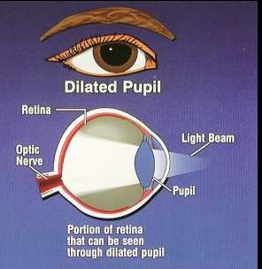
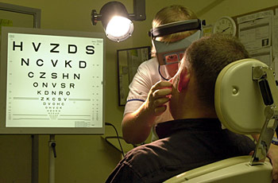
Visual acuity measurement
Pupil
examination
Visual acuity with current correction at distance and, when appropriate, at near should be measured.
Refraction may be indicated to obtain the best-corrected visual acuity.
Pupils are examined for reactivity & an afferent pupillary defect.
Preferred practice pattern-AAO.2010

Slide 12
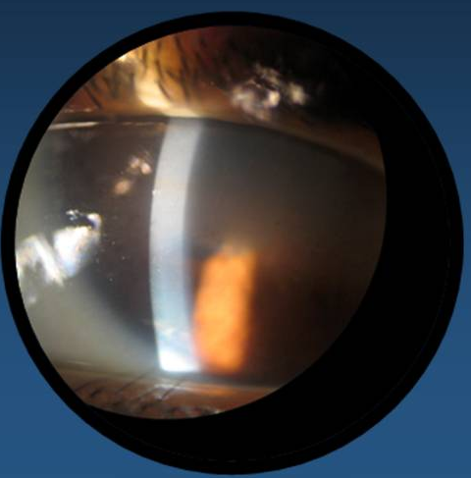
Anterior segment examination
Slit-lamp biomicroscopic examination can provide evidence of physical findings associated with narrow angles, such as –
Shallow peripheral anterior chamber depth & crowded anterior chamber angle anatomy, corneal pathology, or
A secondary mechanism for
elevated IOP like pseudoexfoliation
(exfoliation syndrome), pigment
dispersion with iris transillumination
defects, iris & angle neovascularization
or inflammation.
Preferred practice pattern-AAO.2010

Slide 13
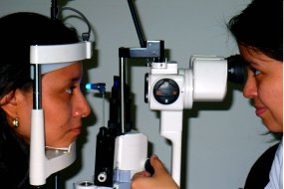
IOP measurement
IOP is measured in each eye, preferably by Goldmann applanation tonometry, before gonioscopy or pupil dilation.
Determining full extent of IOP fluctuation over time is important for those at most risk of developing glaucoma &, therefore, whom to treat to prevent future glaucoma.
Thus, additional IOP measurements
may be indicated, either at different
hours on the same day or
on different days.
Preferred practice pattern-AAO.2010

Slide 14
Optic nerve head (ONH) & Retinal nerve fiber layer(RNFL) analysis
Visible structural alterations of ONH/RNFL & development of peripapillary choroidal atrophy frequently occur before visual field defects can be detected.
Careful study of optic disc neural rim for small haemorrhages is important, as these can precede visual field loss & further optic nerve damage.
Preferred practice pattern-AAO.2010

Slide 15
Optic nerve head (ONH) & Retinal nerve fiber layer (RNFL) analysis
Preferred technique for ONH & RNFL evaluation involves magnified stereoscopic visualization (as with the slit-lamp biomicroscope), preferably through a dilated pupil.
In some cases, direct ophthalmoscopy complements magnified stereoscopic visualization, providing additional information of optic nerve detail due to greater magnification of the direct ophthalmoscope. Red-free illumination of posterior pole may aid in evaluating RNFL.
Preferred practice pattern-AAO.2010

Slide 16
ONH & RNFL Analysis & Documentation
Appearance of optic nerve should be documented.
Colour stereophotography is an accepted method for documenting optic nerve head appearance.
Computer-based image analysis of ONH and RNFL is an alternative for documentation of optic nerve & can identify patients at greater risk of glaucoma progression.
In the absence of these technologies, a nonstereoscopic photograph or a drawing of ONH should be recorded, but these are less desirable alternatives.
Preferred practice pattern-AAO.2010

Slide 17
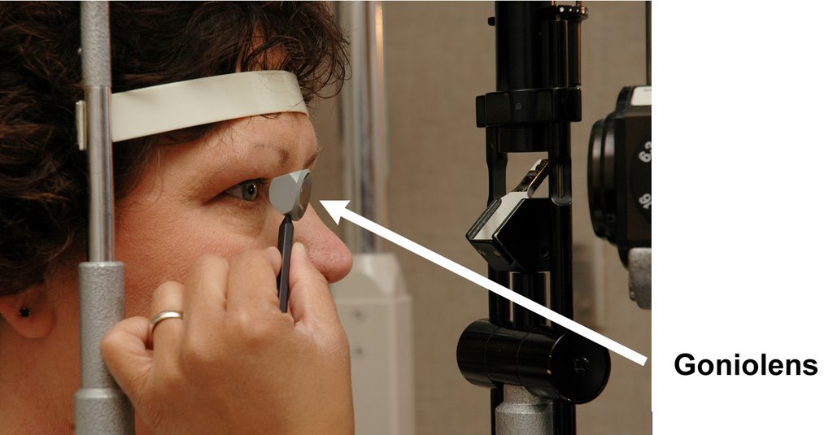
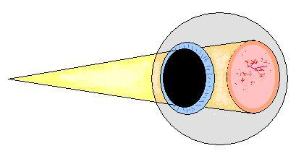
Gonioscopy
Fundus
examination
To exclude angle closure or secondary causes of IOP elevation, like angle recession, pigment dispersion, peripheral anterior synechiae, angle neovascularization & inflammatory precipitates.
For other abnormalities accounting for optic nerve changes &/or visual field defects (e.g., optic nerve pallor, disc drusen, optic nerve pits, disc edema due to CNS disease, macular degeneration, retinal vascular occlusion & other retinal disease).
Preferred practice pattern-AAO.2010

Slide 18
Supplemental ophthalmic testing
These include the following:-
1. Central corneal thickness measurement-Aids in interpretation of IOP readings & to stratify patient risk for optic nerve damage.
2. Visual field evaluation-Automated static threshold perimetry is the preferred technique.
Careful manual combined kinetic & static threshold testing (e.g., Goldmann visual fields) is an acceptable alternative when patients cannot perform automated perimetry reliably or if it is not available.
Repeat, confirmatory visual field examinations may be required for test results that are unreliable or show a new glaucomatous defect before changing management
3. Optic nerve head & retinal nerve fibre layer analysis
Preferred practice pattern-AAO.2010

Slide 19
Glaucoma suspect management
Decision to begin treatment of glaucoma suspects is complicated.
This decision is particularly important, since therapy exposes patients to the risks, side effects & expense of long-term treatment.
For some patients, risk of developing POAG is sufficiently high to justify starting treatment.
IOP is only modifiable parameter in glaucoma & glaucoma suspects.
Preferred practice pattern-AAO.2010

Slide 20
Deciding when to treat glaucoma suspect
Patient showing evidence of optic nerve deterioration based on –
ONH appearance ,RNFL loss or
Visual field changes consistent with glaucomatous damage has developed POAG and should be treated.
Subtle abnormalities in optic disc & RNFL are best detected by comparing periodic fundus imaging with disc & RNFL photography and computerized imaging of optic nerve and nerve fiber layer.
Patient demonstrating very high IOP in which optic nerve damage is likely to occur.
Patients with risk factors like optic nerve appearance very suspicious for glaucomatous damage, a strong family history of glaucoma, borderline visual field test findings, high myopia, or pseudoexfoliation (exfoliation syndrome).
Whatever the scenario, a discussion must occur between the physician & patient to outline the risks & benefits of treatment versus nontreatment
Preferred practice pattern-AAO.2010

Slide 21
How to Treat?
Maintain IOP in a range where patient is likely to remain stable. Estimated upper limit of this range is considered the “target pressure.”
Begin by choosing target pressure 20% lower than baseline IOP.
Evaluate current IOP , its relationship to target IOP at each visit & individualize for each patient.
Unless contraindicated, medical therapy usually is the first intervention to lower IOP.
Preferred practice pattern-AAO.2010

Slide 22
What to consider when treating glaucoma suspect?
Effective medication regimen requires-
Attention to its effect on IOP & side effects
Degree to which efficacy is reduced by nonadherence to therapy.
Choose a regimen of maximal effectiveness & tolerance to achieve desired therapeutic response for each patient.
Diagnosis, number and severity of risk factors, prognosis and management plan, and likelihood of long-term therapy should be discussed with the patient.
Preferred practice pattern-AAO.2010

Slide 23
Therapeutic choices
Drugs are available for initial therapy - prostaglandin analogues, beta-blockers, alpha-adrenergic antagonists, carbonic anhydrase inhibitors
Choice of medication may be influenced by potential cost, side effects and dosing schedules.
If target IOP is not achieved by one medication, then replacement ,adjunctive or combination therapies may be considered to reach target IOP.
Prostaglandins - safe when used once daily ,have a high IOP-lowering effect & chosen as the first therapy for a patient with glaucoma suspect.
Preferred practice pattern-AAO.2010

Slide 24
If treatment is not necessary for glaucoma suspect then what next?
Preferred practice pattern-AAO.2010

Slide 25
Follow-ups
Purpose- evaluate IOP level, visual field status, optic disc appearance & RNFL status to determine if damage has occurred.
Interaction between patient & disease is unique for every patient, and management for each patient must always be individualized.
Follow-up evaluation include-
History
Ophthalmic examination
Preferred practice pattern-AAO.2010

Slide 26
History
The following interval history should be elicited during all follow-up visits for POAG suspect patients:
Interval ocular history
Interval systemic medical & medication history
Side effects of ocular medications if the patient is being treated
Frequency and time of last IOP-lowering medications and review of medication use if the patient is being treated
Preferred practice pattern-AAO.2010

Slide 27
Ophthalmic examination
Tests to be performed during all follow-up visits for suspects-
Visual acuity measurement
Slit-lamp biomicroscopy
IOP measurement
Frequency of periodic optic nerve head & visual field evaluation & documentation is based on risk assessment.
Patients with thinner corneas, higher IOPs, disc haemorrhage, larger cup-to-disc, larger mean PSD, or family history of glaucoma require closer follow-up than patients with lower IOPs, normal corneal thickness & no disc haemorrhages.
Gonioscopy - Indicated in an angle-closure suspicion or an unexplained change in IOP. It should be performed periodically (i.e., 1 to 5 years).
Preferred practice pattern-AAO.2010

Slide 28
Glaucoma suspect counselling
Follow-up is poor due to lack of seriousness about their condition.
Educate patient about their condition, its potential to lead to the blinding disease glaucoma, the rationale and goals of intervention, their condition status, benefits and risks of alternative interventions for active participation in developing an appropriate plan of action.
Diagnosis & treatment frequently affects quality of life including employment & social issues, loss of independence & activities requiring good visual acuity.
Ophthalmologists should be sensitive to these problems & provide support & encouragement.
Preferred practice pattern-AAO.2010

Slide 29
Management algorithm for glaucoma suspect
Individual diagnosed as glaucoma suspect
Patient high risk?
Yes
Discuss treatment benefits
& risks with patients
Decision to treat
Yes
Estimate initial target pressure & initial treatment
No
Follow -up
No
Target pressure achieved?
Yes
Follow
-up
Follow -up
No
Reassess target Pressure & consider intensifying treatment regimen
Follow -up
Preferred practice pattern-AAO.2010

Slide 30
Does treating glaucoma suspect help reduce the risk of glaucoma progression?

Slide 31
YES
Ocular Hypertension Treatment Study suggests that-
Topical ocular hypotensive medication was effective in delaying /preventing onset of POAG in individuals with elevated IOP.
Although not applicable to all patients with borderline/elevated IOP, clinicians should consider initiating treatment for individuals with ocular hypertension who are at moderate or high risk for developing POAG.
Arch Ophthalmol .2002;120:701-713

Slide 32
What is Ocular Hypertension Treatment Study (OHTS)?
Largest randomized trial to date on efficacy & safety of ocular hypotensive medications in delaying/preventing onset of POAG in individuals with ocular hypertension.
One of the landmark trial offering clinicians quantitative evidence to begin an informed dialogue with OHT individuals.
Arch Ophthalmol .2002;120:701-713

Slide 33
OHTS
Aim- To determine safety & efficacy of topical ocular hypotensive medication in delaying /preventing the onset of POAG.
No of patients enrolled-1636 OHT individuals with no evidence of glaucomatous damage with IOP between 24-32 mmHg in 1 eye & 21-32 mmHg in other eye.
Study duration-60 months
Arch Ophthalmol .2002;120:701-713

Slide 34
Study design
1636 participants
Observational group (n=819)
Medication initiated
(n=42)
Medication group (n=817)
Medication withdrawn
(n=40)
Lost to follow-up(n=113)
Lost to follow-up(n=113)
Completed Trial (n=706)
Completed Trial (n=702)
Arch Ophthalmol .2002;120:701-713

Slide 35
Results
IOP reduction of 22.5%was achieved in the medication group during follow-up.
At 60 months,
2/more topical medications were prescribed for 39.7% of participants &
3/more topical medications were prescribed for 9.3% of participants
At 60 months, the cumulative probability of developing POAG was 4.4% in medication group & 9.5% in observational group.
No evidence of increased ocular or systemic symptoms was observed in medication group when compared with observation group.
Arch Ophthalmol .2002;120:701-713

Slide 36
Conclusion
Cumulative probability of developing POAG was significantly lower in medication group compared with observation group (nearly half).
Topical ocular hypotensive medication were effective in delaying /preventing onset of POAG in individuals with elevated IOP.
It doesn’t imply that all individuals with elevated IOP be treated with ocular hypotensive medications.
Arch Ophthalmol .2002;120:701-713

Slide 37
Decision to treat involves many factors-
Low overall incidence of POAG among OHT individuals in population based studies & this study.
Burden of long-term treatment including possible adverse effects, cost and inconvenience.
Individual’s risk of developing POAG.
Individual’s likelihood of being helped by treatment.
Individual’s life-expectancy.
Arch Ophthalmol .2002;120:701-713

Slide 38
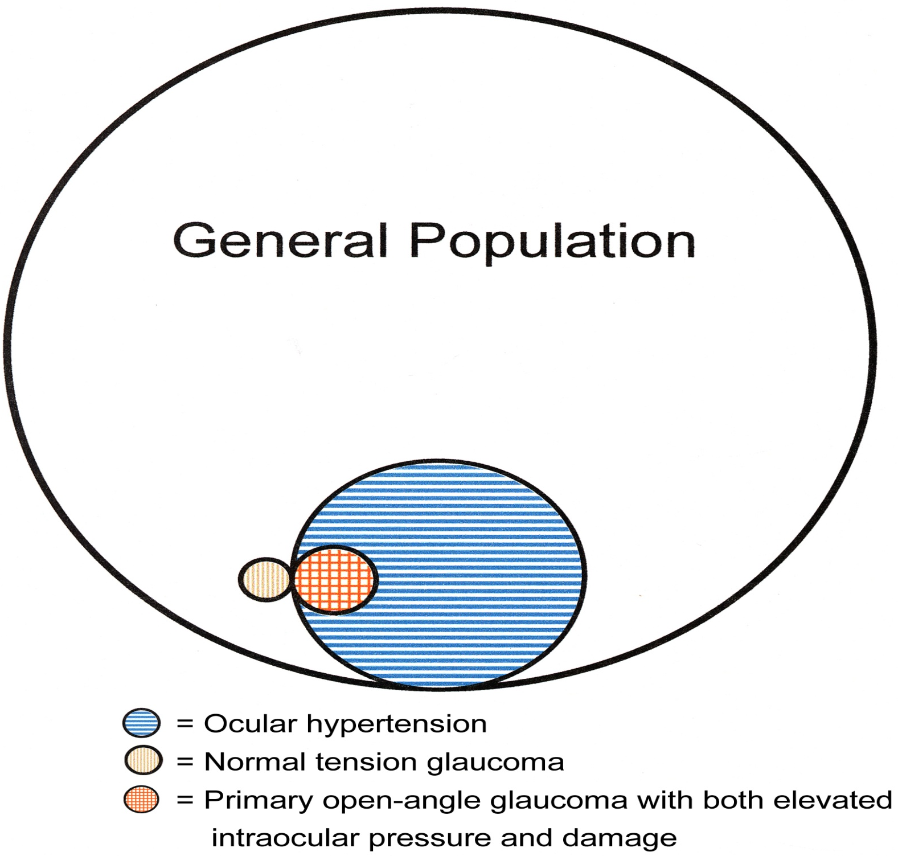
Take Home Message
Ocular hypertension should not be considered as a disease entity by itself, but rather a term describing a subset of individuals who should be observed more closely than the general population for the onset of glaucomatous damage

Slide 39

Take Home Message
Glaucoma suspects are a subset of individuals who should be observed more closely than the general population for the onset of glaucomatous damage
General population
Glaucoma suspect
POAG
NTG

Slide 40
Thank - You

