Slide 1
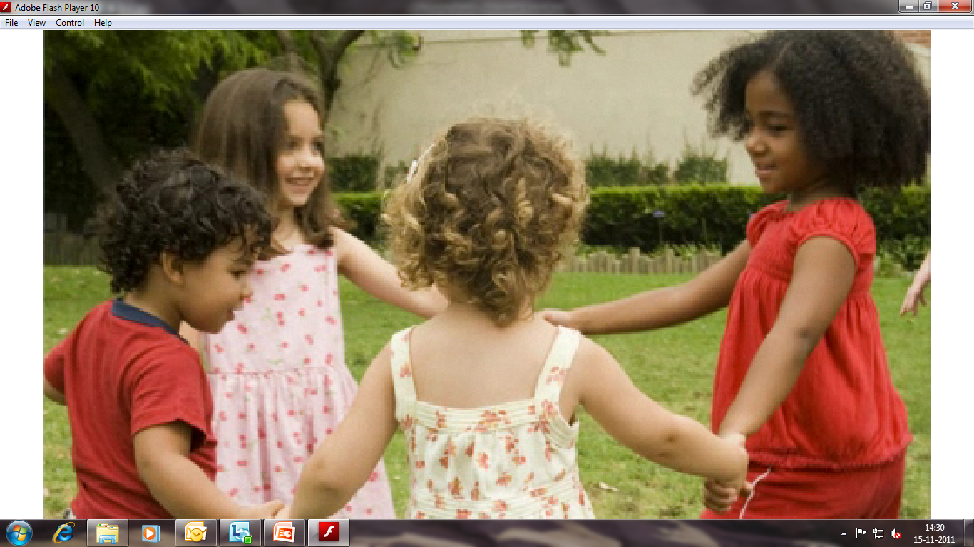
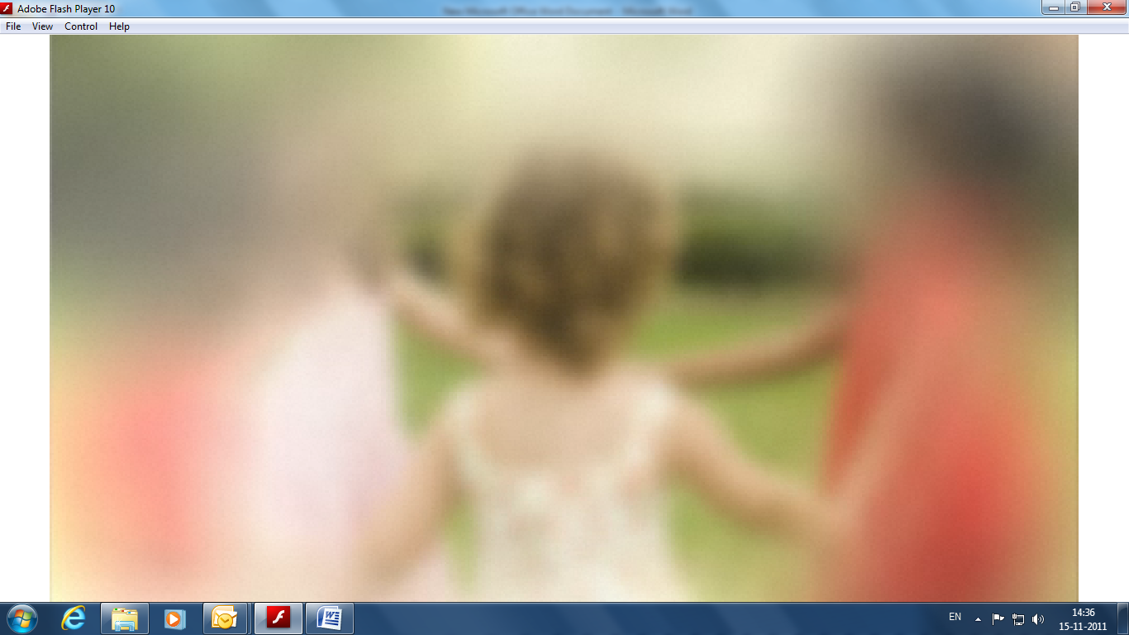
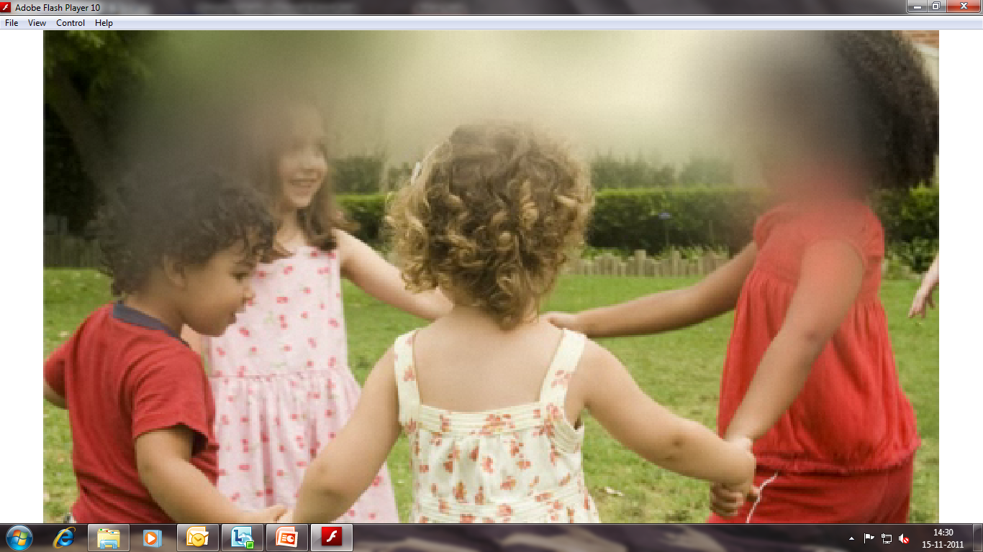
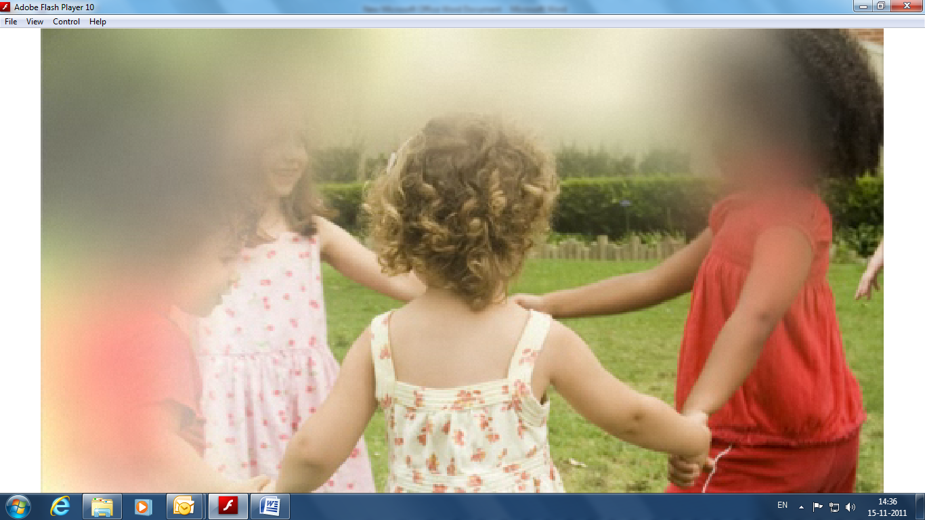
Glaucoma
Silent thief of sight

Slide 2
Introduction to session
Definition of glaucoma
Prevalence
Classification of glaucoma
Pathophysiology of Glaucoma
Risk factors
Symptoms
Diagnosis
Management of glaucoma
Role of GP in glaucoma diagnosis & treatment

Slide 3

India : Causes of Blindness
Second leading cause of preventable blindness in INDIA
Primary open angle glaucoma is estimated to affect 6.48 million persons. The estimated number with primary angle-closure glaucoma is 2.54 million.
>90% were not aware of the disease.
16 million Indians will be affected by 2020.
Ref: Asian J. of Ophthalmology vol.3. No.3. 4, 2001 suppl.
J. of Glaucoma, vol 19 no (6),2010:391-397

Slide 4
Why Glaucoma?
Second leading cause of preventable blindness in INDIA
Silent thief of sight (stealing vision without warning & often without symptoms).
Leads to progressive & irreversible vision loss.
No cure.
However if diagnosed early, can be treated by life long therapy which aims to prevent/delay further vision loss.
Awareness regarding glaucoma is very low compared to cataract.

Slide 5
GLAUCOMA: HOW DEFINITON HAS EVOLVED OVER THE YEARS
STRUCTURAL CHANGES OF OPTIC NERVE HEAD.
Glaucoma was widely known as the disease
related to rise in intraocular pressure
(IOP) > 21 mm Hg
Glaucoma is chronic progressive
optic neuropathy caused by a group
of ocular conditions leading to damage of
optic nerve with loss of visual functions.
INCREASE IN IOP
RGC CELL DEATH & OPTIC NERVE DAMAGE.
PERIPHERAL VISION LOSS
Ref: AAO preferred Practice Patterns

Slide 6
Glaucoma
pathophysiology

Slide 7
GLAUCOMA : AQUEOUS HUMOR

Slide 8
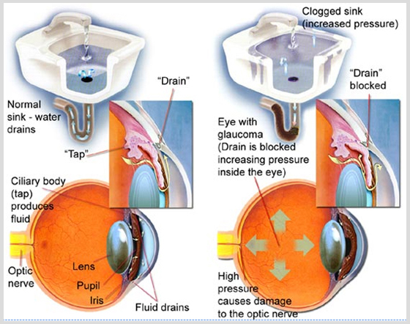
Trabecular meshwork & aging

Slide 9
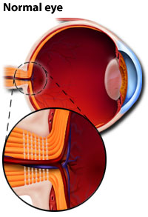
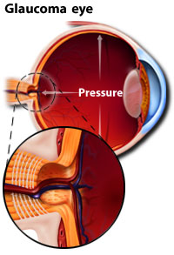
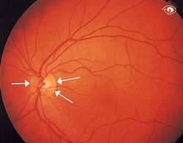
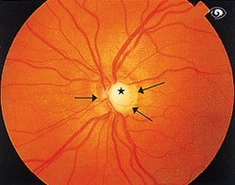
Optic nerve damage-Optic Disc Cupping
IOP rises
Back pressure on retina
Nerves get damaged.
Optic cup becomes more hollow, 1 can’t distinguish between optic cup & disk .

Slide 10
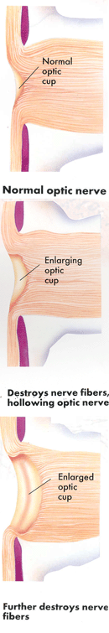

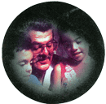
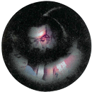
Progression of Glaucoma & vision damage
When nerve fibers are healthy, optic cup is small and vision is normal
If nerve fibers are damaged, optic cup enlarges."Side-vision" is reduced but central vision is normal
As more nerve fibres are damaged, optic cup enlarges more."Tunnel vision" & then blindness can occur

Slide 11
Classification of Glaucoma
Congenital (Bupthalmos)- Defect right from birth.
Acquired- develops over time
Primary- has no underlying cause
Secondary- is due to underlying causes like injury, inflammation, use of steroids etc
Primary angle
closure glaucoma- Narrow irido corneal angle obstructs outflow of fluid. This increases IOP & hampers optic nerve functioning.
Open angle- Occurs in people above 40 years.
Primary open angle glaucoma (POAG)- Draining channels are blocked due to age related changes
Normal tension/pressure glaucoma (NTG/NPG)
SA Farm Pract.2010; 52(6):493-497

Slide 12
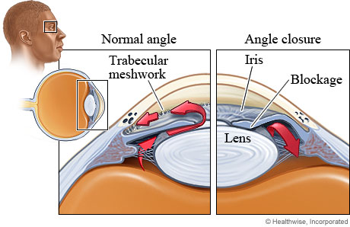
Ocular hypertension (OHT) is intraocular pressure higher than normal in the absence of optic nerve damage or visual field loss.
Such individuals are called glaucoma suspects.
SA Farm Pract.2010; 52(6):493-497

Slide 13
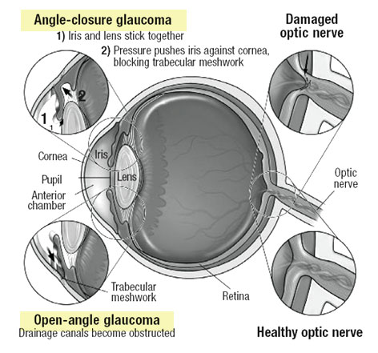

Slide 14
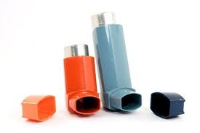
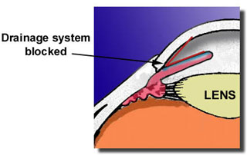
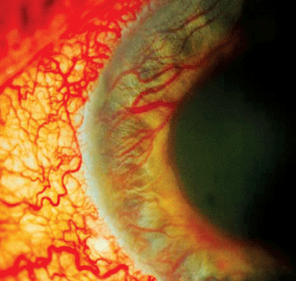
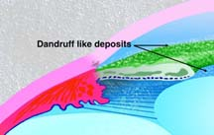
Secondary glaucoma
The most common causes of secondary open angle glaucoma include the following:
Treatment with steroids (topical & systemic, asthma inhalers, nasal sprays, and even topical ointments)
Particles blocking trabecular meshwork (malignant cells, red blood cells, inflammatory cells or pigment)
Membranes in the anterior chamber angle
Trauma to the trabecular meshwork
Neovascularisation in the angle, e.g. in diabetics, or after central retinal vein occlusion
Pseudoexfoliation syndrome
SA Farm Pract.2010; 52(6):493-497

Slide 15

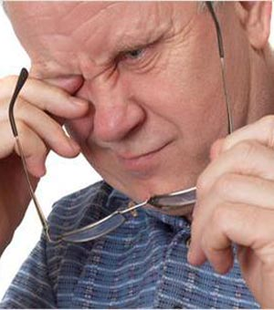
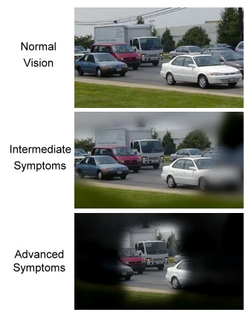
Symptoms
Halos-circular rings
around light
Pain in eyes
Blurred peripheral vision –mild damage
Tunnel shaped vision- advanced stage
Normal vision
SA Farm Pract.2010; 52(6):493-497

Slide 16
Signs & symptoms
Open angle glaucoma
Angle closure glaucoma
Usually painless, patient is unaware of the condition.
Visual field loss is only noticed at a late stage, because visual loss is gradual
Glaucoma patients with bilateral visual field loss have associated decline in motility & driving ability
Painful red eye, headache & frequently, nausea and vomiting.
Vision is blurred
Impaired visual acuity
Pupil is semi-dilated and fixed, with no reaction to light
SA Farm Pract.2010; 52(6):493-497

Slide 17
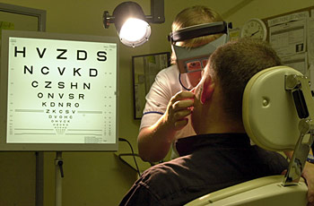
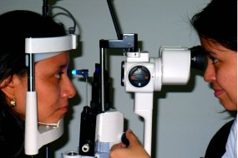
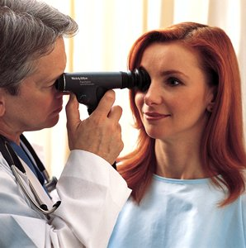
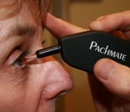
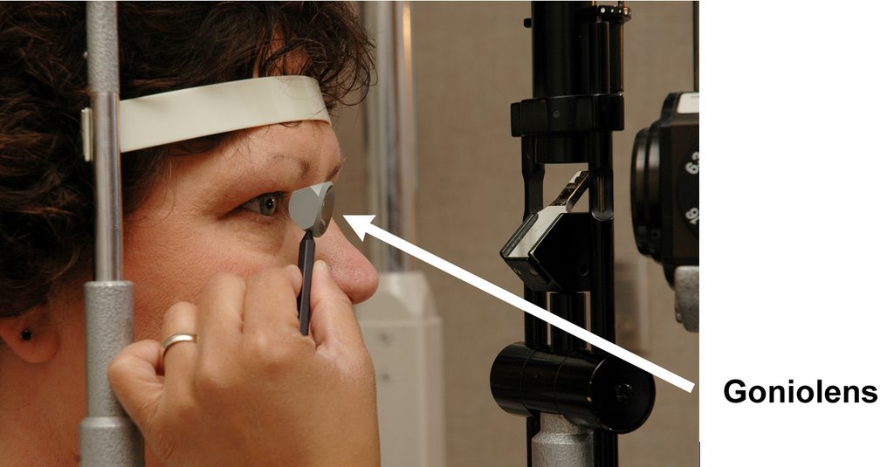
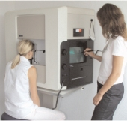
ophthalmoscope-examine interior of eye. (lens, retina, optic nerve)
Refraction- test short/long sighted vision .
Tonometry-measure IOP.
Diagnosis
Slit-lamp examination.
History
Pachymetry-measure corneal thickness.
gonioscopy-measure irido-corneal angle.
Perimetry-measure extent of vision loss.
http://vision.about.com/od/glaucoma/tp/testsforglaucoma.htm0Last accessed 23rd november 2012.

Slide 18
Risk factors
Open angle glaucoma
Angle closure glaucoma
Higher IOP > 21 mmHg
Increasing age (< 40 years = rare; 40–60 years = 1%; 60–80 years = 2%; > 80 years = 4%)
Genetic make-up
Diabetes mellitus
Myopia (near-sightedness)
Vascular factors (migraine; vasospastic disease; hypotension &hypertension)
Thin corneas
Retinal diseases
Hypermetropic (far-sighted) patients
Women (3–4 times higher)
EHighest incidence: 55–65 years of age
Genetic make-up
SA Farm Pract.2010; 52(6):493-497

Slide 19
Management of glaucoma
Prevention or modification of risk factors.
Raised IOP is only modifiable risk factor & primary goal
in management.

Slide 20
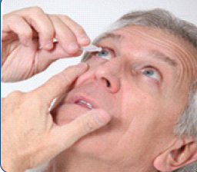
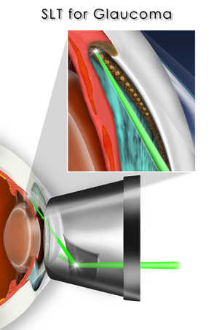
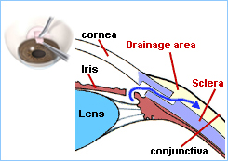
Glaucoma management
Pharmacotherapy – involves administration of various topical anti-glaucoma eyedrops or
pills taken orally to lower & control IOP & thereby prevent/delay further damage to eyes.
Laser treatment-Treatment of choice for angle closure & may be preformed for open angle glaucoma. Laser trabeculoplasty, laser
peripheral iridotomy &
cycloablation are commonly performed laser treatments for glaucoma.
Surgical treatment-
Failure of medications & laser treatment to control IOP is an
indication for surgery.
Trabeculectomy is most
common surgery performed for glaucoma.

Slide 21
Treatment algorithm for managing POAG.
Step 4-Surgery
Insufficient fall of IOP
Progression of visual field defects
Step 3-Adjunctive/ Add-On Therapy:
Combining anti-glaucoma drugs.
β-blockers + CAIs / PGA/ α₂-agonist
Insufficient fall of IOP
Progression of visual field defects
Step 2-Replacement Monotherapy :
Topical carbonic anhydrase inhibitors (CAIs), prostaglandin analogues (PGA), α₂-agonist
Insufficient fall of IOP
Adverse effects
Step 1-Monotherapy : β-blockers/ prostaglandin analogues (PGA)

Slide 22

Anti-glaucoma agents
Outflow Facilitators- increase aqueous humor outflow
Aqueous Suppressors – decrease aqueous humor production
Uveoscleral
outflow
Trabecular
meshwork
outflow
β-blockers
Timolol
Betaxolol
(Optipres
eye drops)
Levobunolol
CAIs
(Carbonic
Anhydrase
Inhibitors)
Acetazolamide
Tablets
(systemic)
Dorzolamide
(topical)
Dorzox eye drops)
Brinzolamide (topical)
α₂-agonist
Brimonidine
(Brimodin eye drops)
Apraclonidine
Prostaglandin
Analogues
Latanoprost
(9 pm e.d)
Bimatoprost
Travoprost
(Xovatra e.d)
Tafluprost
Cholinergic/
Miotics
Pilocarpine
  Adrenergic
  Dipivefrin

Slide 23
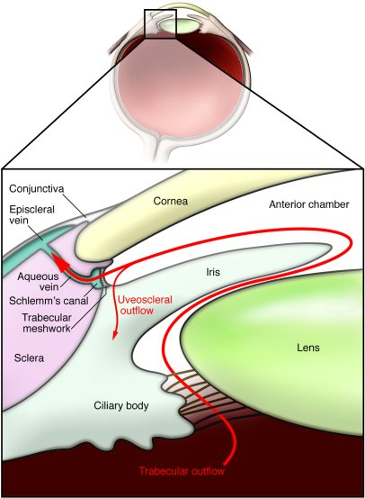
Produced by ciliary process
Moves backwards
Ciliary body
supraciliary & suprachoroidal spaces
Sclera
Uveo-scleral
outflow
Trabecular
meshwork flow
Produced by ciliary process
Enters posterior chamber
Moves out through pupil
Irido-corneal angle.
Drained through trabecular meshwork
Enters schlemm’s canal
Drained in aq. vein
Aqueous suppressors
Aqueous suppressors
Outflow Facilitators
Outflow Facilitators
Aqueous supressors

Slide 24
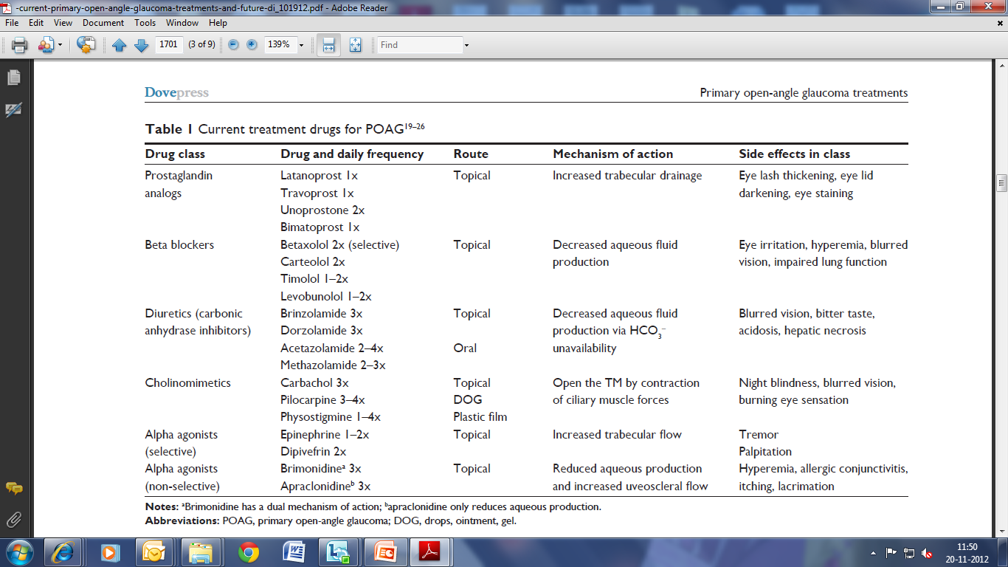
Currently available drugs

Slide 25
Combining Anti-Glaucoma drugs
IOP is not adequately regulated with monotherapy.
Causes-
Initial insufficient effect of drug.
Development of tolerance during long term therapy.
Or by progress of the disease.
Advantage:-
Eliminates potential risk of confusion between 2 bottles
Fewer daily drops than concomitant therapy
Convenient dosing regimen
Risk of elimination of first drop from conjunctival sac by instillation of second drops is completely eliminated.
Ensures increased patient convenience & compliance
Improves therapeutic efficacy.
The idea of combining two or more drugs is to produce the additivity of desired therapeutic effect but not of the side effects
Am J Ophthalmol 2000, 130:832-833

Slide 26
Approved Combinations : Currently Available
Dorzolamide + Timolol (DORZOX-T)
Latanoprost + Timolol ( LATIM)
Brimonidine + Timolol (BRIMOCOM)
Travoprost + Timolol
Bimatoprost + Timolol

Slide 27
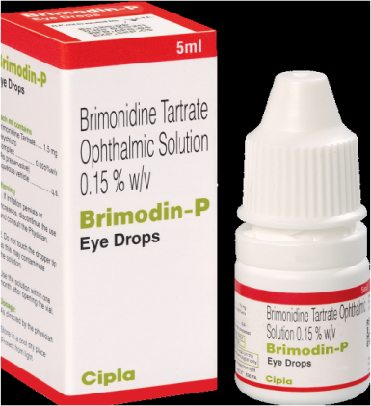
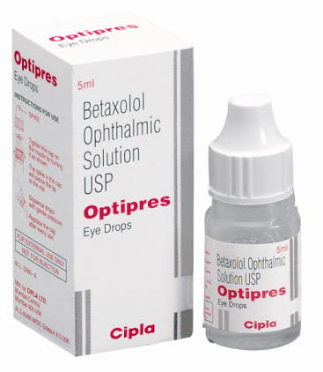
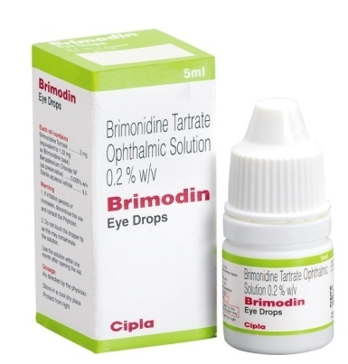
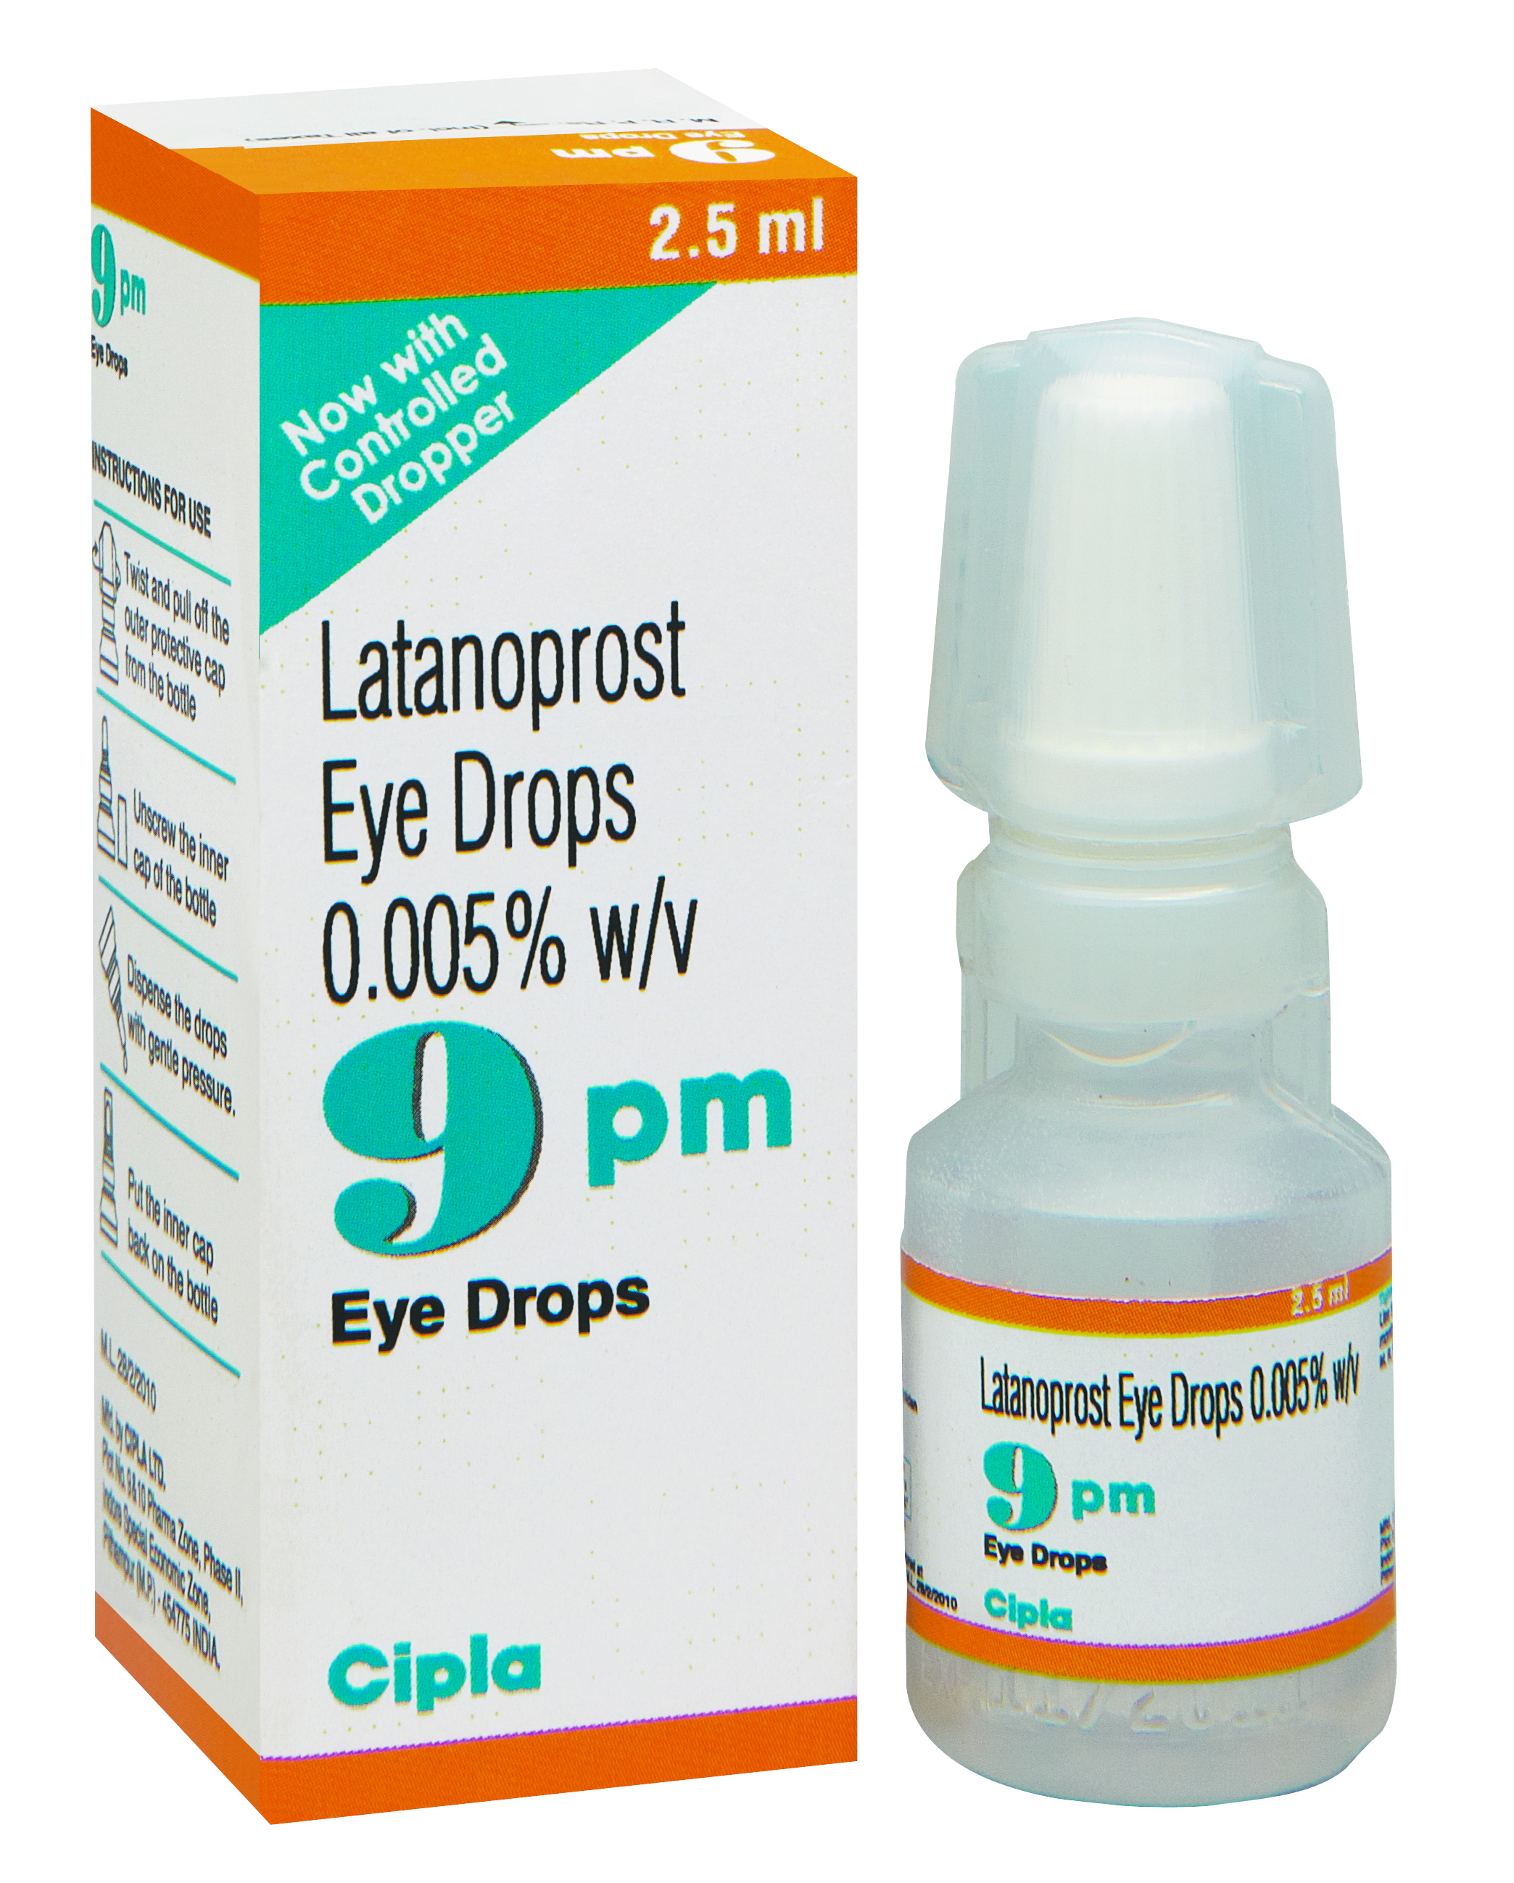
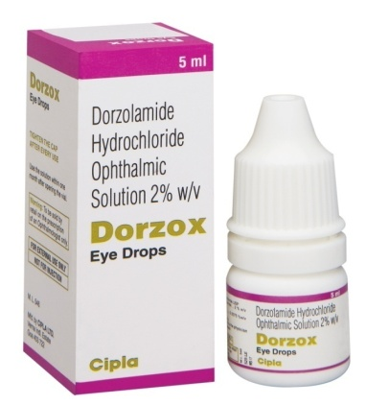
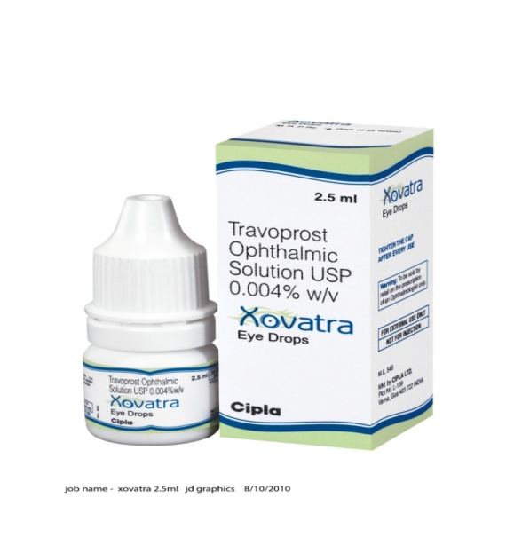
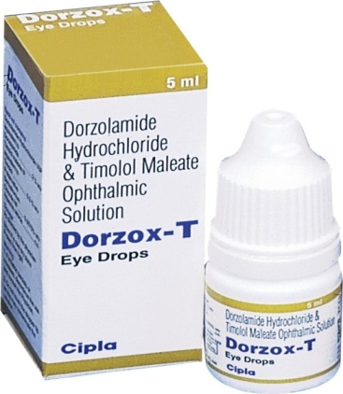
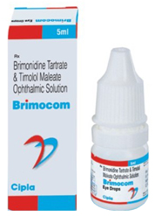
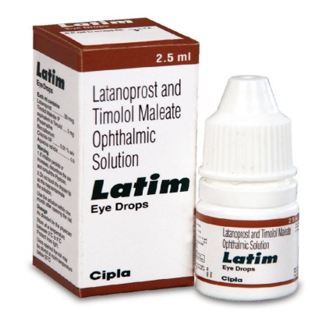
Cipla’s complete glaucoma basket
First line agents
Adjuncts
Fixed dose combination

Slide 28
Latest technologies in glaucoma
Diagnosis-Fourier domain (FD) OCT, continuous IOP monitoring system (contact lens), scanning laser polarimetry, short wavelength automated perimetry
Genetics- genetic screening, genetic counselling, gene therapy
Medication-preservative free unims of anti –glaucoma drugs (tafluprost, dorzolamide/ timolol FDC)
Future drugs- Bis(7)- tacrine, vitamin E, N-actylcystiene & other anti-oxidants,Mirtogenol,Erythropoietin, nimodipine, new topical ophthalmic drug delivery device
Surgeries- Micropulse Laser Trabeculoplasty (MLT), Canaloplasty, Trabectome surgery, Ex-Press Mini Shunt, Glaucoma drainage devices (GDD).
http://www.revophth.com/content/d/glaucoma_management/c/27665/
Cinical ophthalmology.2012;6:1699-1707.
http://www.glaucoma.org/treatment/the-future-of-glaucoma-surgery.php

Slide 29
Role of GP in glaucoma diagnosis & treatment-
family practitioner is often
the first line of medical contact with the patient.

Slide 30
Role of GP in glaucoma diagnosis & treatment-
Recommend all patients above 40 yrs of age to undergo routine eye examination once in a year.
Possess a basic knowledge of glaucoma medications and their systemic and local side effects
Recognise & refer to an ophthalmologists in case of-
Clinical manifestations of glaucoma- acute attack of angle closure glaucoma
Symptoms progression or treatment side effects for reassessment .
Previous glaucoma surgery (even years before), & who presents with a red eye or signs of infection, to exclude blebitis or endophthalmitis.
Risk factors - hypertension, diabetes, migraine, steroid use, previous eye trauma, family history & age.
SA Farm Pract.2010; 52(6):493-497
http://www.glaucoma.org.nz/files/challenge-of-glaucoma.pdf

Slide 31
Role of GP in glaucoma diagnosis & treatment
When referring to ophthalmologist, provide patients complete medical history & systemic medications if any.
Monitor therapy: Avoid steroid use in glaucoma patients
Before prescribing any systemic medication it is important to know his topical medical therapy to prevent drug-drug interaction.
Review repeat prescriptions for medical schemes, preferably 6 monthly.
Provide support, encouragement & counselling to the patient, because of the chronic course of the disease. Discuss the impact of visual loss with patients & their families especially for advanced glaucoma cases .
Educate patients about screening of family members, follow-up visits, and use of medication.
SA Farm Pract.2010; 52(6):493-497

Slide 32
THANK YOU
Any questions?

