Slide 1
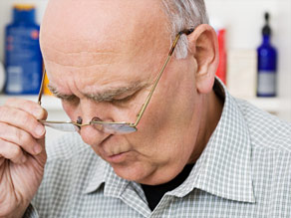

OCULAR DISEASES IN GERIATRIC PATIENTS
See Well for Life, Get Your Eyes Examined Regularly
Age-Related Eye Disease Doesn't Have to Steal Your Sight

Slide 2

As with other parts of the body, the eyes commence to undergo alters as they age
In fact, vision problems are one of the initial signs of ageing
http://www.squidoo.com/old-age-problems

Slide 3
Of the 38 million people who are blind, the majority, 22 million, are 60 years of age or older¹
Approximately one person in three has some form of vision-reducing eye disease by the age of 65²
People 80 years of age and older currently make up eight percent of the population, but account for 69 percent of blindness³
The most common ocular diseases in geriatric people are as follows:
Age-related macular degeneration (AMD)
Cataract
Glaucoma
Diabetic retinopathy¹
Adapted from:
1. Gerontology. 2003 Jan-Feb;49(1):1-11
2. Am Fam Physician 1999;60:99-10
3. http://technocrat.net/d/2007/6/16/21627/

Slide 4
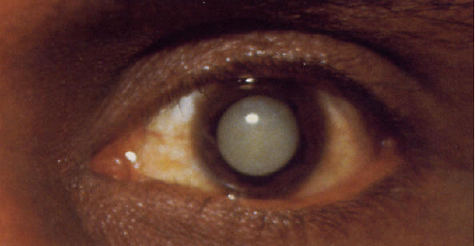
CATARACT
Most Common Cause for Vision Loss

Slide 5

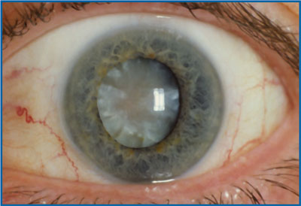
CATARACT
Cataract is a common cause of vision impairment in the elderly and the most common cause of blindness worldwide¹
The prevalence of cataracts in people aged between 65 and 74 years is 50% and it increases to 70% in those over the age of 75 years²
Adapted from:
1. Am Fam Physician 1999;60:99-10
2. SA Fam Pract 2006:48(7)

Slide 6
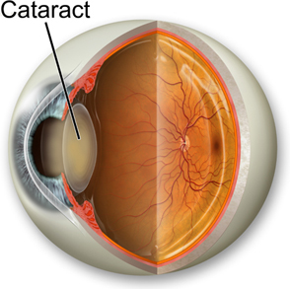
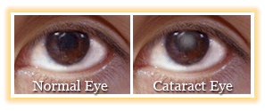
A cataract is a clouding of the lens in the eye that affects vision
The lens of the eye is composed of water and protein
The protein is arranged so that light can pass through and focus on the retina
If the protein clumps together, however, it starts to cloud over a small area of the lens
In time, this cloudy mass of protein — called a cataract — can grow larger, making it hard to see
Adapted from:
The NIH, The Word on Health, January 1999

Slide 7
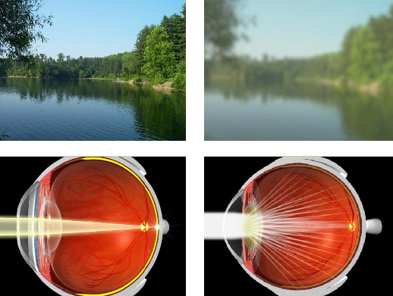
NORMAL VISION
VISION IN CATARACT

Slide 8
RISK FACTORS
Certain diseases such as diabetes
Personal behavior such as smoking and alcohol use
The environment such as prolonged exposure to sunlight
http://www.nei.nih.gov/health/cataract/cataract_facts.asp

Slide 9
symptoms
Cloudy or blurry vision
Colors seem faded
Glare - Headlights, lamps, or sunlight may appear too bright
A halo may appear around lights
Poor night vision
Double vision or multiple images in one eye
http://www.nei.nih.gov/health/cataract/cataract_facts.asp

Slide 10
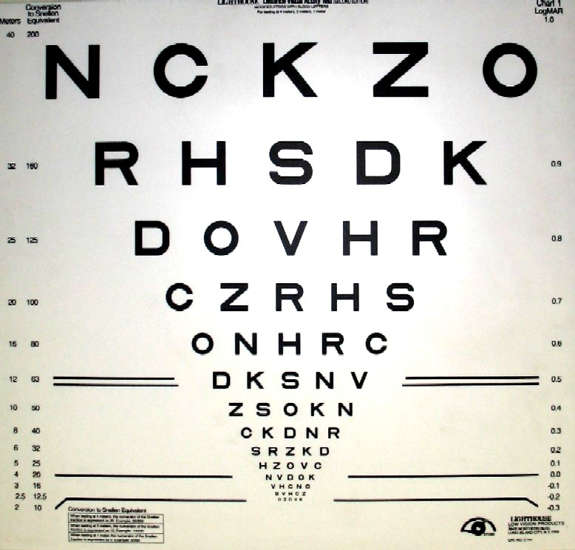
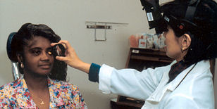
DIAGNOSIS
VISUAL ACUITY
A Chart test measures how well you see at various distances
DILATED EYE EXAM
Drops are placed in eyes to widen, or dilate, the pupils. Eye care professional uses a special magnifying lens to examine the eye
http://www.nei.nih.gov/health/cataract/cataract_facts.asp

Slide 11
TREATMENT
By the year 2020, there will be more than 12 million individuals in the 65 or older age group who will probably need treatment for cataracts
There are 1.5 million cataract operations done yearly; 95 percent of the people who have the surgery see well afterwards
Adapted from:
The NIH, The Word on Health, January 1999

Slide 12
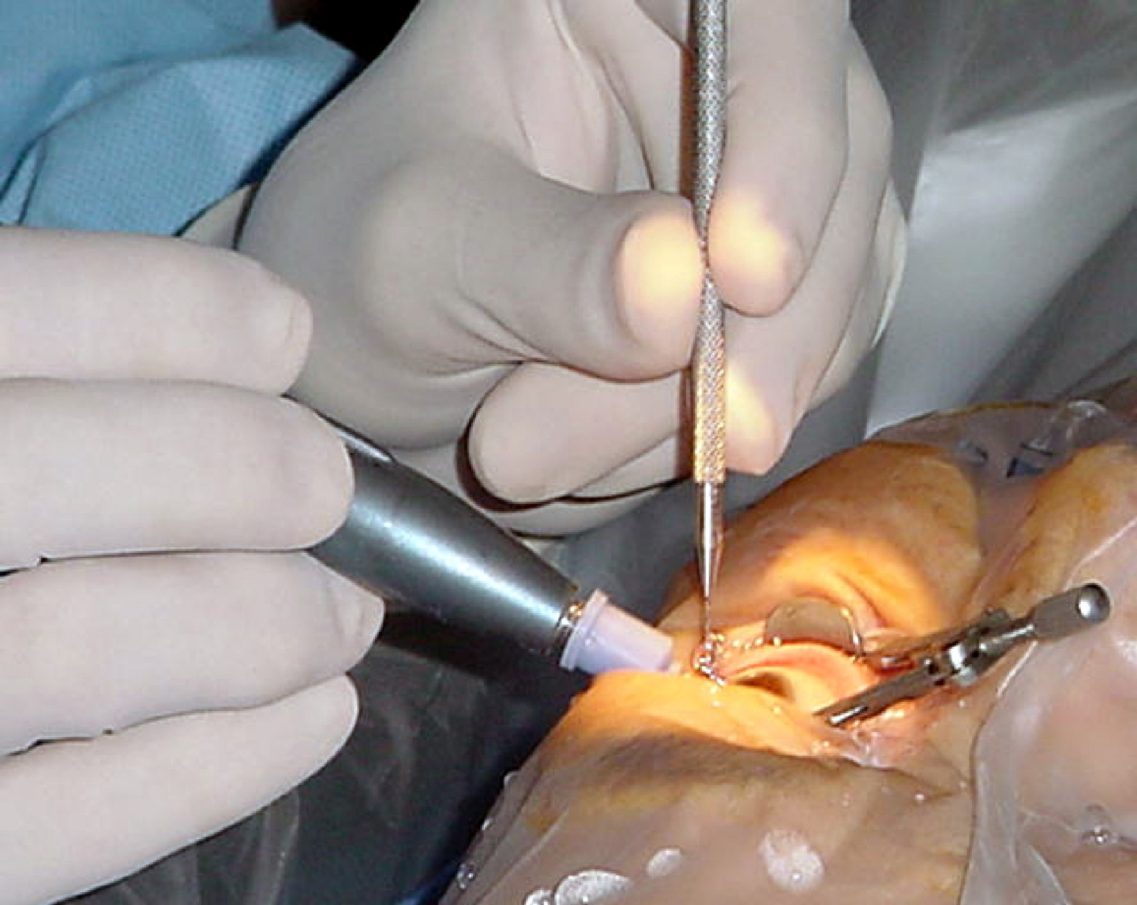

Cataract surgery is the most common surgical procedure covered with over 1 million procedures performed annually
This surgery is considered when the cataract reduces vision function to a level that interferes with everyday activities
Cataract surgery is an outpatient procedure performed under local or topical anesthesia
Over 90 percent of patients undergoing cataract surgery experience visual improvement and improved quality of life if there is no ocular comorbidity
Adapted from:
Am Fam Physician 1999;60:99-10

Slide 13
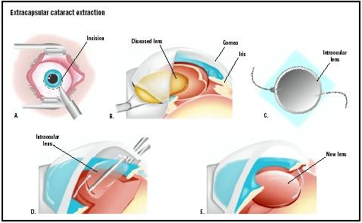
Extracapsular SURGERY
Incision is made between sclera and cornea
Capsule containing lens is opened and nucleus of lens is removed
Remaining portion is sucked out
Next, an IOL is implanted
http://health.usnews.com/usnews/health/eye_vision/cataract/cat.treat.types.htm

Slide 14
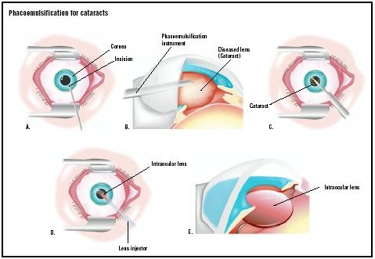
PHACOEMULSIFICATION
Phacoemulsification represents the preferred method of lens removal
It involves fragmentation of the lens using ultrasound and insertion of an artificial intraocular lens
Praxis (Bern 1994). 2010 Aug 11;99(16):971-6

Slide 15
PATIENT AWARENESS
HOW CAN I TELL IF I HAVE CATARACT?
Changes in vision may be signs of cataract
Milky or yellowish spot in the pupil
Changing eyeglass prescriptions often
http://www.preventblindness.org/resources/factsheets/FS32_cataracts.PDF

Slide 16
PATIENT AWARENESS
IS SURGERY THE ONLY TREATMENT?
YES
Cataracts cannot be treated with medicines
Eye drops or other drugs will not dissolve a cataract or slow its progress
http://www.preventblindness.org/resources/factsheets/FS32_cataracts.PDF

Slide 17
PATIENT AWARENESS
HOW DO I KNOW IF CATARACT SURGERY IS RIGHT FOR ME?
A cataract needs to be removed only when vision loss interferes with your everyday activities, such as driving, reading, or watching TV
You and your eye care professional can make this decision together
http://nihseniorhealth.gov/cataract/faq/faq9a.html

Slide 18

PATIENT AWARENESS
WHAT HAPPENS AFTER SURGERY?
After the operation, a patch may be placed over your eye
You will rest for a while. Your medical team will watch for any problems, such as bleeding
Most people who have cataract surgery can go home the same day
http://nihseniorhealth.gov/cataract/faq/faq17a.html

Slide 19
PATIENT AWARENESS
WHEN WILL MY VISION BE NORMAL AGAIN?
You can return quickly to many everyday activities, but your vision may be blurry
The healing eye needs time to adjust so that it can focus properly with the other eye, especially if the other eye has a cataract
http://nihseniorhealth.gov/cataract/faq/faq19a.html

Slide 20

PATIENT AWARENESS
WHAT CAN I DO IF I ALREADY HAVE LOST SOME VISION FROM CATARACT?
If you have lost some sight from cataract or cataract surgery, ask your eye care professional about low vision services and devices that may help you make the most of your remaining vision
Ask for a referral to a specialist in low vision
Many community organizations and agencies offer information about low vision counseling, training, and other special services for people with visual impairments
A nearby school of medicine or optometry may provide low vision services
http://nihseniorhealth.gov/cataract/faq/faq20a.html

Slide 21


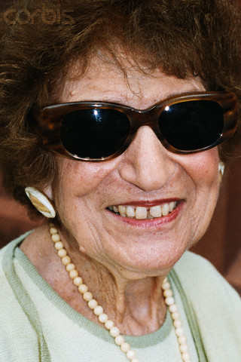
PATIENT AWARENESS
WHAT CAN I DO TO PROTECT MY VISION?
Take good nutrition
Quit Smoking
Wear sunglasses
http://nihseniorhealth.gov/cataract/faq/faq21a.html

Slide 22
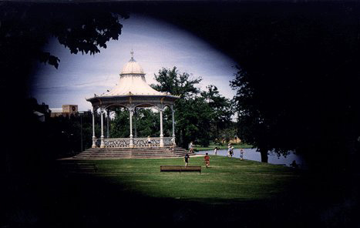
GLAUCOMA
Thief of the Sight

Slide 23
Glaucoma is the second leading cause of blindness in the world, according to the World Health Organization¹
8.4 million people will be blind from primary glaucoma by 2010, rising to 11.1 million by 2020²
1.http://www.glaucoma.org/learn/glaucoma_facts.php
2. Br J Ophthalmol. 2006 March; 90(3): 253–254

Slide 24

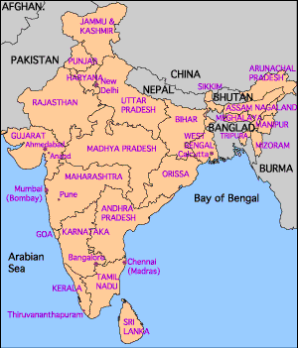
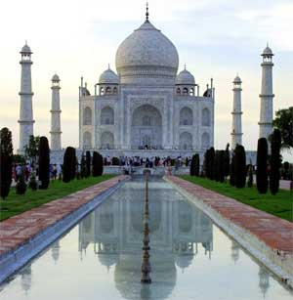
GLAUCOMA : INDIAN PREVALENCE
Second leading cause of preventable blindness in INDIA
12 million Indians will be affected by 2010, 16 million by 2020
POAG in a ≥40-year-old south Indian urban population was 3.51%
POAG in Central India was 3.68%
>90% were not aware of the disease.
1. Indian J of Ophthalmology , vol 56 no (2) , 2008 : 97-98
2. Indian J. of Ophthalmology , vol 56 , 2008 : 56- 72
3. Ophthalmology, Volume 115, Issue 4, Pages 648-654.e1 , 2008

Slide 25
GLAUCOMA: HOW THE DEFINITON IS EVOLVED OVER THE YEARS
Glaucoma was widely known as the disease related to the rise in intraocular pressure (IOP) > 21 mm Hg
And now what is the current definition of Glaucoma
An optic neuropathy characterized by a specific pattern of optic nerve head and visual field damage characterized by acquired loss of RGC cells and optic nerve atrophy
Ref: AAO preferred Practice Patterns

Slide 26
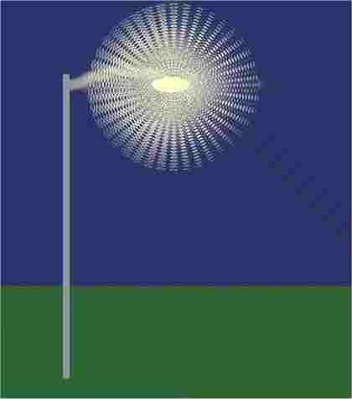
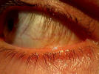


Halo around lights
SYMPTOMS
Red eye, pain in the eye,
Blurred vision
Vision loss
Tunnel vision
http://www.nei.nih.gov/health/glaucoma/glaucoma_facts.asp

Slide 27
GLAUCOMA SYMPTOMS

Slide 28
GLAUCOMA : SYMPTOMS

Slide 29
GLAUCOMA : RISK FACTORS
Risk Factors
Perfusion Pressure
Age
Race
Family History
Myopia
Genetics
Diabetes
Hyper- tension
IOP Fluctuation in IOP
Disc haemo- rrhage
Ref: Euro Times May 2004

Slide 30
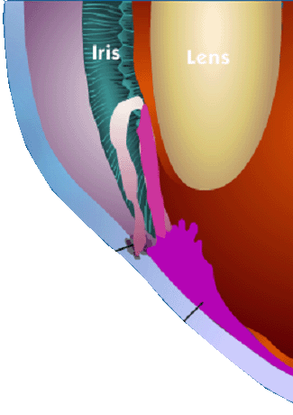
Glaucoma: The Disease
Lens
Normal Drainage Picture
The Trabecular meshwork – is the eye’s drain
The Ciliary Body – is the eye’s “faucet” or “tap” where fluid is made
When this drainage of the fluid gets blocked, excess pressure is formed leading to Glaucoma
http://www.nei.nih.gov/health/glaucoma/glaucoma_facts.asp

Slide 31
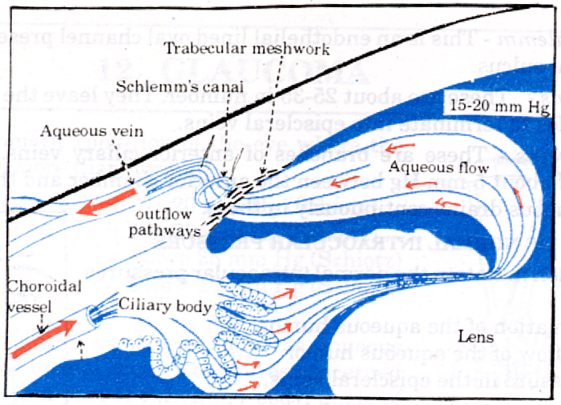
AQUEOUS HUMOR: TRABECULAR MESHWORK FLOW
50% trabecular meshwork
50% Uveoscleral outflow
Basic Ophthalmology, 2nd Ed., 180

Slide 32
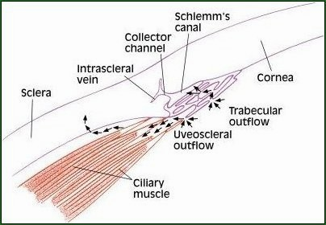
AQUEOUS HUMOR: UVEOSCLERAL OUTFLOW

Slide 33
INTRAOCULAR PRESSURE
Definition
Intraocular pressure (IOP) is the pressure maintained inside the eyeball under normal conditions, created by the volume of its liquid and solid contents (i.e. the aqueous humor and vitreous humor)
Normal intraocular pressure = 10 –21 mm Hg

Slide 34
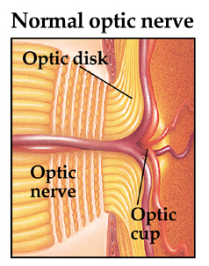
OPTIC DISC/OPTIC CUP/OPTIC NERVE

Slide 35
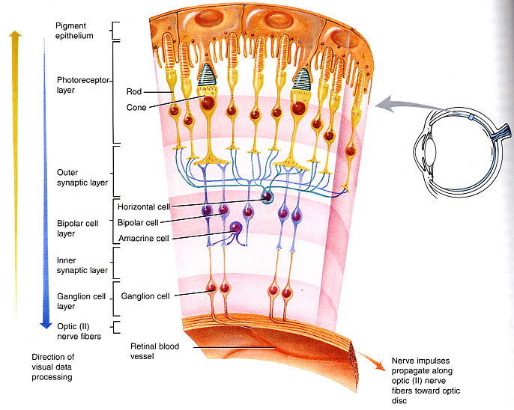
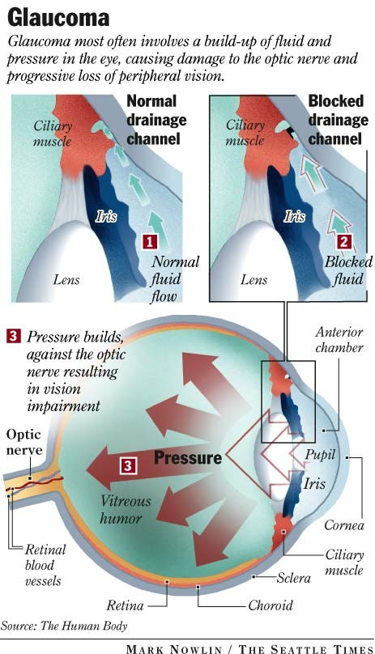
GLAUCOMA: PATHOPHYSIOLOGY
So, what is Glaucoma according to the new theories?
Definition
Progressive optic neuropathy characterized by specific morphological changes (optic disc cupping) resulting in acquired loss of retinal ganglion cells (RGCs) and RGC axons.
The RGCs die by apoptosis (programmed cell death)
RGC death leads to peripheral visual field loss
Glaucoma

Slide 36
GLAUCOMA: OPTIC NERVE DAMAGE
Elevated IOP
Mechanical back pressure
On the junction of optic nerve/retina
Reduce the blood supply to the optic nerve
Loss of blood supply (< in pOBF)
Ischaemia
RGC cell loss
Ref. Neuroprotection in Glaucoma Ophthalmology Times. May 2007 Suppl

Slide 37
How Glaucoma leads to RGC death
Pressure Lowering
IOP
Neuro-protection
Ischemia
Optic Nerve Injury
Irreversible Death of Retinal Ganglion Cells
Genetics
Others
RISK FACTORS
OPTIC NEUROPATHY
NEURONAL DEATH
Ref. Neuroprotection in Glaucoma Ophthalmology Times. May 2007 Suppl

Slide 38
GLAUCOMA : CLASSIFICATION
Glaucoma
Congenital Acquired
(Buphthalmos)
Primary Secondary
Open angle Primary angle closure glaucoma
Primary open angle Normal Tension glaucoma (POAG) glaucoma/Normal
Pressure glaucoma (NTG/NPG)
http://www.nei.nih.gov/health/glaucoma/glaucoma_facts.asp

Slide 39
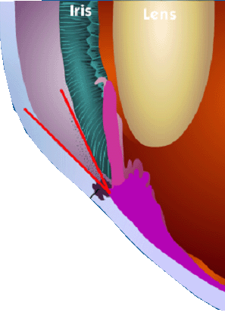
Glaucoma: Types of Glaucoma
Lens
Chronic or Primary Open Angle Glaucoma
Clogged Drainage holes
The angle between the iris and the cornea is normal, but the drainage holes get clogged from the inside.
http://www.nei.nih.gov/health/glaucoma/glaucoma_facts.asp

Slide 40
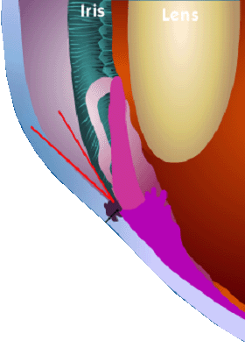
Glaucoma: Types of Glaucoma
Lens
Acute Angle Closure Glaucoma
Blocked Drainage holes
The angle is narrower than normal. If fluid can’t flow easily through the opening in the pupil, the iris pushes forward and blocks the drainage holes.
http://www.nei.nih.gov/health/glaucoma/glaucoma_facts.asp

Slide 41
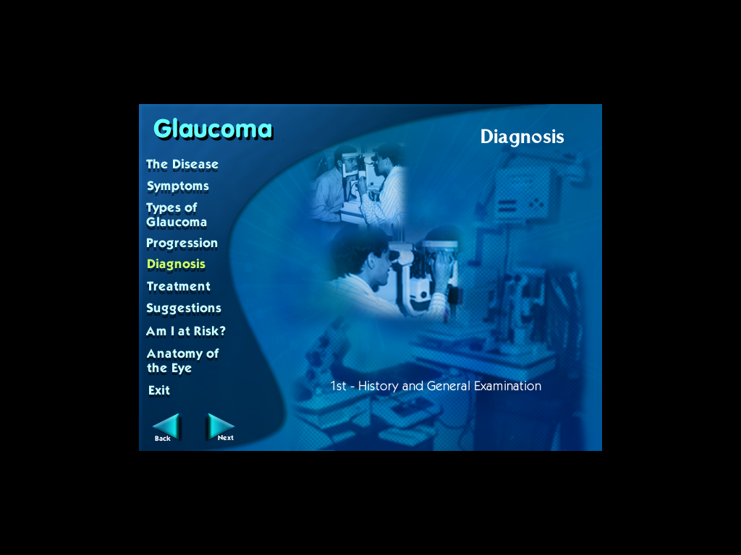
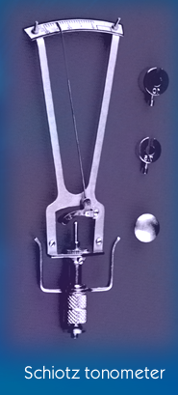
Glaucoma : Diagnosis
Tonometry
Measurement of I.O.P.
Schiotz tonometry
Applanation tonometry
Non contact tonometry
Ref: Asian J. of Ophthalmology vol.3. No.3. 4, 2001 suppl.

Slide 42
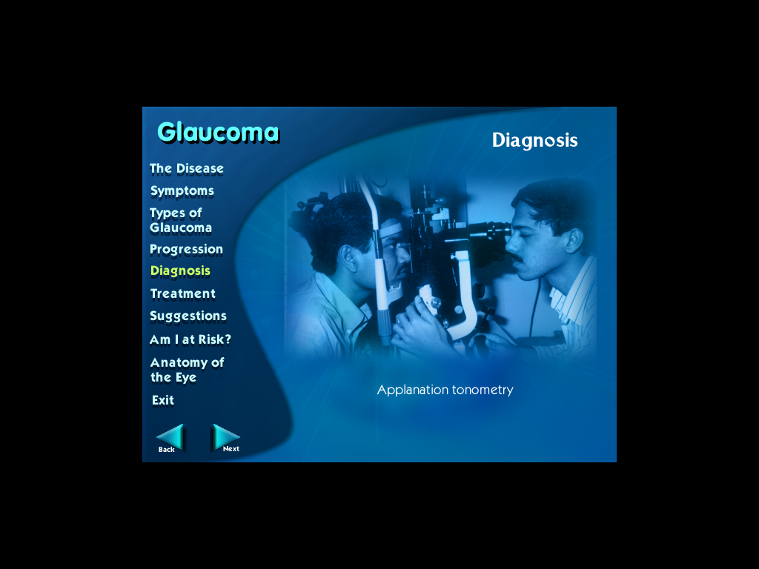
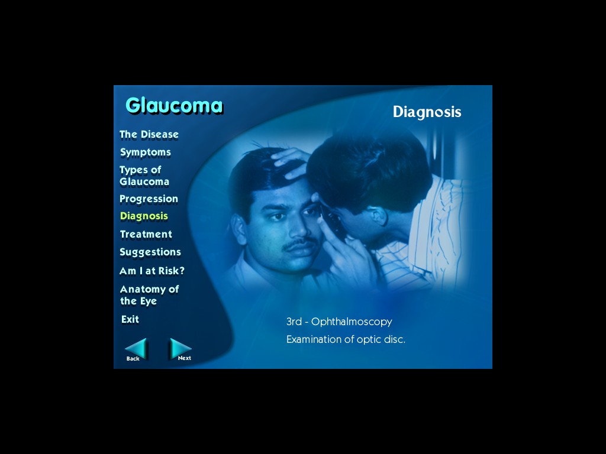
Glaucoma : Diagnosis
Applanation Tonometry
Ophthalmoscopy Examination of optic disc
Ref: Asian J. of Ophthalmology vol.3. No.3. 4, 2001 suppl.

Slide 43
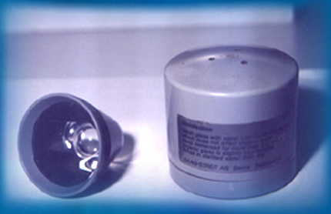
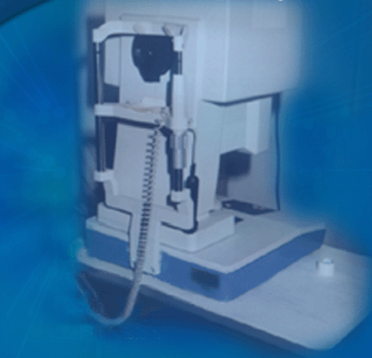
Glaucoma : Diagnosis
Gonioscopy Measurement of anterior chamber angle
Perimetry Actual measurement of visual field looking for any dark areas in field of vision
Ref: Asian J. of Ophthalmology vol.3. No.3. 4, 2001 suppl.

Slide 44
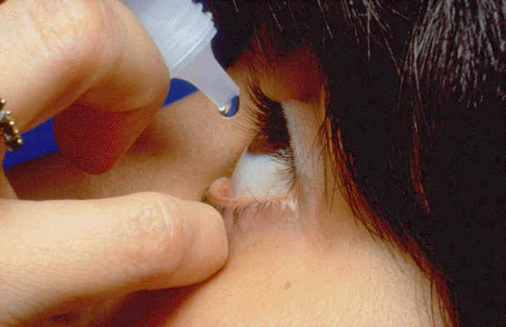
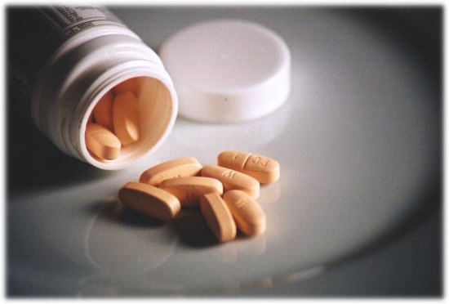
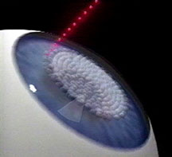
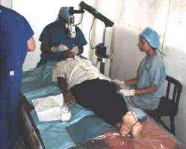
TREATMENT
Pills
Eye drops
Combination method
Laser surgery
Eye operations
http://www.nei.nih.gov/health/glaucoma/glaucoma_facts.asp

Slide 45
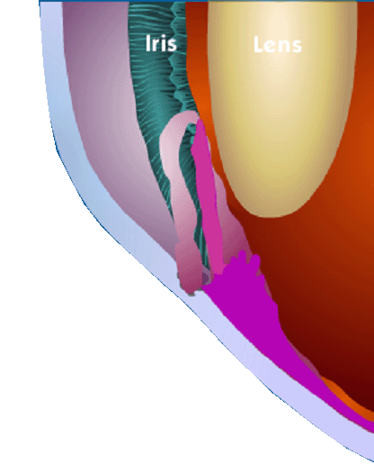
Glaucoma: Treatment
MEDICAL
Lens
Drugs increase conventional outflow.
http://www.nei.nih.gov/health/glaucoma/glaucoma_facts.asp

Slide 46
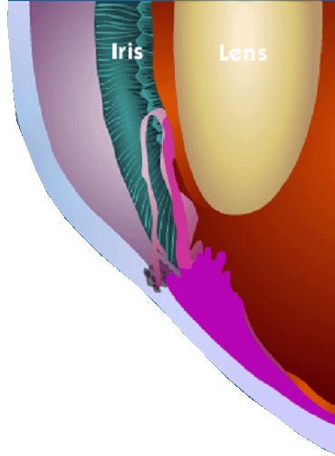
Glaucoma: Treatment
MEDICAL
Lens
Drugs reduce production of fluid in the eye.
http://www.nei.nih.gov/health/glaucoma/glaucoma_facts.asp

Slide 47
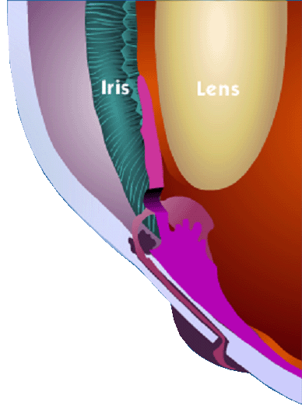
Glaucoma: Treatment
SURGERY
Trabeculectomy
Lens
Sclera
New Drain
http://www.nei.nih.gov/health/glaucoma/glaucoma_facts.asp

Slide 48
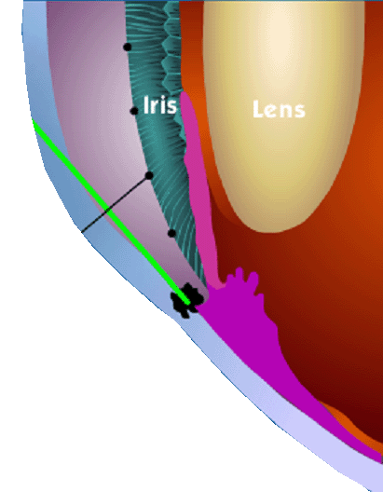
Glaucoma: Treatment
SURGERY
Trabeculoplasty
Lens
Open Drainage hole
Laser
http://www.nei.nih.gov/health/glaucoma/glaucoma_facts.asp

Slide 49
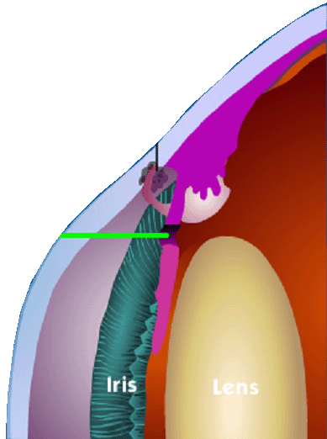
Glaucoma: Treatment
SURGERY
Iridotomy
Making a tiny opening in the iris with a laser allows fluid to drain freely
Laser
Lens
http://www.nei.nih.gov/health/glaucoma/glaucoma_facts.asp

Slide 50

AGE RELATED MACULAR DEGENERATION (AMD)
Takes Centerstage

Slide 51
About 5 percent of the 34 million adults over age have some degree of vision loss because of AMD
AMD is the leading cause of irreversible vision loss¹
The prevalence increases from 1.6% in 52-64 years to 11% in 65-74 years and 27.9% in more than 74 years²
Adapted from:
1. The NIH, The Word on Health, January 1999
2. http://www.bhj.org/journal/2002_4403_jul/md_318.htm

Slide 52
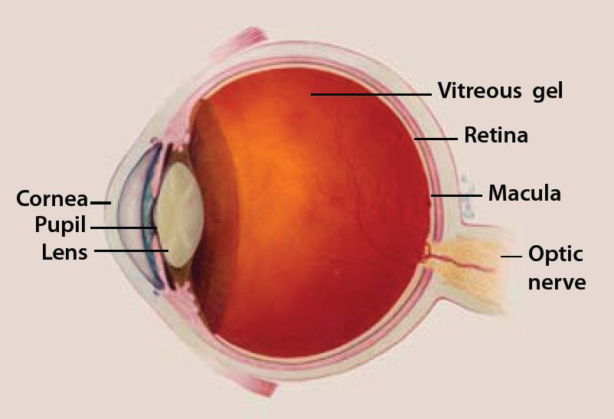
Age Related Macular Degeneration (ARMD)
AMD is a common eye condition among people age 50 and older
It is a leading cause of vision loss in older adults
It gradually destroys the macula, the part of the eye that provides sharp, central vision needed for seeing objects clearly
U.S. DEPARTMENT OF HEALTH AND HUMAN SERVICES
National Institutes of Health
National Eye Institute

Slide 53

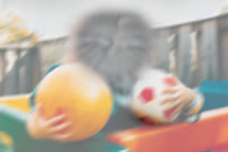
Normal vision
Vision in AMD

Slide 54
Risk FACTORS
Smoking - Research shows that smoking increases the risk of AMD two-fold.
Race - Caucasians are much more likely to get AMD than people of African descent.
Family history - People with a family history of AMD are at higher risk.
U.S. DEPARTMENT OF HEALTH AND HUMAN SERVICES
National Institutes of Health
National Eye Institute

Slide 55
forms of AMD
AMD
DRY AMD
WET AMD
U.S. DEPARTMENT OF HEALTH AND HUMAN SERVICES
National Institutes of Health
National Eye Institute

Slide 56
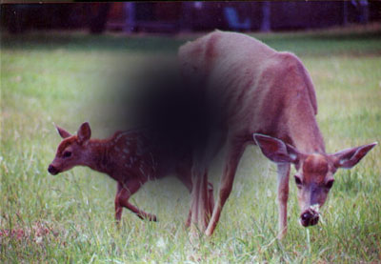
Dry AMD
Dry AMD is the most common form of AMD in its early or intermediate stages.
It occurs in about 90 percent of the people with the condition
Dry AMD happens when the light-sensitive cells in the macula slowly break down, gradually blurring central vision in the affected eye.
As dry AMD progresses, a blurred spot in the center of vision is seen
U.S. DEPARTMENT OF HEALTH AND HUMAN SERVICES
National Institutes of Health
National Eye Institute

Slide 57

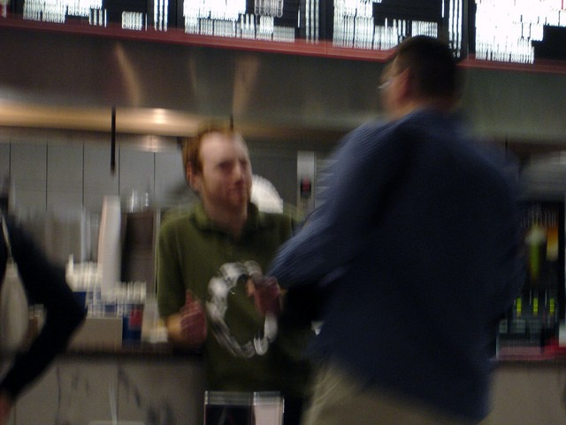
Symptoms in Dry AMD
Blurred vision
Trouble recognizing faces
U.S. DEPARTMENT OF HEALTH AND HUMAN SERVICES
National Institutes of Health
National Eye Institute

Slide 58
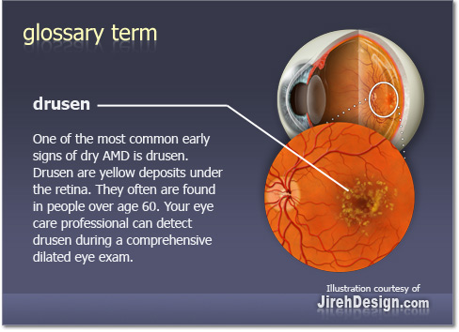
What is drusen?
Drusen are another early sign of dry AMD
They are yellow deposits under the retina
They can be small or large in size
People with large drusen are at risk of developing a more severe form of AMD, which results in severe vision loss
U.S. DEPARTMENT OF HEALTH AND HUMAN SERVICES
National Institutes of Health
National Eye Institute

Slide 59
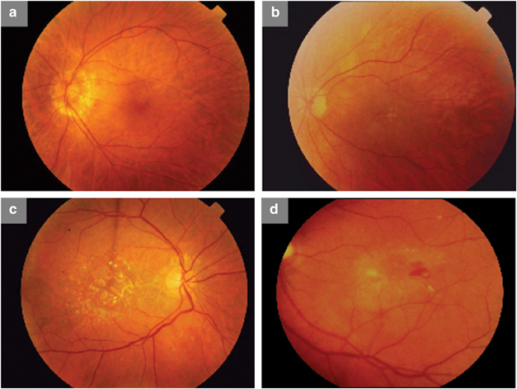
Stages of Dry AMD
(a) Healthy subject, (b) early AMD with small drusen, (c) intermediate AMD (d) advanced AMD

Slide 60
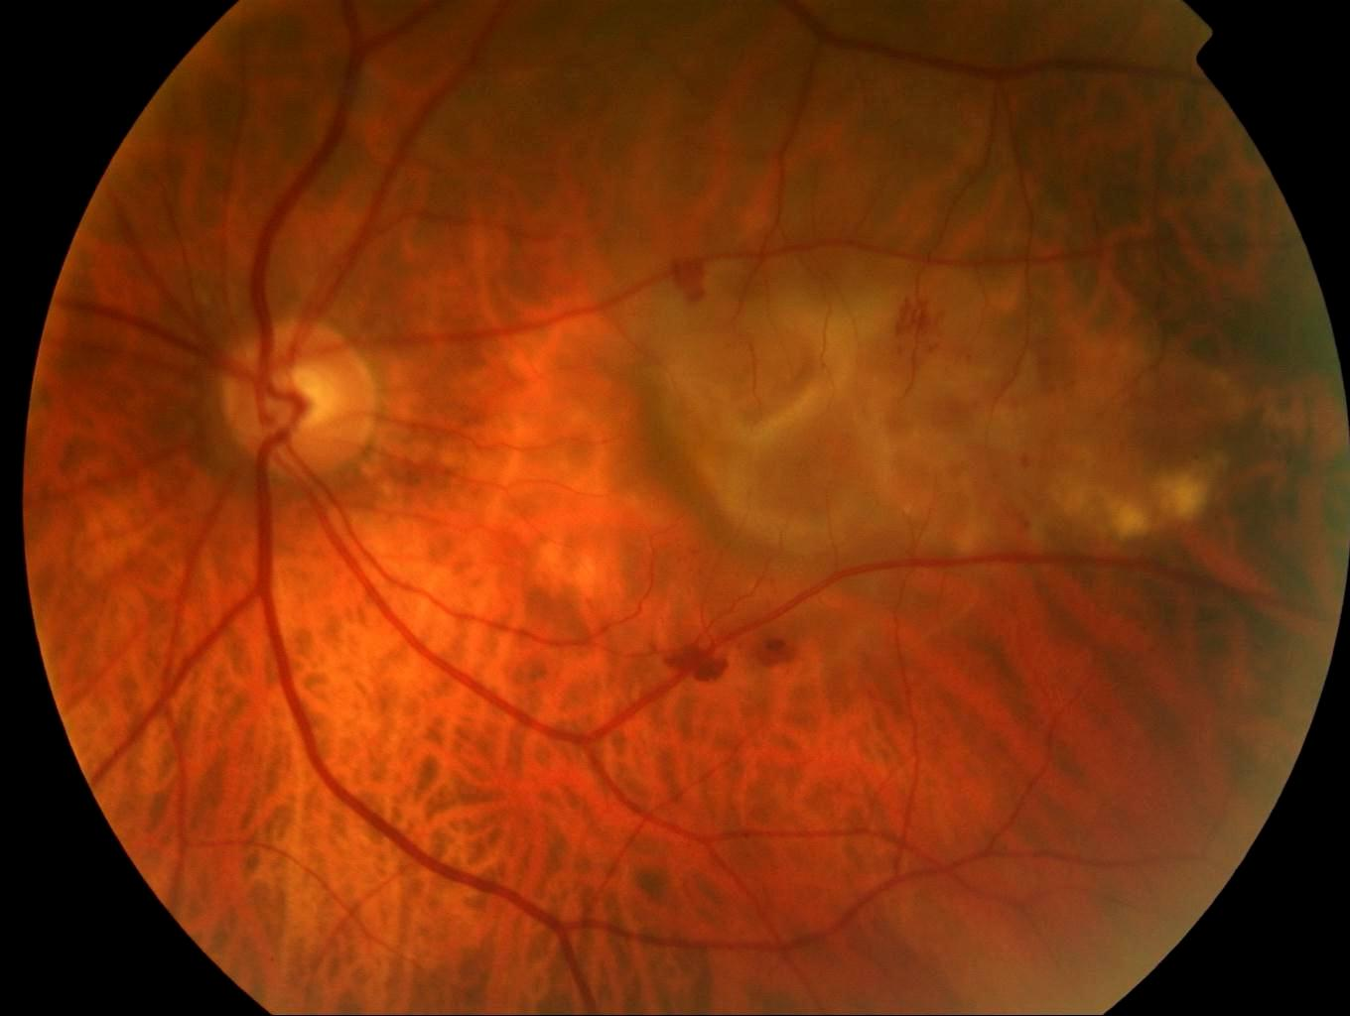
Wet AMD
Affects about 10 percent of all people with AMD
More severe than the early and intermediate stages of the dry form
Wet AMD happens when abnormal blood vessels behind the retina start to grow under the macula.
These new blood vessels can be fragile and leak blood and fluid
The blood and fluid cause the macula to swell and damage occurs rapidly
U.S. DEPARTMENT OF HEALTH AND HUMAN SERVICES
National Institutes of Health
National Eye Institute

Slide 61

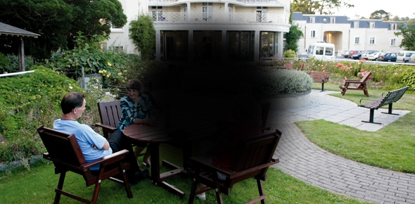
Symptoms in wet AMD
Straight lines appear wavy
Blind spot in the centre
U.S. DEPARTMENT OF HEALTH AND HUMAN SERVICES
National Institutes of Health
National Eye Institute

Slide 62
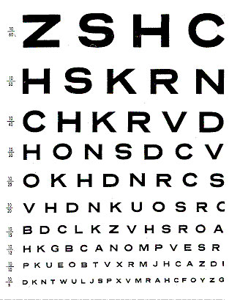
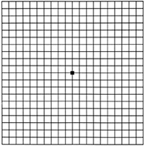

DIAGNOSIS
Visual acuity test
Amsler Grid test
http://www.nei.nih.gov/health/maculardegen/armd_facts.asp

Slide 63


DIAGNOSIS
Retinal Examination
Fluorescein angiography
http://www.nei.nih.gov/health/maculardegen/armd_facts.asp

Slide 64

MANAGEMENT
LASER SURGERY
Uses a laser to destroy the fragile, leaky blood vessels
High energy beam of light is aimed directly onto new blood vessels and destroys them
http://www.nei.nih.gov/health/maculardegen/armd_facts.asp

Slide 65

MANAGEMENT
PHOTODYNAMIC THERAPY
Drug called verteporfin is injected into arm
It travels throughout the body, including new blood vessels in eye
Drug tends to stick to surface of new blood vessels
Light is shined into eye for 90secs, it activates the drug
Activated drug destroys new blood vessels
http://www.nei.nih.gov/health/maculardegen/armd_facts.asp

Slide 66
PATIENT AWARENESS

Slide 67




Will AMD affect my quality of life?
AMD will have its impact on
Reading
Shopping
Watching TV
Cooking
U.S. DEPARTMENT OF HEALTH AND HUMAN SERVICES
National Institutes of Health
National Eye Institute

Slide 68



Can my AMD be treated?
YES
Anti – VEGF injection
Laser therapy
Photodynamic therapy
U.S. DEPARTMENT OF HEALTH AND HUMAN SERVICES
National Institutes of Health
National Eye Institute

Slide 69
Tips to prevent AMD

Slide 70

Visit eye doctor regularly
Above 65 yrs, a complete eye exam must be done every one or two years even in case of normal vision
www.preventblindness.org

Slide 71
Learn & watch the signs & symptoms of AMD
Check the central vision in both the eyes everyday
Report any changes to the eye doctor
www.preventblindness.org

Slide 72

Take care of yourself
EAT HEALTHY
STAY ACTIVE
QUIT SMOKING
www.preventblindness.org

Slide 73
TIPS FOR LIVING WITH ARMD

Slide 74


Make things brighter
Many people with AMD see better in bright light
Paint rooms & ceilings white to add extra brightness
Pull back curtains to allow more sun into the room
www.preventblindness.org

Slide 75




Choose the right light
Make sure that light doesn’t shine directly into eyes
Add lights or spotlights around dark areas of house
While cooking, there should be enough light around the stove, gas
While reading, install light directly on the work area
www.preventblindness.org

Slide 76





Use Low - vision aids
Talking books on cds, cassettes
Magnifying lenses to read
Large print books & magazines
Large screen computers
Closed circuit TV’s
www.preventblindness.org

Slide 77

Eating habits
Eat dark colored fruits & vegetables – an important source of antioxidants
Antioxidants provide health benefits & are likely to reduce the risk of AMD
http://www.aao.org/newsroom/release/20090223.cfm

Slide 78

DIABETIC RETINOPATHY (DR)
Timely Treatment Is Key

Slide 79
The final major age-related eye disease whose symptoms are often ignored is diabetic retinopathy¹
Diabetic retinopathy is the most common and serious ocular complication
Of the 246 million people with diabetes, about a third have signs of diabetic retinopathy, and a third of these might have vision-threatening retinopathy²
Adapted from:
The NIH, The Word on Health, January 1999
Lancet 2010; 376: 124–36

Slide 80

Diabetic retinopathy (DR)
The most common eye disease among people with diabetes
High blood sugar levels and high blood pressure (BP) can damage the tiny vessels (capillaries) in the back of eye (retina)
In some people, fluid leaks through the damaged vessels, injuring the retina and causing loss of vision
Nursing2007, July 2007 ,Volume 37 ,Number7 :Pages 51 - 51

Slide 82



symptoms
Blurred vision
Double vision
Nursing2007, July 2007 ,Volume 37 ,Number7 :Pages 51 - 51

Slide 83


Slide 84
RISK FACTORS
All people with diabetes-both type 1 and type 2
During pregnancy, diabetic retinopathy may be a problem for women with diabetes
http://www.nei.nih.gov/health/diabetic/retinopathy.asp

Slide 85

STAGES OF DIABETIC RETINOPATHY
Mild nonproliferative retinopathy – microaneurysms occur (small areas of balloon like swelling in retina’s blood vessel)
Moderate nonproliferative retinopathy – blood vessels that nourish the retina are blocked
Severe nonproliferative retinopathy – more blood vessels blocked, retina sends signals to grow new blood vessels for nourishment
Proliferative retinopathy – new blood vessels grown are abnormal and fragile, grow along the vitreous gel
http://www.nei.nih.gov/health/diabetic/retinopathy.asp

Slide 86


Healthy Retina
Diabetic Retina
Damaged capillaries can interfere with vision.
Reduce the amount of blood nourishing the retina.
Reduced blood flow causes weak new capillaries to grow on the retina
As diabetic retinopathy progresses, vision loss can get worse.

Slide 87

Progression of Diabetic Retinopathy
Tiny blood vessels ,
bulge swell and
ultimately leak
Lack of oxygen causes
ischemic conditions leading
to
sealing and closing of
blood vessels
Growth of weak fragile
capillaries lead to
easy bleeding of the same
leading to hemorrhage
and vision loss

Slide 88


Slide 89

DIAGNOSIS
Dilated eye exam
Visual acuity test
http://www.docshop.com/education/vision/eye-diseases/diabetic-retinopathy/faqs/

Slide 90


TREATMENT
Laser photocoagulation
Vitrectomy
Vitreous gel filled with blood is removed
It is replaced with salt solution
Laser shrinks the abnormal blood vessels
Adapted from : Nursing2007, July 2007 ,Volume 37 ,Number7 :Pages 51 - 51

Slide 91
PATIENT AWARENESS
HOW SUCCESSFUL IS DIABETIC RETINOPATHY TREATMENT?
Diabetic retinopathy treatment has a high success rate
Laser photocoagulation is not intended to improve vision, but is successful at preventing further vision loss
Undergoing Vitrectomy surgery will improve vision for most diabetic retinopathy patients who are good candidates for the procedure
http://www.docshop.com/education/vision/eye-diseases/diabetic-retinopathy/faqs/

Slide 92
PATIENT AWARENESS
ARE THERE ANY OTHER EYE PROBLEMS THAT CAN HAPPEN TO DIABETICS?
Cataract
Glaucoma
http://www.docshop.com/education/vision/eye-diseases/diabetic-retinopathy/faqs/

Slide 93
PATIENT AWARENESS
WILL I GO BLIND IF I SUFFER FROM DIABETIC RETINOPATHY?
Yes
If the disease progresses & is not treated, there is a chance of vision loss
http://www.nei.nih.gov/health/diabetic/diabeticretino.pdf

Slide 94

PATIENT AWARENESS
WHAT CAN I DO IF I HAVE DR ?
Keep your blood glucose and blood pressure as close to normal as you can
http://diabetes.niddk.nih.gov/dm/pubs/complications_eyes/index.htm

Slide 95

Contd…
Have an annual eye exam, and call your eye doctor between exams if you have any problems or questions
Adapted from:
Nursing2007, July 2007 ,Volume 37 ,Number7 :Pages 51 - 51

Slide 96



Contd….
Eat a healthful diet, watch your weight, and exercise according to your health care provider's recommendations
Adapted from:
Nursing2007, July 2007 ,Volume 37 ,Number7 :Pages 51 - 51

Slide 97

Contd….
Quit smoking
Adapted from:
Nursing2007, July 2007 ,Volume 37 ,Number7 :Pages 51 - 51

Slide 98
THANK - YOU

