Slide 1
PG analogues
First-Line therapy for Glaucoma management

Slide 2
In treating primary open angle glaucoma, you are most likely to initiate therapy with a topical:
A Question poll was conducted at one of the well known ophthalmology website
Prostaglandin analogues are preferred choice as first line therapy
http://www.healio.com/optometry/glaucoma/news/print/primary-care-optometry-news/%7BE241BEEC-4D3F-45E6-9A24-E715F594371C%7D/Clinicians-prostaglandins-are-the-clear-choice-for-first-line-glaucoma-therapy last accessed 21st August 2012.

Slide 3
Place in therapy
Step 4-Surgery
Insufficient fall of IOP
Progression of visual field defects
Step 3-Adjunctive/ Add-On Therapy:
Combining anti-glaucoma drugs.
β-blockers + CAIs / PGA/ α₂-agonist
Thus PGA are widely being used at all stages of glaucoma treatment
Insufficient fall of IOP
Progression of visual field defects
Step 2-Replacement Monotherapy :
Topical carbonic anhydrase inhibitors (CAIs), prostaglandin analogues (PGA), α₂-agonist
Insufficient fall of IOP
Adverse effects
Step 1-Monotherapy : β-blockers/ prostaglandin analogues (PGA)

Slide 4
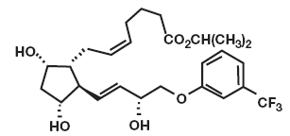
What are Prostaglandins?
Prostaglandins (PGs) constitute a group of naturally occurring hydroxylated fatty acids.
Biosynthesised from free arachidonic acid, and are released by variety of physiological stimuli.
Many tissues secrete prostaglandins for various functions, and have important functions in the body.
Ref: Drugs and Ageing 1999; 14(5): 387-398

Slide 5
Prostaglandins: Types & their receptors
Naturally occurring prostaglandins/ prostanoids | Prostanoid receptors
PGD₂ | DP
PGE₂ | EP
Prostacylin (PGI₂) | IP
Thromboxane (TXA₂) | TP
PGF_{2α} | FP
FP receptor has a widespread distribution in ciliary muscle & ciliary processes.
Ref: Drugs and Ageing 1999; 14(5): 387-398

Slide 6
Prostaglandins
In 1981, Camras and Dito demonstrated that topically applied PGF_{2α} reduces intraocular pressure (IOP) in monkeys with no or minimal intraocular side effects.
Synthetic prostaglandin analogues (PGAs) are molecules which are manufactured to bind to a prostaglandin receptor.
Uses -Prostaglandin analogues such as misoprostol are used in treatment of duodenal and gastric ulcers.
Prostaglandin analogues can also be used in the management of open-angle glaucoma.
Ref: 1. Drugs and Ageing 1999; 14(5): 387-398
IOVS; May 2001, Vol .42 (6): 1134-1145
http://en.wikipedia.org/wiki/Prostaglandin_analogue last accessed on 22nd August 2012

Slide 7
Different types of PGA used in glaucoma management
The commercially available PGAs are as follows:-
PG analogues | Year of launch
Latanoprost 0.005% | 1996
Unoprostone isopropyl 0.15% | 2000 (not available in India)
Bimatoprost 0.03 & 0.01% | 2001 & 2010
Travoprost 0.004% & travoprost 0.004% with Ionic buffer system | 2001
Tafluprost 0.0015% | 2008
Most of these medications are considered as prodrug (with some controversy on bimatoprost) as they are dispensed in their inactive form & are hydrolysed by corneal enzymatic degradation into active molecules (biological free acid^{)2.}
Ophthalmology Times, July 1, 2002
2. Highlights of ophthalmology Jounal. 1(2)
3. http://www.ashp.org/menu/News/PharmacyNews/NewsArticle.aspx?id=3681

Slide 8
How do PG analogues work?
PG analogues reduce IOP by increasing aqueous humor outflow through uveoscleral pathway.
Flow of aqueous humor
Trabecular meshwork flow
Uveo-scleral outflow
Accounts for 80% of flow
Accounts for 20% of flow
Eye .1997;11:149-154

Slide 9
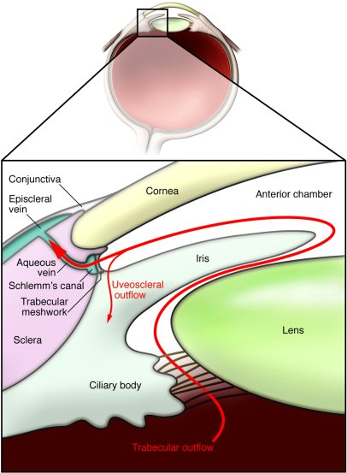
Produced by ciliary process
Moves backwards
Ciliary body
supraciliary &
suprachoroidal spaces
Sclera
Uveo-scleral
outflow
Trabecular
meshwork flow
Produced by ciliary process
Enters posterior chamber
Moves out through pupil
Irido-corneal angle.
Drained through trabecular meshwork
Enters schlemm’s canal
Drained in aq. vein

Slide 10
How do PG analogues work?
They increase uveoscleral outflow by 2 mechanisms:
Relaxation of ciliary muscle
Decreased resistance in the uveoscleral pathways due to changes in extracellular matrix
Eye .1997;11:149-154

Slide 11
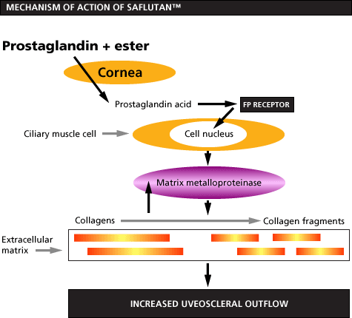
Mode of action- post instillation in eye.
PRODRUG
Corneal esterases
Activate C-fos protiens
Secretion of MMPs
Widen ECM
Amongst all PGA Travoprost has strong affinity to Fp receptors

Slide 12
IOP reduction by various anti-glaucoma medications
PGAs as a class appear to provide excellent control of both short- and long-term IOP fluctuation in comparison to all other classes of anti-glaucoma drugs.
Reduction in IOP from baseline was 31-33% for peak & 28-29% for trough.
Surv Ophthalmol.2009; 54 (6): 643-662
http://www.glaucomaassociates.com/medications.html last accessed 22nd August 2012.
J. Of Clinical Epidemiology; 2009: 1-5

Slide 13
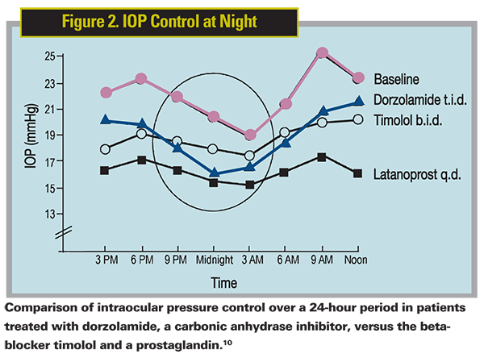
Prostaglandin analogues:
Proven for 24 hour IOP Control
IOP fluctuations are considered as independent & stronger risk factor of visual field progression.
Recent studies have shown a blunting of the nocturnal spikes in IOP, when we are asleep and lying flat.
Prostaglandin analogues seem to be the most effective in flattening the IOP fluctuations
Comparison of IOP over 24hr period in patients treated with dorzolamide (CAI), timolol (β-blocker) & Latanoprost (PGA)
Ref: Invest Ophthalmol Vis Sci 2000; 41: 2566-2573
http://www.revophth.com/content/d/cover_focus/i/1227/c/23095/ last accessed 22nd August 2012.

Slide 14
Latanoprost 0.005%
The first agent to receive a first line indication in the EU for patients with POAG or ocular hypertension since the introduction of cholinergics and betablockers.
Latanoprost has Undergone extensive clinical trials for efficacy, drug interactions, and side effects.
Sustained long term IOP control
  2 years as monotherapy
  5 years as adjunctive therapy
25% more effective vs. beta blocker
37% more effective vs. alpha-agonist
52% more effective vs. CAI’s
Monotherapy with Latanoprost can be an alternative with timolol & dorzolamide
Surv. Ophthalmol 47 (suppl): 2002
Surv of Ophthalmol; 47 (suppl 1): S65-S72 2002
J of Glaucoma 2002; 11: 90-96
Survey of Ophthalmology; 47 (suppl 1): 2002; S148-S154
Br. J. Ophthalmol 2000; 84: 579-582
Ref: http://www.docguide.com

Slide 15
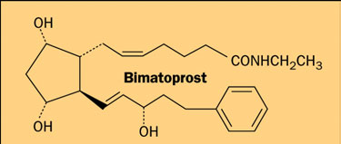
Bimatoprost 0.03% & 0.01%
Equal efficacy when compared with other PGAs.
Bimatoprost 0.03% was associated with significant hyperaemia which lead to patient non-compliance hence lower strength formulation of bimatoprost (0.01%) was introduced in 2010 which had 4 times higher concentration of BAK than the initial formulation to increase penetration of thr drug in ocular tissues.
Bimatoprost 0.03% provides:-
Significantly greater reductions in IOP of about 2–4 mmHg than timolol 0.5% given twice daily.
Clinical Ophthalmology 2007;1(3):225-232
Am J ophthalmol .2010;149 (4):661-671

Slide 16
Travoprost 0.004%
Also available as Travoprost with ionic buffer system (BAK free) with equivalent IOP lowering efficacy as travoprost 0.004% with BAK.
The development this BAK free formulation might prove to be beneficial for patients having concomitant OSD & for those with a sensitivity to the preservative BAK.
Provide a treatment option for practitioners who prefer to prescribe a BAK free product for chronic therapy.
IOP reduction was maintained for 84 hrs.
Equal efficacy when compared with other PGAs.
Sustained long term IOP control upto 48 months
Travoprost 0.004% lowered IOP more than timolol, The decrease from baseline was 30% to 33% for travoprost compared with a 22% to 29% decrease for timolol.
Substantially additive to timolol as adjunctive therapy.
  Travoprost EMEA monograph 2004
  Clinical Therapeutics. 2004, 26(1): 84-90
  American J of Ophthalmology 2001; 132 : 472 - 484

Slide 17
Comparison of all the 3 prostaglandin analogues
 | Latanoprost 0.005% | Bimatoprost 0.03% | Travoprost 0.004%
Molecular form | Isopropyl ester analog of PGF_{2α} | Prostamide | Isopropyl ester analog of PGF_{2α}
Duration of action | 24-40 hrs | 24-40 hrs | 84hrs
Hyperaemia³ | Least compared to other PGAs (16.5%) | Maximum hyperaemia noticed (40.2%) | Moderate hyperaemia noticed. (33%)
Treatment discontinuation⁴ | 18.4% | 77.1% | 34.6%
Additional features | Causes least hyperaemia, shows excellent patient persistency, has undergone extensive clinical trials for efficacy, drug interactions, and side effects. | Is available at lower strength 0.01% to reduce the hyperaemia associated higher strength | Travoprost with Ionic buffer system is a safer option for glaucoma patients with concomitant dry eye and those with a sensitivity to the preservative
3. Br J Ophthalmol 2009;93:316–321.
4. Clinical Ophthalmology 2010;4:261-267
Travoprost EMEA monograph 2004

Slide 18
Results of Randomized Trials Comparing the Efficacy of the Prostaglandin Analogues
Author/ Reference | Drugs/ Condition | n | Design | Duration | Sponsor | Mean Diurnal IOP at Last Visit, mm Hg
Yildirim | Lat/Bim/Trav POAG | 48 | Parallel | 8 weeks | Indep | Lat 17.9 Bim 17.7 Trav 17.3
Hepsen | Lat/Bim/Trav XFS | 45 | Parallel | 12 weeks 24 hours | Indep | Lat 16.1 Bim 15.4 Trav 15.1
Orzalesi | Lat/Bim/Trav POAG/OH | 44 | Cross over | 4 weeks | Indep | Lat 16.2 Bim 15.3 Trav 15.9
Parrish | Lat/Bim/Trav POAG/OH | 410 | Parallel | 12 weeks | Pharmacia | Lat 16.7 Bim 16.4 Trav 16.8
No clinically significant differences exist among these agents regarding their ability to lower intraocular pressure.
Surv Ophthalmol.2008; 53:S69--S84

Slide 19
Tafluprost
Received approval in 2012. Available as preservative free unit dose vials.
Shows similar to slightly lower IOP lowering capabilities (29%) when compared to latanoprost.
New molecule effective & well tolerated for upto 24 months.
Data on tafluprost is limited.
Available in India
Acta Ophthalmologica.2010;88(1):12-19

Slide 20
Unoprostone
Unlike the 20-carbon molecular skeleton of arachidonic acid, unoprostone a, 22-carbon molecule.
Unoprostone administered two times daily lowered lOP by 17%.
Less effective than the other 3 analogs in clinical trials.
http://www.agec.org/2010/10/switching-prostaglandin-analogs-in-the-treatment-of-glaucoma/ Last accessed 21st August 2012

Slide 21
Inidcations
PGAs are indicated for the reduction of elevated intraocular pressure in patients with open angle glaucoma and ocular hypertension.
Allied indications:-
Control of Post-operative IOP spikes
Reducing Intraocular Pressure in
  Primary angle closure glaucoma
  Steroid induced glaucoma
  Pigmentary glaucoma
  Paediatric glaucoma (latanoprost 0.005% studied)
Ref: Surv Ophthalmol 2002 47 (suppl1.) S125 – S128
J. Cataract Refract Surgery 1998; 24: 964 – 967
Surv. Ophthalmol. 2002; 7 (Suppl 1): S129 – S132
J of Glaucoma 2000; 9: 179 – 182
Ophthalmology 1999: 106: 550 - 555

Slide 22
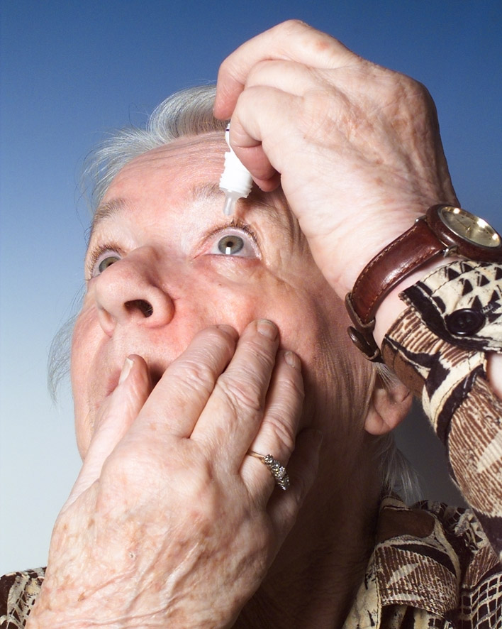
Dosage regimen
The recommended treatment regimen is one drop in the affected eye once daily (usually recommended in the evening).
More frequent dosing of these agents resulted in decreased efficacy of the drug (related to development of receptor subsensitivity)
Ref: 1. Drugs and Aging 1999; 14(5): 387-398
2. Drugs and Aging 2003; 20(8): 597-630.
http://www.vaeye.com/Specialties/glaucoma-treatment/prostaglandin-analogues.aspx. Last accessed 20th August 2012.

Slide 23
PGA safety
Relatively safe local & systemic side effect profiles when compared to other classes of drugs like β-blocker,α-agonists.
Safe to use in glaucoma patients with concomitant cardiovascular or cardiopulmonary contraindications .
Side effects associated- itching, burning, stinging, conjunctival hyperaemia, increased iris pigmentation (which can be permanent), hypertrichosis, increased eyelash growth, peri-orbital tissue changes.
Cystoid macular edema & recurrences of herpetic eye disease have been reported. These drugs are contraindicated in patients with active intraocular inflammation (uveitis). Prostaglandins should be used with caution in patients who have had cataract surgery or other problems with the lens of the eye, or who are at risk for swelling in the macula at the back of the eye.
http://www.webmd.com/eye-health/prostaglandin-analogs-for-glaucoma last accessed 20th August 2012.
http://www.glaucomaassociates.com/medications.html last accessed 22nd August 2012.
Eur J Ophthalmol. 2007 Jul-Aug;17(4):521-7

Slide 24


Prostaglandins in special population
Pregnancy- Category C. Prostaglandins are biologically active and may be absorbed through the skin; caution should be exercised to avoid direct exposure to the drug in women who are pregnant or attempting to become pregnant.
Nursing – Not recommended
Paediatric Use-Safety and efficacy in paediatric population is not established.
Renal and Hepatic Impairment- Efficacy not established; use with caution.
http://dailymed.nlm.nih.gov/dailymed/lookup.cfm?setid=a5e67c75-db88-4372-bb07-c8dd15c97631#section-8.3
http://www.medicines.org.uk/EMC/medicine/8031/SPC/TRAVATAN/

Slide 25

Take home message
PGAs are currently considered our “first line”
medications by virtue of several aspects.
Once daily dosing (usually recommended to be instilled in the evening),
An impressive pressure decrease (typically at least 20-30% from baseline),
Very favourable side effect profile.
All of the medications in this group have the ability to increase eyelash length and thickness, darken eye (iris) color, increase pigmentation of the skin surrounding the eye (raccoon eyes), and cause “red” eyes. However, there are usually no systemic side effects.
Between 1997 and 2003, new glaucoma drugs, primarily prostaglandins, improved intraocular pressure control and delayed surgery, reducing glaucoma surgery by 22%.
http://www.vaeye.com/Specialties/glaucoma-treatment/prostaglandin-analogues.aspx. Last accessed 20th August 2012.
Eur J Ophthalmol. 2007 Jul-Aug;17(4):521-7

