Slide 1
Role of newer diagnostic tools in evaluation of glaucoma

Slide 2
Currently used diagnostic techniques in glaucoma

Slide 3
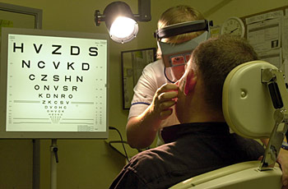
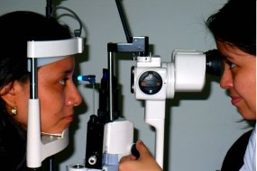
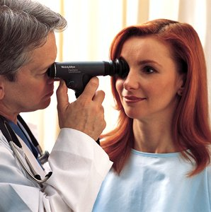
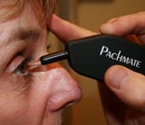
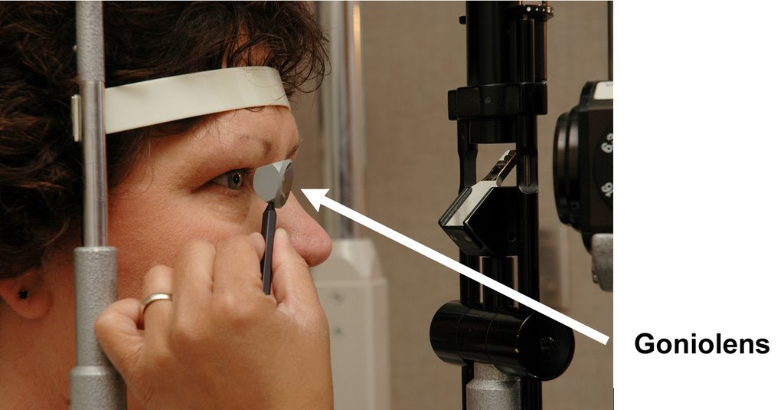
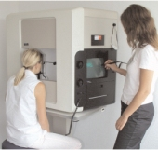
ophthalmoscope-examine interior of eye. (lens, retina, optic nerve)
Refraction- test short/long sighted vision
Tonometry-measure IOP.
Diagnosis
Slit-lamp examination.
History
Pachymetry-measure corneal thickness.
gonioscopy-measure irido-corneal angle.
Perimetry-measure extent of vision loss.

Slide 4
Need for newer diagnostic techniques
Glaucoma detection relies on examination of structural damage to optic nerve & measurements of visual function.
Clinical examinations are subjective, thus prone to variabilit
Recent research has focused on objective methods to aid in glaucoma diagnosis
Newer techniques have been extensively studies as adjuncts to the existing techniques
Reference- Surv Ophthalmol. 2008 November ; 53(SUPPL1): S17–S32.

Slide 5
Newer techniques for glaucoma evaluation
Adjuncts to Subjective to ONH evaluation
Confocal scanning laser ophthalmoscopy
Scanning laser polarimetry
Short-wavelength automated perimetry (SWAP)
Frequency doubling perimetry
Optical coherence tomography
Selective perimetry techniques
Reference- Surv Ophthalmol. 2008 November ; 53(SUPPL1): S17–S32.

Slide 6
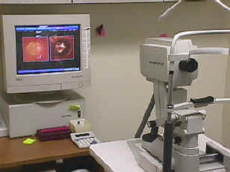
Confocal scanning laser ophthalmoscopy (CSLO)
Available for glaucoma detection since 1992
Provides quantitative 3D composite image of ONH & posterior segment
Commercially available instrument, HRT
Uses confocal optics to obtain multiple
measures of retinal heights at consecutive
focal planes.
Provides a topographic map extending
from lamina cribosa to the retinal anterior
surface.
HRT- Heidelberg retinal tomography
Reference- Surv Ophthalmol. 2008 November ; 53(SUPPL1): S17–S32.

Slide 7
HRT parameters & assessments
Parameters generated by CSLO- rim area, rim volume, cup shape measure, linear cup/disk (C/D) ratio, retinal height variation along the contour line & RNFL thickness
HRT assessments of the ONH are capable of distinguishing between healthy and glaucomatous eyes, with a range of sensitivities from 51–97% and a range of specificities from 75–95%
Amongst the many HRT parameters associated with glaucoma development the most predictive values were mean height contour, rim area, and mean cup depth.
Reference- Surv Ophthalmol. 2008 November ; 53(SUPPL1): S17–S32.

Slide 8
strengths
limitations
Good image quality through undilated pupils
Ability to upgrade existing machines with newer software, allowing to build upon long-term databases.
Superimposing baseline & follow-up images allows for automated detection of ONH changes
HRT use in ancillary study to OHTS has resulted in a well-characterized data set, beneficial for future investigations of this technique.
An additional improvement to the HRT version 3.0 software is a larger and ethnicity-specific normative database.
Some topographic measurements are based on a reference plane constructed from a user-drawn contour line, so that operator input is required for particular analyses.
Topographic change analysis & GPS don’t require a user-drawn contour line.
In some eyes, IOP can significantly influence HRT measurements
Reference- Surv Ophthalmol. 2008 November ; 53(SUPPL1): S17–S32.
Indian J Ophthalmol. 2011 Jan; 59(Suppl1): S59–S68.

Slide 9
Take home message on HRT
Provides localized, objective and quantitative information on the volume, area and depth of retinal height changes
Uses sophisticated statistical analysis that automatically identifies repeatable change greater than the variability of the superpixels comprising an individual’s images.
Is a promising tool for early glaucoma diagnosis.
Reference- Surv Ophthalmol. 2008 November ; 53(SUPPL1): S17–S32.

Slide 10
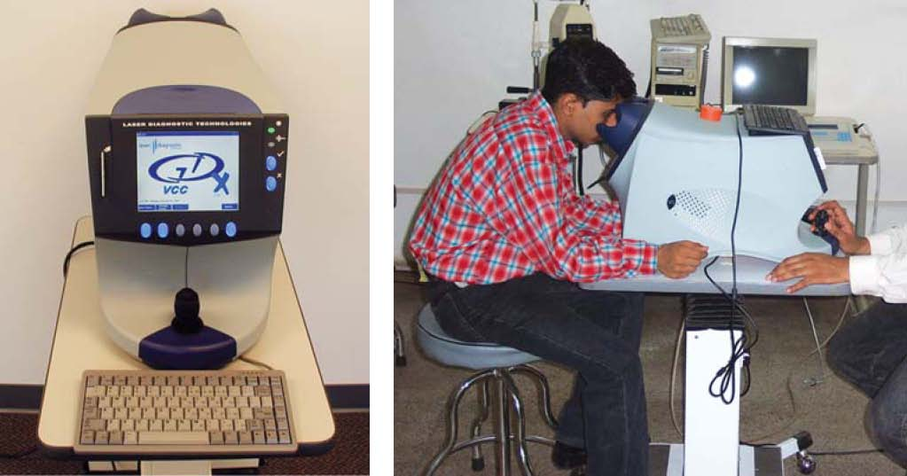
Scanning laser polarimetry (SLP)
Non-invasive method to objectively measure the RNFL
Potential diagnostic tool for detecting damage in early glaucoma.
Consists of CSLO with a polarized laser beam; when the polarized light passes through the birefringent RNFL,
a measurable phase shift is
created, which can be
correlated to the RNFL
thickness.
SLP was first commercially
available as the GDx Nerve
Fiber Analyzer
Reference- Surv Ophthalmol. 2008 November ; 53(SUPPL1): S17–S32.

Slide 11
Commercially available SLP instruments
GDx VCC (variable cornea compensation) and the latest GDx ECC (enhanced corneal compensation) (both from Carl Zeiss Meditec, Dublin, CA, USA).
GDx has undergone numerous implementations, to provide more reliable & reproducible measurements of RNFL thickness.
Has good diagnostics accuracy, with reported AUCs values for glaucoma detection ranging from 0.90 to 0.978
GDx-VCC and RNFL photography correlate with damage in corresponding hemiretinas, the best GDx-VCC parameter had a higher degree of discriminant ability than the best RNFL photographic parameter.
AUC - area-under-the curve
Reference- Surv Ophthalmol. 2008 November ; 53(SUPPL1): S17–S32.

Slide 12
Indications
Early and moderate glaucomatous damage identification and follow ups to detect progression
Advance cases: limited role, but can help when perimetry is not feasible
Preperimetric glaucoma- helps identifying loss before seen on visual field, useful in ocular hypertensives
Glaucoma suspects: GDx VCC is an important tool in defining the management strategy of glaucoma suspects
Also useful in monitoring neurological patients.

Slide 13
Limitations
Doesnot measure actual RNFL thickness (inferred value)
Does not differentiate true biological changes from variability
Young children database not available
Requires a wider database from the Indian population
Limited use in moderate/ advanced glaucoma
Anterior & posterior segment pathology does affect the accuracy.

Slide 14
Limitations
Unreliable values in patients with media opacities, OSDs, peripapillary atrophy, keratorefractive surgery.
Vitreous opacities, optic nerve crescents, and other nonglaucomatous retinal distortions may induce erroneous RNFL measurements.
Some GDx-VCC scans are characterized by problematic atypical birefringence patterns (ABPs); enhanced corneal compensation (ECC), was developed to reduce this artifact.
Newer GDx instruments are not backward compatible with older once, thus RNFL measures acquired with different GDx instruments are not comparable.
ABP- ABPs result from artifact introduced by the device’s attempt to compensate for poor noise-to-signal ratio.

Slide 15
Take home message for GDX
RNFL measurements with GDX is highly reproducible in a long term situation
Useful for longitudinal assessment of RNFL
Useful adjunct for early diagnosis of glaucoma cases
Limited use in management of advanced glaucoma cases
Caution should be exercised when using for longitudinal evaluation of RNFL in eyes with atypical retardation patterns.

Slide 16
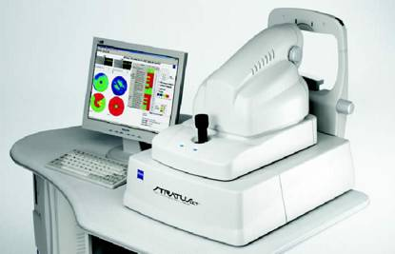
Optical coherence tomography (Oct)
Uses low-coherence interferometry to perform high-resolution cross-sectional imaging of tissue morphology, providing an optical biopsy.
Permits direct, real-time visualization of retinal pathology
Provides quantitative measurements of retinal architecture at higher resolutions than CSLO and
SLP.
The commercially available
ophthalmic time domain OCT
(Stratus OCT; Carl Zeiss
Meditec, Inc., Dublin CA)
has ~10-micron axial image
resolution.

Slide 17
Clinical applications of oct
RNFL analysis- RNFL thickness measurements is graphed in a TSNIT orientation & compared to age matched normative data. Decreased RNFL thickness represents glaucoma.
ONH analysis- disc margins are objectively identified by using signal from and of RPE. Key parameters include cup to disc ratio and horizontal integrated rim volume
Macular thickness analysis- thinning of macula may reflect glaucomatous loss
A recent software upgrade of Stratus OCT (Stratus OCT Version 5.0) has included the Glaucoma Progression Analysis to evaluate the association between average RNFL thickness and age.

Slide 18
advantages
limitations
Easy to operate
Best resolution amongst all
Rapid image acquisition time
Images are obtained without undue discomfort to patient (non-contact technique)
Qualitative & quantitative data can be collected and analysed in an objective & reproducible way
Only technology capable of imaging the ONH, RNFL and macula
Can obtain posterior segment images without pupillary dilation.
Localised NRR/ optic cup changes might be missed by interpolation algorithm
Depends on the skill of the operator
Poor image quality in dense media opacities
Difficult in unco-operative patients
Expensive instrumentation.
Automatic demarcation of optic disc borders may be inaccurate in some cases which would confound interpretation of optic disc topography
Reference- Surv Ophthalmol. 2008 November ; 53(SUPPL1): S17–S32.
Indian J Ophthalmol. 2011 Jan; 59(Suppl1): S59–S68.

Slide 19
Take home message for OCT
Non-invasive, non-contact method of producing high speed & high resolution images.
Can be used to produce anterior & posterior segment imaging of retina, measure NFL thickness to evaluate glaucoma.
Has good sensitivity & specificity for differentiating normal from glaucomatous eyes.
A new-generation OCT – frequency-domain OCT (also known as spectral-domain OCT or Fourier domain OCT) – has recently entered the market.
It holds great promise for becoming the gold standard of structural imaging of glaucoma, although the published data are still very limited.

Slide 20
Merits and limitations of ONH and RNFL analyzers and optic disc/RNFL photography
Analysis method | Merits | Limitations*
ONH photography | Evaluated in clinical trials and long clinical experience Established technique that will not change over time Excellent for educational purposes Allows evaluation of details such as presence of disc hemorrhage Useful as baseline even after cataract surgery | Subjective interpretation dependent on clinical expertise Poor agreement among experts in diagnosis and detection of change Poorly tolerated by patients, usually requiring pupil dilation
RNFL photography | Early detection of structural changes | Requires highly trained photographer
*Some limitations to all techniques include the lack of widespread availability to the non-specialist, high price of the devices, and lack of consensus on how to interpret the findings for diagnosis and progression.
Can J Ophthalmol 2009;44(Suppl 1):S1−S93.
Notes:
Acronyms
ONH = optic nerve head
RNFL = retinal nerve fibre layer
20

Slide 21
Merits and limitations of ONH and RNFL analyzers and optic disc/RNFL photography (cont’d)
Analysis method | Merits | Limitations*
CSLT | Long track record, stable technology Diagnostic and progression software available and tested in clinical studies Easy to acquire images through undilated pupils Simultaneous evaluation of ONH and RNFL parameters Easy-to-read printouts and interactive software (useful for progression) Portable device (HRT 3) | Relatively low specificity for screening situations Sometimes influenced by cataract surgery Progression analysis not yet fully validated in long-term studies Difficult to detect optic disc hemorrhages Relatively limited RNFL analysis
*Some limitations to all techniques include the lack of widespread availability to the non-specialist, high price of the devices, and lack of consensus on how to interpret the findings for diagnosis and progression.
Can J Ophthalmol 2009;44(Suppl 1):S1−S93.
Notes:
Acronyms
CSLT = confocal scanning laser tomography
HRT = Heidelberg Retina Tomograph
ONH = optic nerve head
21

Slide 22
Merits and limitations of ONH and RNFL analyzers and optic disc/RNFL photography (cont’d)
Analysis method | Merits | Limitations*
SLP | Easy to acquire images through undilated pupils Large normative database Good specificity in most studies Easy-to-read printouts | Evolving technology Indirect measurement of RNFL Restricted to RNFL evaluation Lack of validated progression analysis
OCT | High axial resolution Allows evaluation of RNFL and ONH Large normative database Easy-to-read printouts | Sometimes requires pupil dilation Evolving technology Lack of validated progression analysis Nonportable device
*Some limitations to all techniques include the lack of widespread availability to the non-specialist, high price of the devices, and lack of consensus on how to interpret the findings for diagnosis and progression.
Can J Ophthalmol 2009;44(Suppl 1):S1−S93.
Notes:
Acronyms
OCT = optical coherence tomography
ONH = optic nerve head
RNFL = retinal nerve fibre layer
SLP = scanning laser polarimetry
22

Slide 23
Short wavelength automated perimetry (SWAP)
Isolates short-wavelength-sensitive pathway & differs from conventional perimetry for its narrow-band blue-light stimulus & the yellow background illumination.
Can be installed on HFA perimeters, similar to SAP, uses SITA strategy that reduces the overall test duration
More sensitive than SAP for detection of early functional deficits
SWAP defects may occur 3–5 years before abnormalities are seen on Full-threshold SAP, they are predictive of both the onset & location of future SAP defects.
Traditionally indicated as a test to evaluate visual function in glaucoma suspects, especially younger ones.

Slide 24
limitations
Any diffuse depression of sensitivity on SWAP testing should be interpreted with caution.
May not be sensitive enough to monitor progression in more advanced cases
Associated with higher test-retest variability than SAP; SWAP-SITA decreases testing time and inter-test variability
It is important to explain the appearance of the SWAP target and to give practice before performing the patient’s first SWAP examination.
Results are more heavily influenced by ocular media opacities than SAP, complicating diagnosis in elderly patients.

Slide 25
Take home message
SWAP is mainly useful in-
Glaucoma suspects with a normal white on white perimetry
Ocular hypertension
Glaucoma subjects with mid visual field loss
Has limited use in moderate and advanced glaucoma

Slide 26
Frequency doubling perimetry
Determines the contrast sensitivity for detecting the frequency doubling stimulus.
Portable & considerably easier to use for both technician & patient
The exam is faster than SAP & more resistant to blurring effects
The FDT Matrix (Carl-Zeiss Meditec) is latest commercially version offering a new additional testing program alongwith previous versions of this technology
High sensitivity & specificity to discriminate glaucomatous patients from normal subjects

Slide 27
Frequency doubling perimetry
Results predict future onset & location of functional loss assessed by SAP in glaucoma suspects
FDT Matrix is a promising instrument providing early diagnosis of glaucomatous functional loss, especially helpful for subjects unable to perform SAP
Advantages are lower test-retest variability compared to SAP 22 & SWAP.
Disadvantages- unreliable FDT testing results seen in patients with age-related and posterior sub-capsular cataracts

Slide 28
Merits and limitations of manual perimetry, SAP, SWAP, and FDT
Perimetry Type | Advantages | Disadvantages
Manual (i.e., Goldmann) | Long track record Easier to do than SAP | Nonstandardized Well-trained technician required
SAP | Quantitative and standardized algorithms Diagnostic and progression statistics available | Expensive and nonportable equipment
SWAP | May detect defects and change earlier than SAP | More influenced by cataract
FDT | Sensitive to early changes Good patient acceptance Portable — screening tool | No progression software available
Canadian Ophthalmological Society evidence-based clinical practice guidelines for the management of glaucoma in the adult eye. Can J Ophthalmol 2009;44(Suppl 1):S1−S93.

Slide 29
Visual field testing in glaucoma
Recommendation
SAP be used as the standard for VF testing for glaucoma diagnosis & monitoring. SITA Standard is recommended as the preferred choice for following patients with glaucoma, while SITA Fast could be considered for screening and diagnosis. Newer psychophysical tests such as SWAP and FDT perimetry technology might be useful in some cases, but their role in glaucoma management has not been fully assessed.
1. Artes PH, et al. Invest Ophthalmol Vis Sci 2002;43:2654–9.
2. Artes PH, et al. Invest Ophthalmol Vis Sci 2005;46:2451–7.
Canadian Ophthalmological Society evidence-based clinical practice guidelines for the management of glaucoma in the adult eye. Can J Ophthalmol 2009;44(Suppl 1):S1−S93.
Notes:
Acronyms
FDT = frequency-doubling technology
SAP = standard automated (or achromatic) perimetry
SITA = Swedish Interactive Threshold Algorithm
SWAP = short wavelength automated perimetry
VF = visual field
References
Artes PH, Iwase A, Ohno Y, Kitazawa Y, Chauhan BC. Properties of perimetric threshold estimates from Full Threshold, SITA Standard, and SITA Fast strategies. Invest Ophthalmol Vis Sci 2002;43:2654–9.
Artes PH, Hutchison DM, Nicolela MT, LeBlanc RP, Chauhan BC. Threshold and variability properties of matrix frequency-doubling technology and standard automated perimetry in glaucoma. Invest Ophthalmol Vis Sci 2005;46:2451–7.
29

Slide 30
To conclude
There is no gold standard for presence or progression of glaucoma
Relative sensitivities & specificities of current structural or functional techniques are uncertain
Advances in evaluation techniques provide more objective documentation & precision for diagnosis and progression detection
It is essential that clinicians understand the strengths and limitations of each instrument and interpret the data accordingly.
Use good quality images in conjunction with a complete clinical examination & assessment of visual function for patient management.

