Slide 1
Glaucoma diagnosis

Slide 2
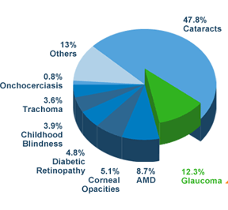
India : Causes of Blindness
Glauocma is the third leading cause of preventable blindness in INDIA
On the basis of available data, there are approximately 11.2 million persons aged 40 years & older with glaucoma in India.
http://www.glaucomaindia.com/. Last accessed 3rd may 2013.

Slide 3
Facts & figures on glaucoma
Glaucoma was undetected in more than 90% of the individuals identified in population based studies¹.
Less than 20% of patients had been detected to have disease at the time of an earlier examination².
Diagnosis rate is less than 10%²
Overall 13.5% were aware of glaucoma³
Detection rates are dependent on the performance of a comprehensive eye examination and on gonioscopy skills.
Ref-
Tamil Nadu Journal of ophthalmology.2009;47(4):12-16.
J Glaucoma. 2010;19:391–397
Indian J Ophthalmol. 2009 Sep-Oct; 57(5): 355–360.

Slide 4
Comprehensive eye examination – Basics of glaucoma examination
Comprehensive eye examination and patient history form the basis of an examination for glaucoma,¹ with specific attention to-
the evaluation of the optic nerve,
potential risk factors for glaucoma,
the possibility of secondary glaucomas,
concomitant systemic diseases,
medications, and
subjective symptoms.
Can J Ophthalmol 2009;44(Suppl 1):S1−S93.
Can J Ophthalmol 2007;42:39–45.

Slide 5
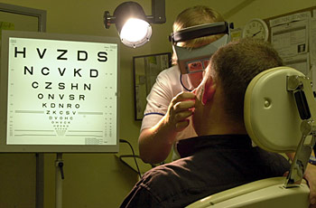
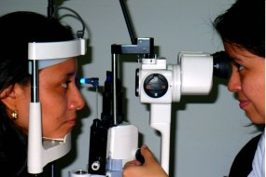
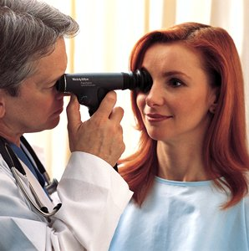
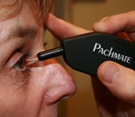
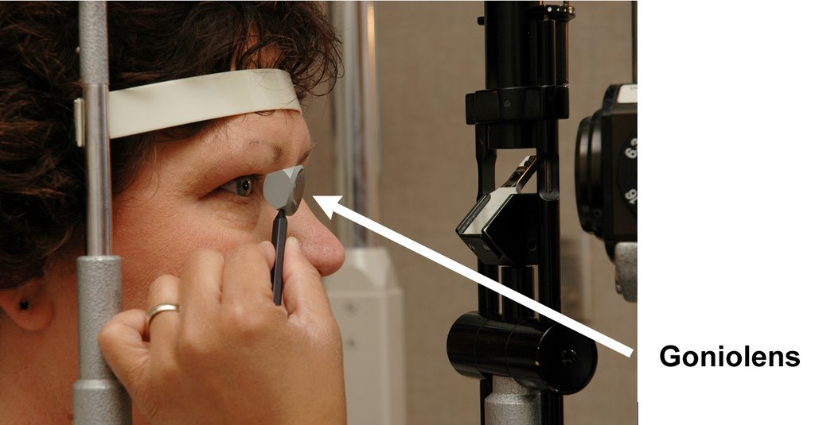
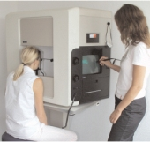
ophthalmoscope-examine interior of eye. (lens, retina, optic nerve)
Refraction- test short/long sighted vision .
Tonometry-measure IOP.
Diagnosis
Slit-lamp examination.
History
Pachymetry-measure corneal thickness.
gonioscopy-measure irido-corneal angle.
Perimetry-measure extent of vision loss.

Slide 6
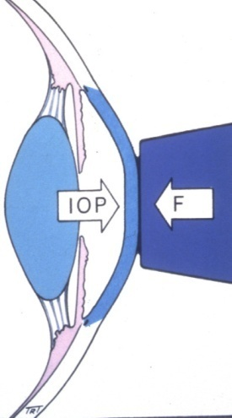
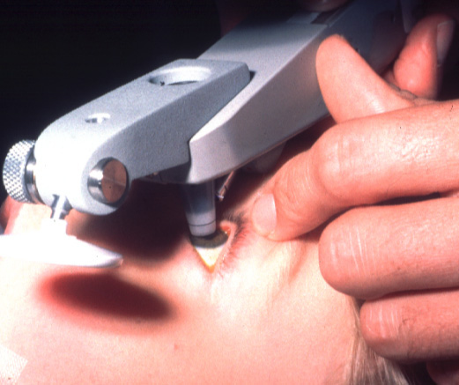
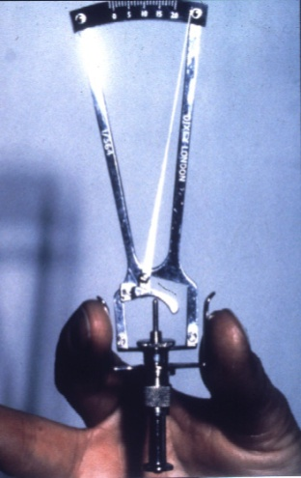
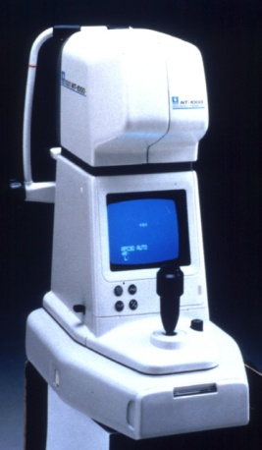
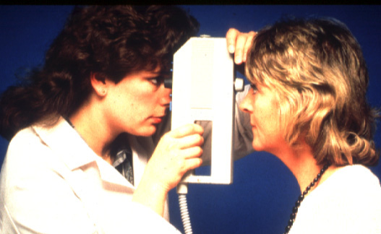
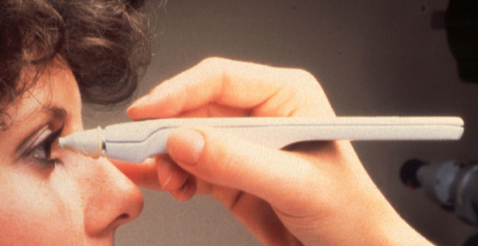
Tonometers
Goldmann
Perkins
Schiotz
Contact applanation
Portable contact applanation
Contact indentation
Air-puff
Pulsair 2000 (Keeler)
Tono-Pen
Non-contact indentation
Portable non-contact applanation
portable contact applanation

Slide 7
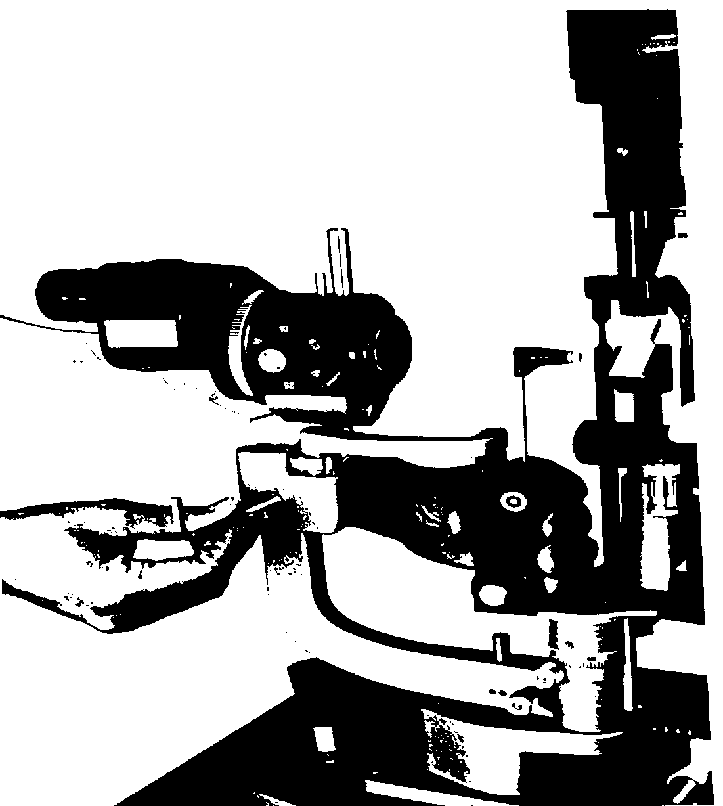
Goldmann applanation tonometry (GAT) – Gold standard
Gold standard against which others measured.
Good accuracy in gas-filled eyes.
Inter- and intraobserver variability (>30% varied by 2-3 mmHg), due to subjective nature of optical endpoint.
Assume error of 2 mmHg.
http://www.google.co.in/url?url=http://webeye.ophth.uiowa.edu/dept/resfelo/goals/videos/Tests%26devices/Goldmanntonometry.ppt&rct=j&frm=1&q=&esrc=s&sa=U&ei=GO20U-jGHMihugT39oGYCA&ved=0CCEQFjAC&usg=AFQjCNGbfQCJ7jABvgjULx_Q9_6pxISkhg. Last accessed 3rd July 2014.

Slide 8
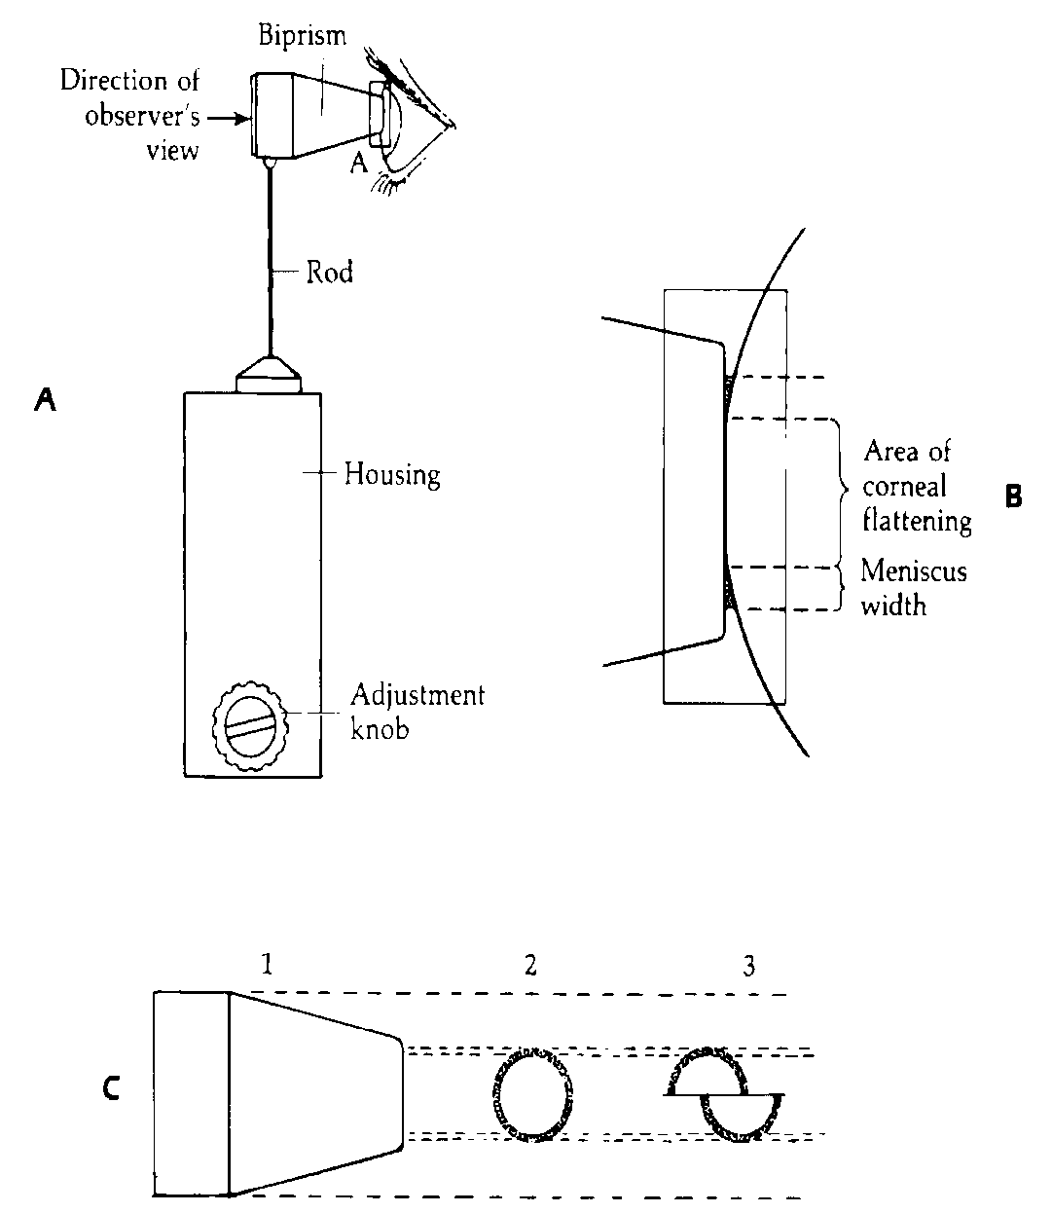
Technique of measurement
Plastic biprism contacts cornea creates two semicircles
Edge of corneal contact is visible after placing fluorescein into tear film & viewing with cobalt blue light
Manually rotate the dial calibrated in grams, force is adjusted by changing the length of a spring within the device.
Inner margins of semicircles touch when 3.06 mm of cornea is applanated.

Slide 9
Instructions to patient
Press head firmly against chin and forehead rest.
Look straight ahead and fixate on a target (e.g. examiners opposite ear)
Breathe normally, do not hold your breath
Blink immediately prior to measurement to moisten cornea.

Slide 10
Errors in Measurement
The fluorescein ring is too wide or too narrow:
Too wide: occurs if prism not dried after cleaning or lids touch prism. Overestimates IOP. Solution: dry prism
Too narrow: inadequte fluorescein concentration may cause hypofluorescence. Underestimates IOP. Solution: patient blinks or additional fluorescein added.

Slide 11
Errors (cont.)
Thin corneas produces underestimate
Thick cornea d/t increased collagen gives overestimate, if d/t edema gives underestimate.
Inadequate vertical alignment of semicircles leads to overstimate of IOP.
Distortion d/t irregular cornea influences accuracy, less useful with corneal scarring.

Slide 12
Errors (cont.)
Squeezing of eyelids, breath holding or other Valsalva maneuvers, pressure on globe, excessive EOM force applied to restricted globe, vertical gaze, tight collars, retreating patient, inaccurately calibrated tonometer.
Repeated tonometry may induce decline in estimated IOP.

Slide 13
Error d/t corneal curvature
Increase of 1 mmHg for every 3D increase in corneal power.
More fluid displaced under steep cornea, increases contribution of ocular rigidity in overestimating IOP.
The steeper the cornea, the more cornea must be indented to produce standard area of contact.
>3D astigmatism produces elliptical rather than circular area

Slide 14
Correction for astigmatism
With semicircles displaced horizontally, IOP underestimated by 1 mmHg for every 4D of WTR astigmatism, vice versa for ATR astigmatism.
To minimize, prisms should be rotated so that axis of least corneal curvature is opposite red line on prism holder (i.e. align negative cylinder axis).
Can average reading with vertical and horizontal alignment of prism.

Slide 15
Sterilization
CDC recommendation (HIV, HSV, and adenovirus): wipe tip clean and disinfect tip only with bleach (1:10 dilution x 5”, changed once daily).
Alternative is 3% H2O2, changed at least twice daily (affects tip less than bleach or ETOH).
Alternative #2: wiping tip with 70% ETOH

Slide 16
Gonioscopy
Fundamental part of ophthalmic evaluation
Conformation of normal angle structures
Determination of narrowness or closure of anterior chamber angle
Grading of angle width
Pathological findings
Needs to be performed routinely to avoid misdiagnosis
http://www.apglaucomasociety.org/toc/Gonioscopy(NM).pdf. Last accessed 3rd July 2014.

Slide 17
Direct Gonioscopy
The anterior curve of the goniolens is such that the critical angle is not reached, and light rays are refracted at the contact lens- air interface
EG: Koeppe, Shaffer, Layden, Barkan, Thorpe, Swan Jacob
Advantages: An erect and panoramic view.
Can be performed on both eyes simultaneously.
Disadvantages: Difficulty of learning technique. Instrumentation expensive and difficult to obtain.
Less magnification
Also need for the patient to be supine.
Uses: Surgical goniolenses used at the time of angle surgery, e.g. goniotomy, and for Gonioscopy in infants for diagnostic purposes.

Slide 18




Various Diagnostic Gonio Lenses and Specifications
Direct Goniolenses:
Koeppe- Prototype
Shaffer. – small Koeppe lens(infants)
Barkan- prototype surgical goniolens
Thorpe- surgical and diagnostic lens.
Swan Jacob- surgical goniolens for children

Slide 19
INDIRECT Gonioscopy:
The light rays are reflected by a mirror/ prism in the contact lens and leave the lens at nearly a right angle to the contact lens- air interface
Eg: Goldmann single, and three mirror lenses, Ziess four mirror lenses, posner and susmann four mirror lenses, Thorpe four mirror, Ritch trabeculoplasty lens

Slide 20



Indirect goniolenses:
Goldmann single mirror- mirror inclined at 62 degree for gonioscopy.
Central well- dia of 12 mm, post radius of curvature of 7.38 mm
Goldmann three mirror- 59 degrees
Zeiss four mirror- all four mirrors inclined at 64 degree.
Ritch trabeculoplasty lens.

Slide 21
Four mirror lenses- Ziess type:
Allows quick evaluation of angle structures.
• No coupling solution necessary.
• Enables differentiation between appositional (reversible) and synechial angle closure
Disadvantages:
Mastery of proper technique requires skill and practice.
• Tendency to underestimate the narrowness of the angle; it is difficult to avoid inadvertently applying
pressure to the central cornea,thus artificially widening the angle.

Slide 22
Goldmann type lenses:
Ease in learning technique and less expensive.
Greater visibility of detail than with the Koeppe technique because of higher magnification.
Therefore, it is better for detection of details such as subtle neovascularization in the angle.
Stability of lens over cornea better.
Disadvantages: Cannot perform dynamic, or indentation Gonioscopy.

Slide 23

How to do Gonioscopy?
Anesthetize the cornea.
Insert the lens with or without coupling device.
Short beam of light, avoid illuminating the pupil
To manipulate - ask patient to look in the direction of the mirror
Indent the cornea with a four mirror lens ( appearance of Descemet’s folds)

Slide 24
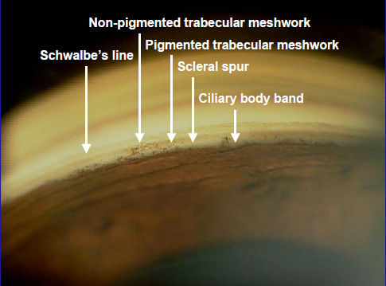
Normal angle structures

Slide 25
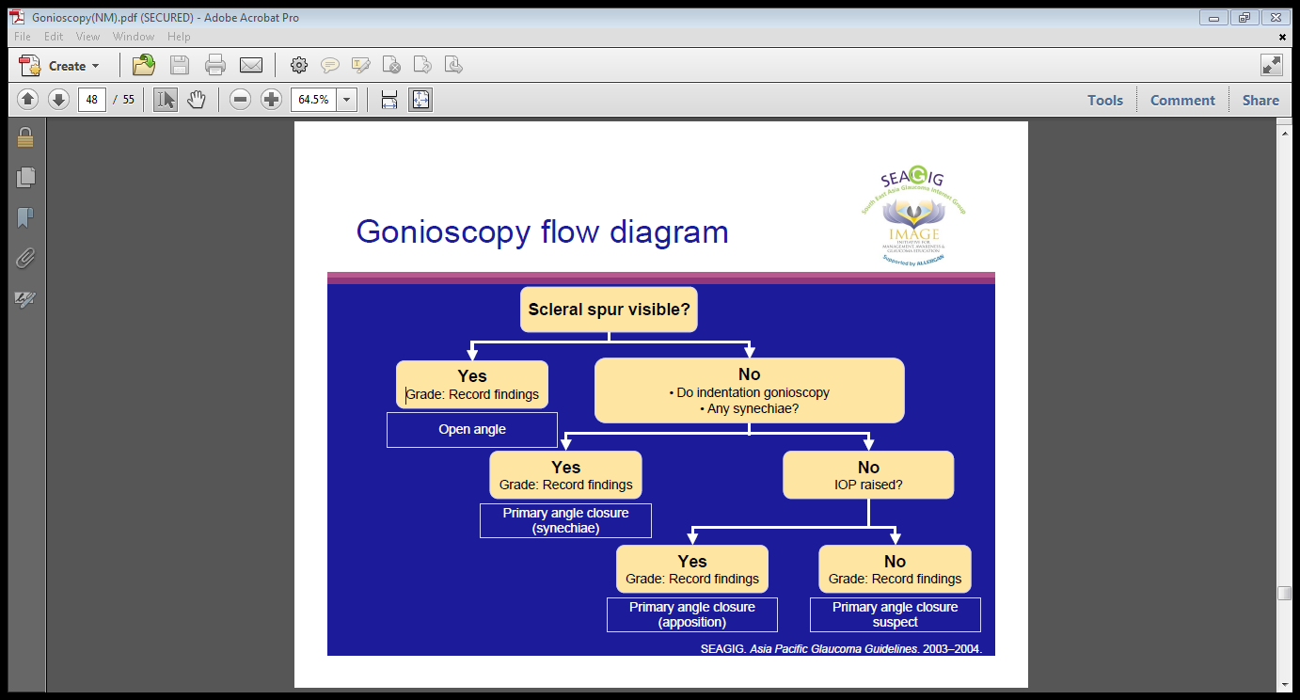
Gonioscopy flow diagram

Slide 26
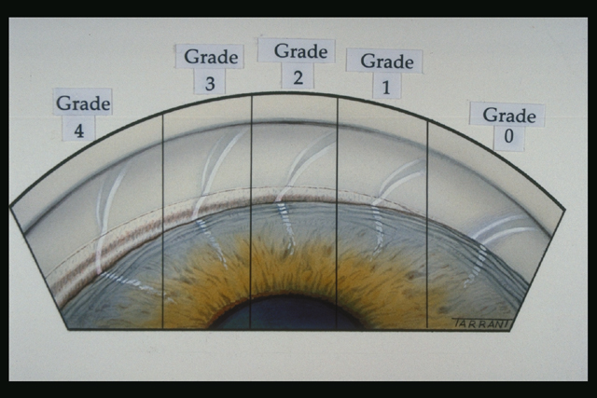
Shaffer system:
Grade 0 —PARTIAL OR COMPLETE CLOSURE
Grade I </= 10° angle of approach
Grade II -20° angle of approach
Grade III 20°–35° angle of approach
Grade IV 35°–45° angle of approach

Slide 27
Scheie system:
Grade 0- Entire angle visible as far posterior as a wide ciliary body band
Grade I- Last roll of iris obscures part of the ciliary body
Grade II- Nothing posterior to trabecular meshwork visible
Grade III- Posterior portion of trabecular meshwork hidden
Grade IV -No structures posterior to Schwalbe’s line visible
Based upon the most posterior structure visible in the angle.
Caveats: Because this classification system does not deal with the issue of the angle of approach and, hence, occludability, the scleral spur could be visible for its entire circumference in an eye with an occludable angle.

Slide 28
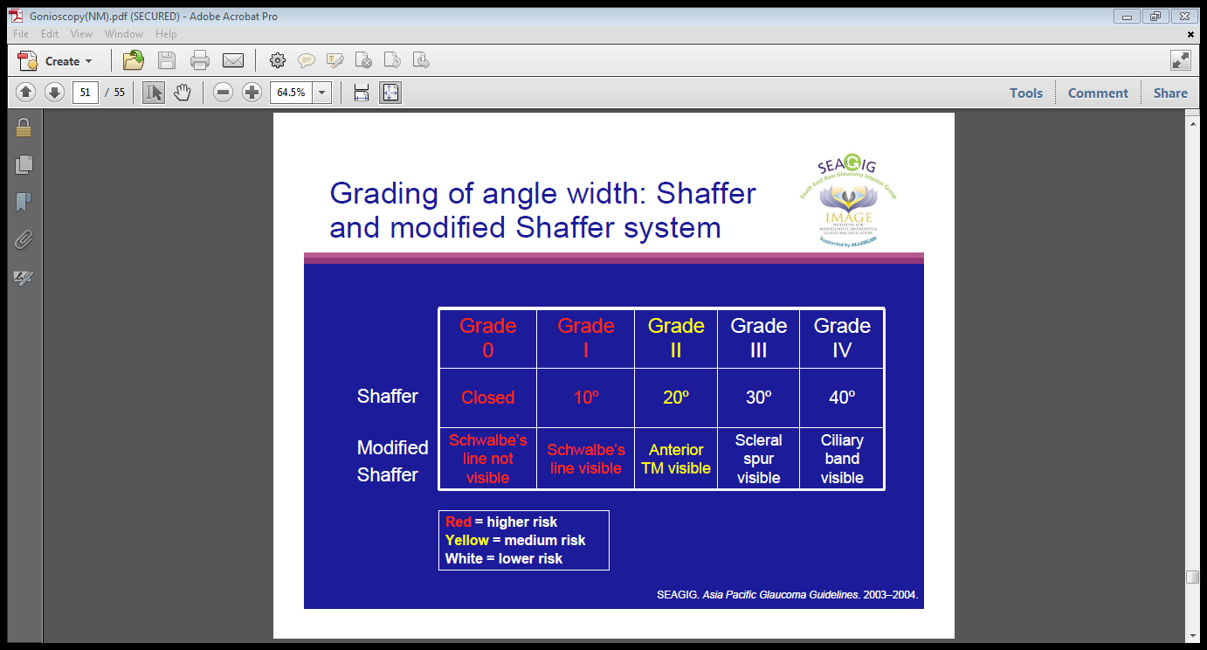
Grading of angle width:Shaffer and modified Shaffer system

Slide 29
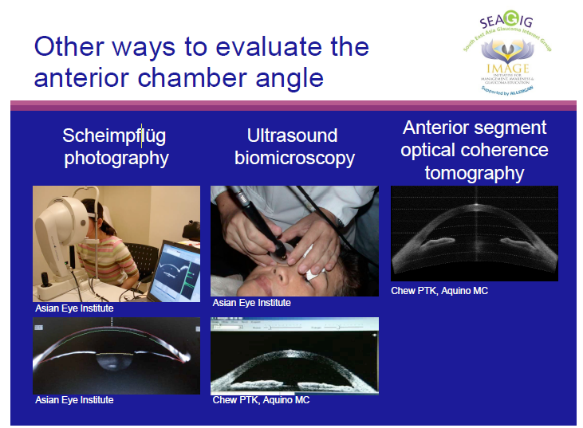

Slide 30
Optic Disc Evaluation
Slit lamp biomicroscopy : Ideal
Stereoscopic View –Cupping
Measuring the optic disc size
Direct Ophthalmoscopy
Good Magnification
Indirect Ophthalmoscopy
Overall View
Optic disc Photoghraphy.
Documentation, Monitoring for progression.

Slide 31
The 7 parameters to look for…
Disc: Size and Shape
2)Neuroretinal Rim (NRR):
Size,Shape,Pallor
ISNT rule
3)Cup: Size and Shape in relation to the optic disc size,
-Vertical C/ D Ratio, Cup depth / Excavation
4) Optic Disc Hemorrhage: Presence & Location

Slide 32
The 7 parameters to look for…
5) Nerve Fibre Layer Defect:
focal & diffuse
6) Para Papillary Atrophy;
Size,location & Configuration
7) Retinal Arterial Attenuation:
focal & diffuse
All these variables can be measured semiquantitavively by ophthalmoscopy without applying sophisticated techniques

Slide 33
1)Optic Disc: Size & Shape
Determining the size of the disc =Crucial
Helps to differentiate Physiological cupping from Pathological.
Large discs have big physiological cups.
Small Discs have small cups or no cups
Measurement of Vertical Disc diameter :
Length of the vertical beam of slit lamp light
Multiplied by correction factor of the condensing lens
Volk 60 D= X 1
Volk 90D= X 1.5

Slide 34
Cup: Size, Shape, location in relation to the disc size
Optic Cup= Excavation in the optic nerve head
Stereoscopic evaluation
In normal eyes= Areas of optic disc & Optic cup are corelated
Large optic discs=Large cup
Small optic disc =Small cup or no cup
Early & moderate glaucomatous damage in small disc may be missed because of the erroneously low cup disc ratios

Slide 35
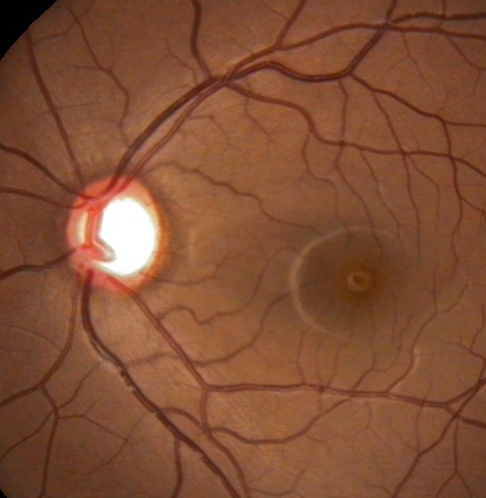
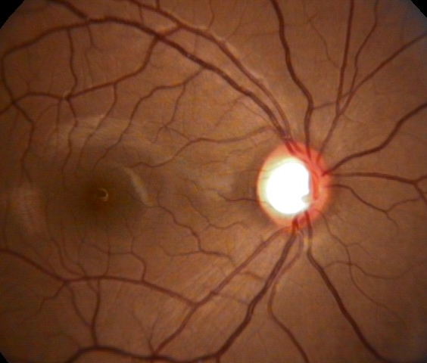
Large Disc=Large Cup
3mm

Slide 36
Vertical Cup Disc Ratio
Vertically oval optic disc
Horizontally oval optic cup
In normal eyes: Horizontal CD ratio > than vertical CD ratio
In Glaucomatous eyes: Vertical CD ratio > than the horizontal CD ratio

Slide 37
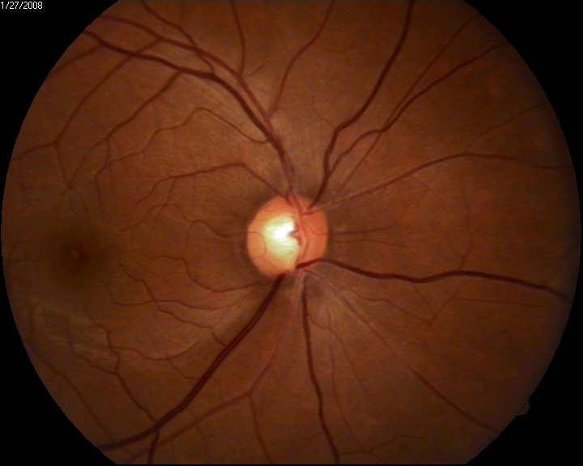
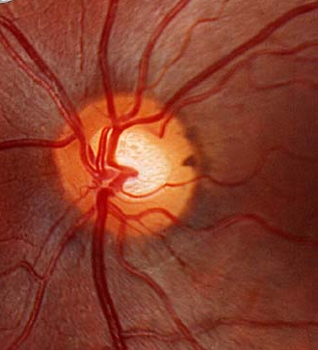
Vertical CD ratio

Slide 38
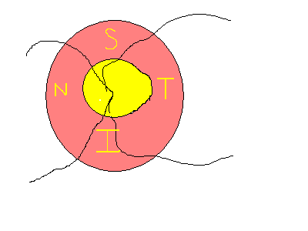
The Neuroretinal Rim
Size, Shape, Pallor.
The ISNT rule:
I>S>N>T

Slide 39
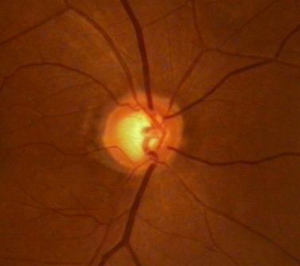
Thinning of the NRR
Pallor of NRR
Notching:
A notch is a localized defect in the Neuroretinal rim on the cup side of the rim

Slide 40
The Neurretinal rim loss in Glaucoma
Usual sequence of NRR loss in Glaucoma:
Inferotemporal
Superotemporal
Horizontal temporal
Inferonasal
Superonasal
In contrast,in the non glaucomatous optic nerve damage, the NRR is not always affected and hence contour of NRR is maintained.

Slide 41
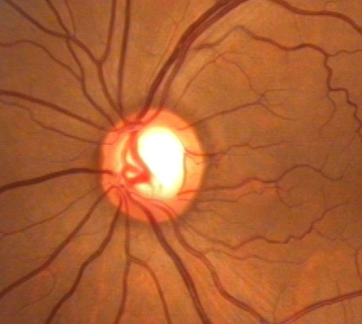
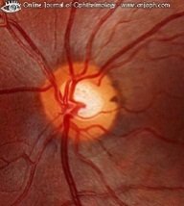
NRR , the “ISNT Rule”
I>S>N>T
I>S>N>T
`kindly elaborate little more on the ISNT rule.

Slide 42
Optic Disc Hemorrhage
Splinter or Flame shaped hemorrhages
At the margin of the disc
Hallmark of Glaucomatous optic nerve damage
4 to 7 % of eyes with galucoma
Found in early & moderately advanced Glaucoma and rare in very advanced stage
Located usually in the inferotemporal & superotemporal disc margins
Associated with localized RNFL defect and neuroretinal rim notches .
Suggests Progression.
More common in NTG

Slide 43
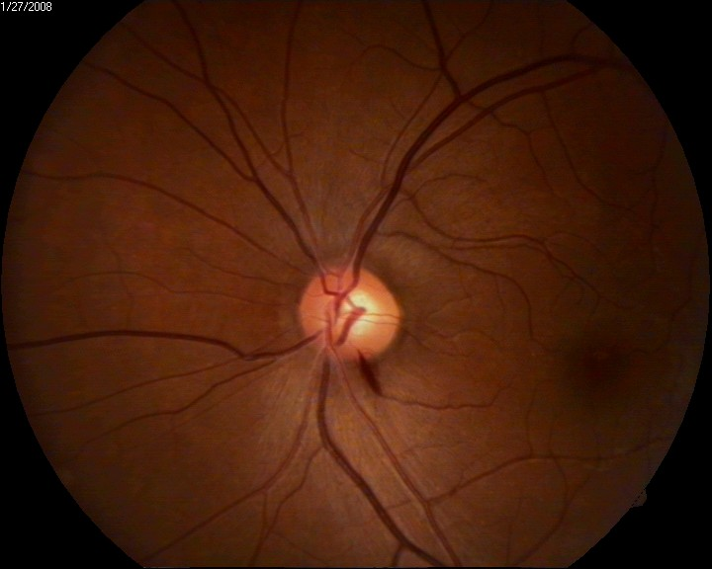
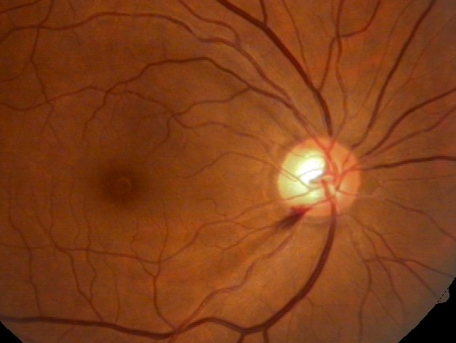
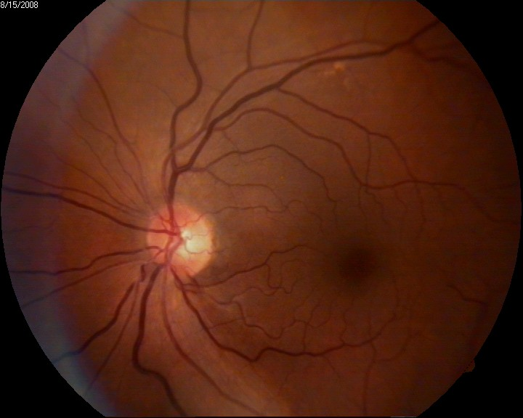
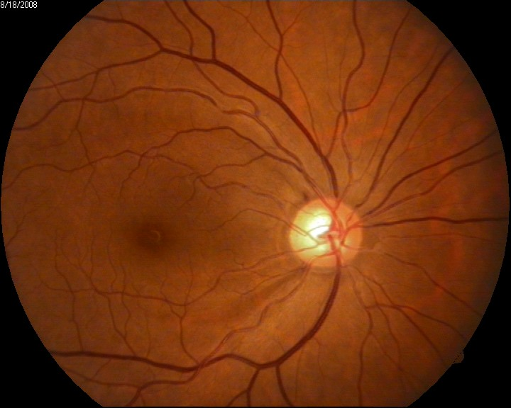
Optic Disc Hemorrhage

Slide 44
Retinal Nerve Fibre Layer Defect
RNFL contains retinal ganglion cells axons covered by astrocytes and bundled by processes of muller cells
Seen as bright fine striations fanning off from the disc to the periphery.
Dilated pupil, green light, clear optical media aids the evaluation of RNFL

Slide 45
Retinal Nerve Fibre Layer Defect
Localized RNFL defects:
Can be detected before visual field defect has developed
Focal type of NTG
Early to medium advanced Glaucomatous damage
Diffuse loss of RNFL:
More difficult to detect
Peripapillary retinal vessels appear bare
Underlying Choroidal vessels more clearly seen

Slide 46
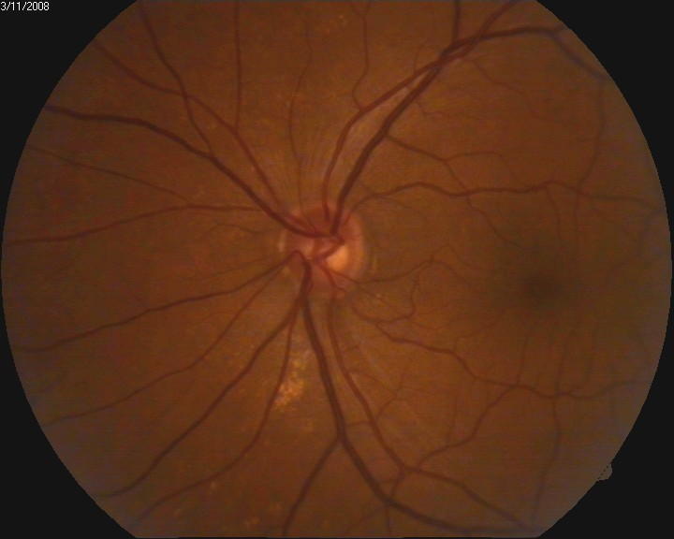
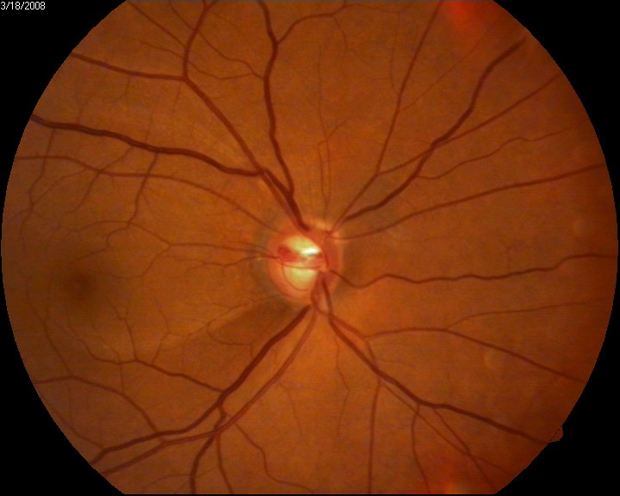
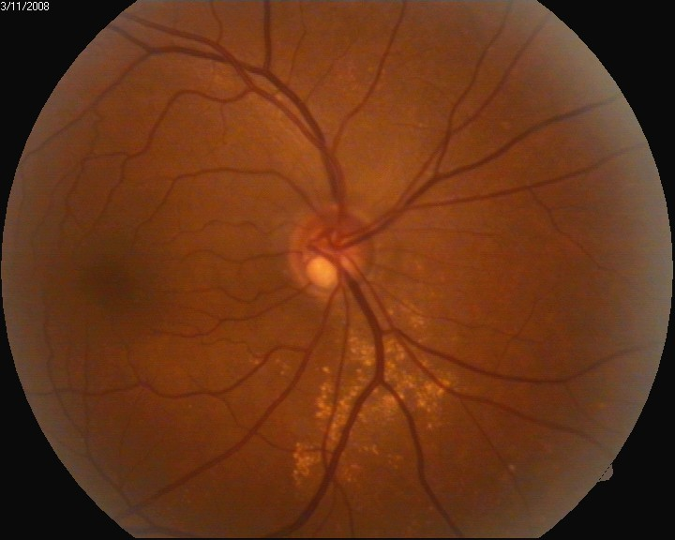
Early Damage
Moderate damage

Slide 47
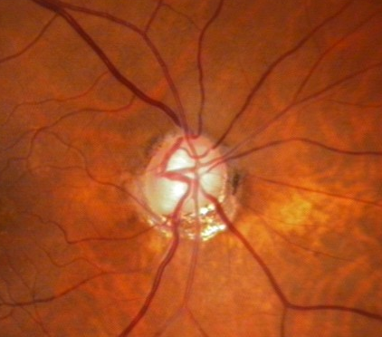
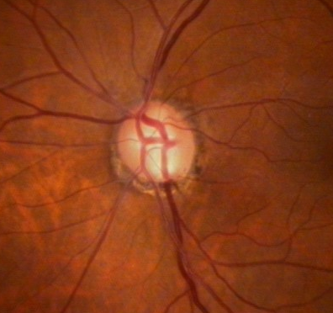
Advanced
Both the poles affected

Slide 48
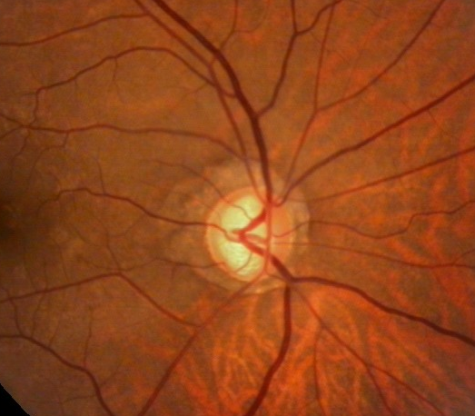
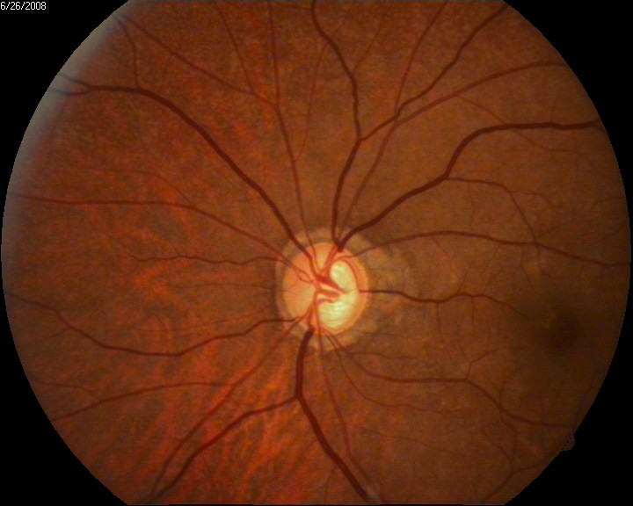
Advanced…

Slide 49
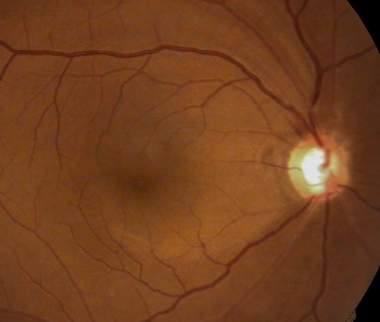

Slide 50
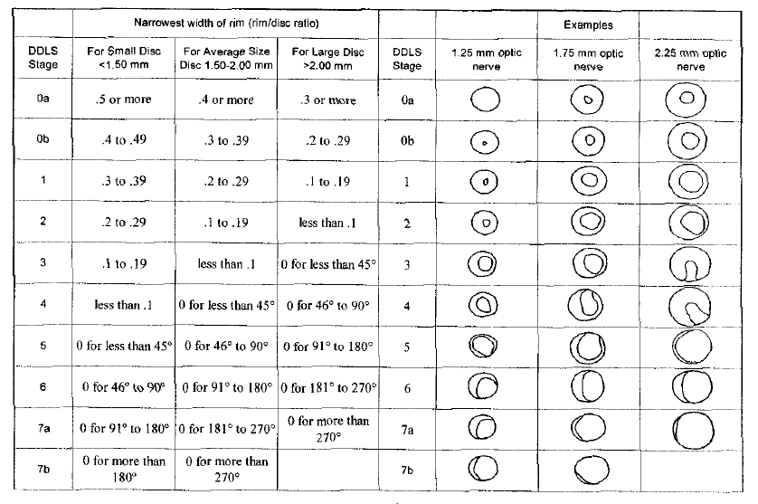
Disc Damage Likelihood Scale

Slide 51
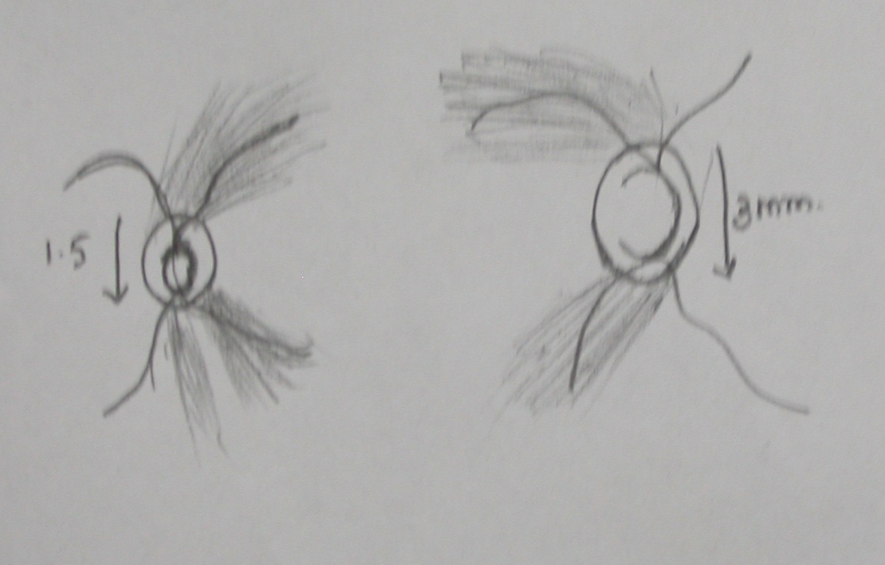
Optic Disc Photographs Optic Disc Drawings
Documentation of disc damage:
Monitoring change for progression
Rate of change

Slide 52
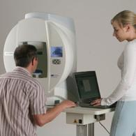
Standard automated perimetry
Important tool for glaucoma diagnosis and progression
Measures visual function outside fovea within central 30 degrees of visual field defects in glaucoma occur within limits
AIOS guidelines for glaucoma investigations

Slide 53
Humphrey visual field analyser
Popular perimeters in clinical use
White on white perimetry
One of the following test is usually used-30-2 full threshold, 30-2/24-2 SITA standard or 30-2/24-2 SITA Fast.
SITA strategy takes less time than full threshold without loosing its diagnostic ability & is generally preferred.

Slide 54
Test selection
Depends on status of the eye
Patient’s ability to perform the test
In advanced cases where 24-2 or 30-2 pattern does not give enough information it is advisable to use a 10-2 pattern.
Stick to same test pattern and thresholding algorithm for subsequent tests

Slide 55
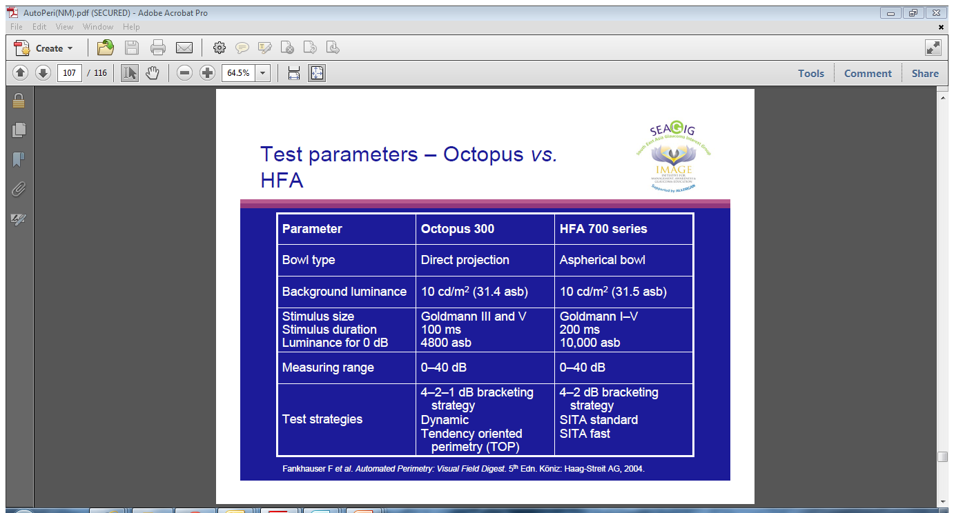
Perimetry test parameters- Octopus vs HFA

Slide 56
Keypoints for perimetry
Visual field examination is essential for diagnosis and management of glaucoma
Must be done in all patients of glaucoma or suspected glaucoma
It is important to have a good baseline in the beginning of the test. For this the test may have to be repeated 2-3 times or more at short intervals
Test conditions should vary significantly from one examination to other

Slide 57
Keypoints for perimetry
Field should be reliable. Unreliable fields should be ignored and test repeated.
Built in software tools are useful and should be used to diagnose glaucoma and progression on visual fields
Visual fields must be repeated periodically , frequency depending on severity and stability of glaucoma
For glaucoma diagnosis visual field changes must correlate with clinical findings

Slide 58
Other recent tests for glaucoma diagnosis

Slide 59
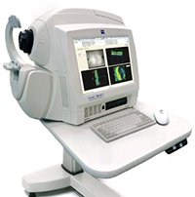
Optical coherence tomography
Can show each layer of tissue in the eye allowing to pinpoint the exact location of tissue damage.
Aids in the diagnosis and management of glaucoma and macular degeneration.
Safe, painless and quick procedure, does not require pupil dilation.
A laser scans the retina, optic nerve, cornea, or anterior chamber in just a manner of seconds to provide a detailed information regarding the microscopic details of the eye.
A glaucoma suspect would benefit from undergoing this diagnostic test.
http://www.washingtoneye.com/Chevy-Chase/glaucoma-screening-and-testing.htm. Last accessed 4th July 2014.

Slide 60
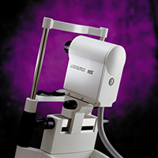
Heidelberg Retina Tomograph (HRT)
Specialized lasers form a 3-D topographic map of the optic nerve and adjacent retina.
A major advantage is that by taking a series of measurements over time, it can detect small changes that may otherwise go undetected by traditional methods of examination
Since subtle changes in the optic nerve tissue can be the first sign of glaucoma and can precede visual field changes, the HRT may enable eye doctors to diagnose the disease earlier.
http://www.washingtoneye.com/Chevy-Chase/glaucoma-screening-and-testing.htm. Last accessed 4th July 2014.

Slide 61
Thank you

